Slide 1
Overview of Recent Elections, 2010
By Dan Nataf, Ph.D.
Director, Center for the Study of Local Issues
Anne Arundel Community College
January 20, 2011

Slide 2
National Politics: Exit Poll re: House Vote
Demographics of National House of Representatives Vote (vs. ‘08 Obama – National Exit Polls
Party identification in 2010: Dem/Rep at 35%, 29% Ind.
(vs. 39/32/29% in 2008)
Defection slightly higher among Dems 7% vs 5% Reps
Indep. vote sided strongly with Reps 56% not Dems 37% (vs. 41/52% in ‘08)
Women equally split (48 D; 49% R) (vs. 56, 43% in 2008)
Whites strongly Rep (60%) not Dem (37%) (vs. 55, 43% in 2008)
Only those with little (57%) or postgrad ed (53%) favored Dems

Slide 3
National Politics: Exit Poll re: House Vote
Demographics of National House of Representatives Vote (vs. ‘08 Obama – National Exit Polls
Vote by Age (08/10) | Dem ’08 | Dem ‘10 | Rep
18-29 18/12 | 66 | 55 | 42
30-44 29/24 | 52 | 46 | 50
45-64 37/43 | 50 | 45 | 53
65 and Older 16/21 | 45 | 38 | 59
Older voters worried about Medicare/Health care reform?

Slide 4
National Politics: House Vote
Libs and Moderates favored Dems (90, 55%) but were too small (20, 38%) a part of electorate vs Cons. (42%) who massively favored Reps (84)
(2008: Lib 22; Moderate 44; Cons. 34%)
Lost job – no effect(30%)? Yes (50 Dem; 46% Rep) No (45, 54%)
Union member (17%): Yes (61 Dem; 37% Rep) No (43, 54%)
2008 Presidential Vote: Obama (45%) 84,14%; McCain (45%) 7,91%, Other (4%) 33, 58%
Is vote support for Obama? Yes (23%) 96 Dem; 3% Rep; No (37%) 6, 92%, Not factor (38%), 52, 44%

Slide 5
National Politics: House Vote
Too many people strongly disapprove of the job Congress is doing…
How Congress is Handling its Job | Democrat | Republican
Strongly Approve (4%) | 82 | 16
Somewhat Approve (20%) | 78 | 20
Somewhat Disapprove (26%) | 57 | 41
Strongly Disapprove (48%) | 19 | 77
But unfavorable opinions are spread to both Dems and Reps
What is your opinion of… | Democrat | Republican
Democrats - favorable (44%) | 91 | 8
Republicans - favorable (41%) | 11 | 88

Slide 6
National Politics: House Vote
Govt. perceived as over-reaching…
Govt should do more ? | Dem | Rep
Yes, do more (38%) vs 51% in ’08 | 77 | 21
No, do less (56%) vs. 43% in ‘08 | 20 | 76
With too many dissatisfied with federal govt.
Opinion of Federal Government | Democrat | Republican
Enthusiastic (3%) | 92 | 6
Satisfied (21%) | 79 | 18
Dissatisfied (48%) | 41 | 55
Angry (25%) | 14 | 83

Slide 7
National Politics: House Vote
Economic anxieties favor Reps..
How worried about economic conds.? | Dem | Rep
Very Worried (49%) | 30 | 68
Somewhat Worried (37%) | 52 | 43
Not Too Worried (10%) | 81 | 18
Reversal of 2008 when those worried lined up behind Dems
Worried That Economic Crisis Will Hurt Your Family | Dem | Rep
Very Worried (48%) | 62 | 36
Somewhat Worried (33%) | 52 | 47
Not Too Worried (13%) | 33 | 63
Not Worried At All (5%) | 40 | 56

Slide 8
National Politics: House Vote
Stimulus not perceived as having done enough…
Stimulus Policy has | Dem | Rep
Helped (32%) | 86 | 13
Hurt (34%) | 10 | 87
Made No Difference (31%) | 39 | 57
While blaming Wall Street or Bush just wasn’t enough…
Who Do You Blame for Economic Problems? | Dem | Rep
Wall Street (35%) | 41 | 57
George W. Bush (29%) | 83 | 15
Barack Obama (24%) | 6 | 91

Slide 9
National Politics: House Vote
Health care reform was polarizing and insufficiently popular
What Should Congress Do With New Health Care Law? | Dem | Rep
Expand It (31%) | 84 | 15
Leave It As Is (16%) | 63 | 34
Repeal It (48%) | 11 | 86
And probably viewed as a distraction from the prime concerns of most citizens…
Most Important Issue Facing Country Today | Democrat | Republican
Economy (63%) | 43 | 54
Health Care (18%) | 51 | 47
Illegal Immigration (8% | 26 | 68
War in Afghanistan (7%) | 58 | 40

Slide 10
National Politics: House Vote
Now policy direction lacks consensus…and is polarizing
Bush-Era Tax Cuts Should Be Continued For... | Dem | Rep
All Americans (40%) | 14 | 84
Families Under $250,000 (36%) | 64 | 32
No One (15%) | 75 | 22
Highest Priority for Next Congress | Dem | Rep
Cutting Taxes (18%) | 26 | 71
Reducing Deficit (40%) | 32 | 65
Spending to Create Jobs (37%) | 68 | 30
Republicans face contradictory pressures – reduce deficit vs. cutting taxes

Slide 11
National Politics: House Vote
Dems disapprove of war in Afghanistan – losing the base?
U.S. War in Afghanistan | Dem | Rep
Approve (40%) | 24 | 75
Disapprove (54%) | 61 | 36
Should Same-Sex Marriages Be Legally Recognized? | Dem | Rep
Yes (41%) | 67 | 30
No (53%) | 27 | 70
While same sex marriage still troubled waters for Dems

Slide 12
Polling Results for AA County
Remarkable stability in right/wrong direction…

Slide 13
AA County Polling Results: Most Important Problem Fall '04 to Fall '10

Slide 14
AA County Polling Results:
Percentage saying “excellent” or “good” also stable since March 2009

Slide 15
AA County compared to USA – County looks around 35% better

Slide 16
AA County Polling Results: Mostly stable findings in % saying a condition ‘applies’
Some costs have gone down

Slide 17
The economy: what else applies?
Minor improvement in readiness to spend

Slide 18
Statewide Races – AAC Results ‘06/’10
Very little change in Governor or Comptroller outcomes
Mikulski improves

Slide 19
Anne Arundel Consistently supports Rep. Gubernatorial Candidates
Gubernatorial Races – Anne Arundel County
O’Malley on low end of typical Dem vote deficit

Slide 20
Statewide Races: O’Malley vs. Ehrlich for Governor 2006-2010
Polls are in range, but with internal variation
 | Nov. 2006 | March 2010 |  | October 11-14, 2010 |  |  | Oct. 26-27 | Nov. 2
Candidate | Actual Vote | All Categories | Exclude some | All categories | Exclude some | Exclude all except voters | Exit Poll | Actual Vote
O’Malley | 42 | 35 | 43 | 29 | 32 | 42 | 46 | 43
Ehrlich | 56.9 | 47 | 57 | 40 | 45 | 59 | 51 | 54
Gap | 14.9 | 12 | 14 | 11 | 13 | 19 | 5 | 11
Other | -- | 3 | -- | 2 | -- | -- | 3 | --
Undecided | -- | -- | -- | 22 | 24 | -- | -- | --
Neither | -- | 5 | -- | 1 | -- | -- | -- | --
Unsure | -- | 10 | -- | 5 | -- | -- | -- | --
Total |  | 100 | 100 | 99 | 101 | 101 | 100

Slide 21
State Senate in AAC (Districts 30,31,32,33)
Dems experience lower percentages in all districts

Slide 22
Delegate Races in Districts 30,31,32,33: Dem-Rep Gap
Loses in 32 – what’s the future for Dems there?
Big Dem loss in 31
33b uncontested
33a only 1 Dem cand.
Race gets very close in 30

Slide 23
Senate and Delegate Minimum Winning Totals in Districts 30,31,32,33
 | Minimum winning vote |  | Seats
District | Senate | Delegates | Senate | Delegate
30 | 25253 | 22535 | Dem | D=1/R=2
31 | 25723 | 22436 | Rep | D=0/R=3
32 | 24762 | 18786 | Dem | D=3/R=0
33(a) | 43466 uncontested | 18603 | Rep | D=0/R=2
33b | uncontested | 14623 |  | D=0/R=1

Slide 24
District 33 – McConkey wins again!
 | Brennan | McConkey | Mc-Br | Vitale
Odenton/Millersville | 27.0 | 34.4 | +7.4 | 38.3
Severna Park | 23.7 | 29.7 | +6 | 46.3
Crofton/Crownsville | 27.9 | 33.2 | +5.3 | 38.6
Overall % | 25.7 | 32.3 | +6.6 | 41.7
Raw vote | 14792 | 18603 | +3811 | 24033
Vitale sweeps up Severna Park; McConkey a solid second place.

Slide 25
District 30 – Dems lose a seat
 | Busch |  |  | Clagett |  |  | George
 | 2006 | 2010 | 2010-2006 | 2006 | 2010 | 2010-2006 | 2006 | 2010 | 2010-2006
Broadneck | 15.07 | 15.64 | +.57 | 14.88 | 13.36 | -1.52 | 18.28 | 22.14 | +3.86
Annapolis | 20.91 | 21.60 | +.7 | 19.86 | 17.76 | -2.1 | 13.44 | 16.43 | +2.99
South County | 15.06 | 14.65 | -.41 | 17.27 | 14.91 | -2.36 | 17.50 | 21.18 | +3.68
Totals | 17.06 | 18.01 | +.95 | 16.97 | 15.87 | -1.1 | 16.55 | 19.25 | +2.65
 | Totals | %
Ron George | 25610 | 19.25
Mike Busch | 23964 | 18.01
Herb McMillan | 22535 | 16.94
V. Clagett | 21118 | 15.87
Seth Howard | 20064 | 15.08
Judd Legum | 19647 | 14.77
Busch improves over 2006; Clagett drops across the board; George romps

Slide 26
County Elections: Slots at Arundel Mills
Opponents to the introduction of slot machines at Arundel Mills Mall are circulating a petition to put the county council’s decision to grant zoning needed for slots to referendum in November, potentially reversing the decision. Do you support or oppose this petition effort?
Will you be voting for or against Question A on the November ballot? A "for" vote would approve the County Council's zoning decision permitting slots in the county, including at Arundel Mills and Laurel. An 'against' vote would leave the county without slots zoning at any location.
Position | March ’10 | Oct. ‘10 | Exit Poll | Actual Vote
Support | 45 | 42 | 60 | 55.6
Oppose | 45 | 42 | 39 | 44.4
Gap | 0 | 0 | 21 | 11.2
Unsure | 7 | 16 | -- | --
No answer | 2 | -- | 1 | --
Total | 99 | 100 | 100 | 100
What happened to shift voter sentiment at last minute?

Slide 27
Question A: Election Day vs. Early Voting by Council District
Early voting a good predictor of election day votes
Early voted at West County

Slide 28
County Executive Vote 1994-2010
12425
Including Shay -1930
GAP
2716
23987
6151
3920
Only a few thousand votes separate Dem/Rep candidates

Slide 29
2010 County Exec Race Over Time
 | Nov. 2006 | June 2010 Online Poll | Sept. 2010 Online Poll | October 11-14, 2010 |  |  | Oct. 26-27 | Nov. 2
Candidate | Actual Vote | All Categories | All Categories | All categories | Exclude some | Exclude all except voters | Exit Poll | Actual Vote
Johnson/ Conti | 49 | 30 (Owens) 23 (Conti) | 28 | 21 | 24 | 37 | 39 | 44.0
Leopold | 51 | 52/54 | 54 | 34 | 38 | 59 | 50 | 50.5
Gap | 2 | 22/31 | 26 | 13 | 14 | 22 | 11 | 6.5
Other | -- | 15/16 | 10 | 2 | 3 | -- | -- | 5.4
Undecided | -- | -- | -- | 32 | 35 | -- | -- | --
Neither | -- | 4/7 | 9 | 2 | -- | -- | 3 | --
Unsure | -- | -- | -- | 10 | -- | -- | -- | --
Total |  | 101/100 |  | 101 | 100 | 101 | 100 | 100
Unlike Governor’s race, CE race much harder to predict –much tightening at the end…

Slide 30
County Executive Vote – Composition of Vote by Party
Unaffiliated split votes
Oct. 11-14 telephone survey 1st) vs. exit poll (2nd)
Telephone Poll
Conti gains among unaffiliated and Dem voters
Leopold taps Reps and crossover Dems

Slide 31
Vote Composition: Exit Poll
Conti lags among Dem voters but gains a bit among unaffiliated

Slide 32
Voter Composition continued: Exit Poll
Conti lags among Dems, but gains among Reps

Slide 33
Vote by Ideology
Conti lags among liberals but does a bit better with conservatives

Slide 34
County Exec.: How informed were voters?
Leopold voters started and remained more informed
Voters seem informed by election

Slide 35
County executive choice: Whose stands do you favor? Sorted by Undecided/Don’t know (Oct. 11-14)
 | On this issue are you more favorable to Conti, Leopold or Shay?
Issue | Conti | Leopold | L-C | Shay | Undecided | Don’t know enough | Undec.+ don’t know enough
Allowing slots at Arundel Mills mall | 10 | 17 | 7 | 1 | 27 | 46 | 73
Improving transportation | 13 | 20 | 7 | 1 | 21 | 45 | 66
Protecting the needs of vulnerable populations in the county budget | 16 | 18 | 2 | 1 | 21 | 44 | 65
Maintaining high ethical standards | 17 | 17 | 0 | 3 | 24 | 39 | 63
Improving public schools | 13 | 24 | 11 | 1 | 19 | 43 | 62
Keeping neighborhoods safe | 13 | 24 | 11 | 1 | 21 | 41 | 62
Making County government more efficient | 12 | 29 | 17 | 2 | 21 | 37 | 58
Preserving the environment | 15 | 21 | 6 | 7 | 18 | 39 | 57
Managing growth | 13 | 29 | 16 | 2 | 18 | 38 | 56
Having the right experience for the job | 11 | 32 | 21 | 1 | 21 | 35 | 56
Keeping taxes low | 14 | 30 | 16 | 1 | 19 | 36 | 55
Encouraging economic development | 13 | 31 | 18 | 1 | 18 | 37 | 55

Slide 36
County executive choice: Whose stands do you favor? Sorted by those favoring Leopold over Conti (Oct. 11-14)
 | Conti | Leopold | L-C | Shay | Undecided | Don’t know enough | U
 |  |  |  |  |  |  | Undecided/Don’tknow enough
Having the right experience for the job | 11 | 32 | 21 | 1 | 21 | 35 | 56
Encouraging economic development | 13 | 31 | 18 | 1 | 18 | 37 | 55
Making County government more efficient | 12 | 29 | 17 | 2 | 21 | 37 | 58
Managing growth | 13 | 29 | 16 | 2 | 18 | 38 | 56
Keeping taxes low | 14 | 30 | 16 | 1 | 19 | 36 | 55
Improving public schools | 13 | 24 | 11 | 1 | 19 | 43 | 62
Keeping neighborhoods safe | 13 | 24 | 11 | 1 | 21 | 41 | 62
Allowing slots at Arundel Mills mall | 10 | 17 | 7 | 1 | 27 | 46 | 73
Improving transportation | 13 | 20 | 7 | 1 | 21 | 45 | 66
Preserving the environment | 15 | 21 | 6 | 7 | 18 | 39 | 57
Protecting the needs of vulnerable populations in the county budget | 16 | 18 | 2 | 1 | 21 | 44 | 65
Maintaining high ethical standards | 17 | 17 | 0 | 3 | 24 | 39 | 63

Slide 37
Issue Stands/Traits Most Shaping Choice for County Exec. (Exit Poll)
Issue/trait | Overall | Conti | Leopold | L-C
Balance budget | 30 | 21 | 44 | 23
Taxes | 21 | 10 | 34 | 24
Right experience | 22 | 15 | 32 | 17
Cost of living | 14 | 7 | 23 | 16
Strong leader | 16 | 11 | 24 | 13
Economy | 33 | 31 | 43 | 12
Crime | 14 | 9 | 20 | 11
Growth/devel. | 15 | 12 | 18 | 6
Familiar name | 4 | 1 | 7 | 6
Slots | 10 | 8 | 12 | 4
Constituent serv. | 9 | 8 | 11 | 3
Environment | 15 | 17 | 11 | -6
Schools | 21 | 26 | 19 | -7
Honesty | 13 | 21 | 8 | -13
Right moral outlook | 16 | 24 | 9 | -15
Party affiliation | 28 | 38 | 22 | -16
Leopold bets on experience and issues
Conti bets on character and party

Slide 38
Weathersbee vs. Bateman
Council District | Weathersbee ‘06 | Weathersbee ‘10 | Weathersbee ‘10-’06 | Bateman ‘10 | W-B
1 | 57.3 | 54.3 | -3 | 60.4 | -6.1
2 | 55.3 | 52.8 | -2.5 | 59.8 | -7.0
3 | 48.8 | 43.6 | -5.2 | 55.5 | -11.9
4 | 58.2 | 56.4 | -1.8 | 61.9 | -5.5
5 | 49.2 | 46.7 | -2.5 | 55.1 | -8.4
6 | 62.0 | 58.6 | -3.4 | 61.5 | -2.9
7 | 51.8 | 45.7 | -6.1 | 50.7 | -5.0
Total | 54.7 | 51.2 | -3.5 | 57.8 (up from 54% in ‘06) | -6.7
Weathersbee has large losses in districts 3 and 7 in 2010 and no gains in any district
Bateman increases votes from ‘06 and wins majority in all districts in 2010

Slide 39
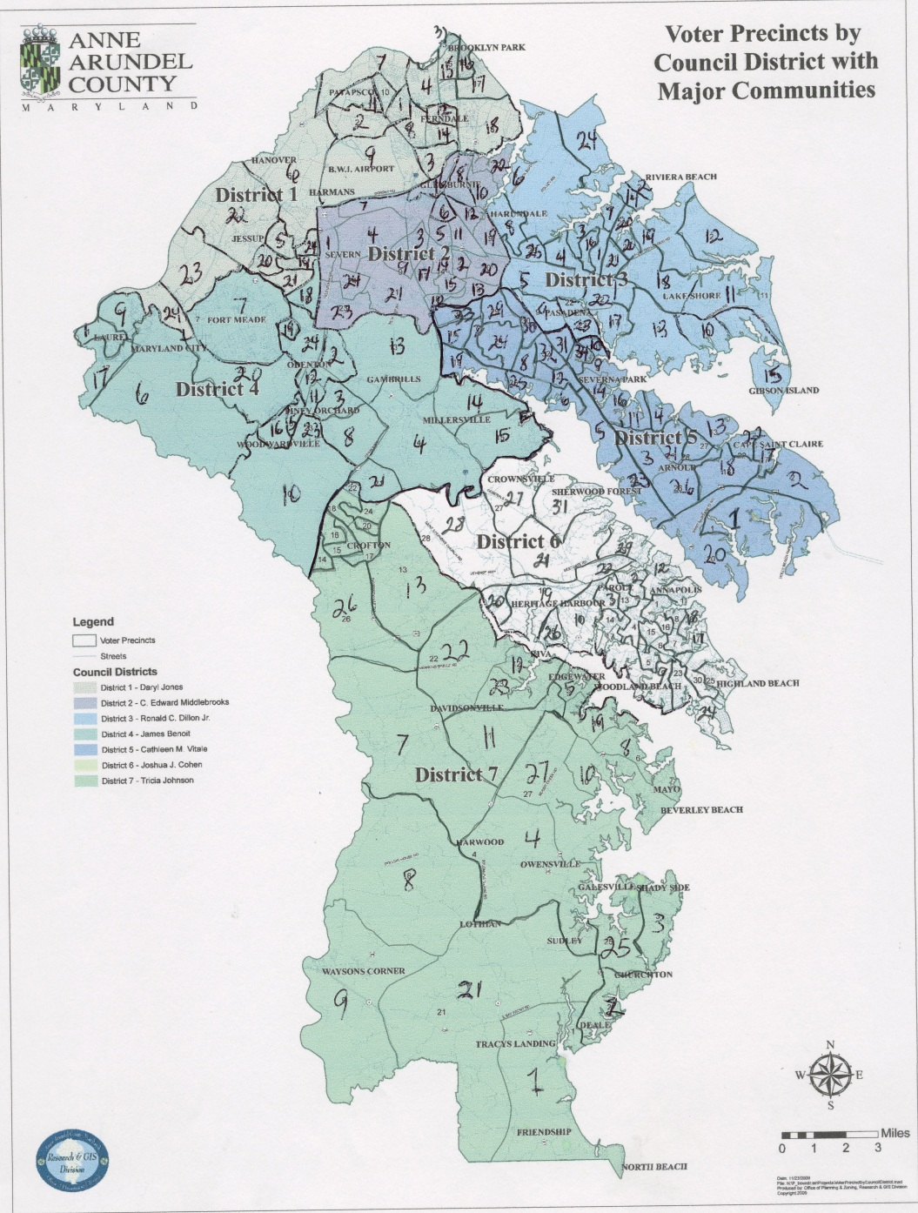
Council Districts Party Registration
53%D, 29%R, 18%U
42%D, 39%R, 19%U
49%D, 32%R, 18%U
48%D, 31%R, 18%U
37%D, 44%R, 20%U
47%D, 31%R, 18%U
36% D, 41%R, 19%U

Slide 40
Democratic Candidates by Council District

Slide 41
Democratic Candidates by Council District
Districts 4 and 6 overperform
 | Obama | OMalley | Conti | DemCC | Mean | Party Reg | Mean-Reg.
CC1 | 49.2 | 45.8 | 47.4 | 52.5 | 48.7 | 51.7 | -3
CC2 | 48.5 | 42.8 | 46.2 | 45.5 | 45.7 | 48.1 | -2.4
CC3 | 35.7 | 30.8 | 35 | 41 | 35.6 | 41.7 | -6.1
CC4 | 57.1 | 51.9 | 53.8 | 59.5 | 55.6 | 47.1 | 8.5
CC5 | 42.8 | 37.1 | 38.7 | 36 | 38.6 | 36.6 | 2.1
CC6 | 58 | 51.7 | 48.1 | 53.1 | 52.7 | 46.1 | 6.6
CC7 | 43.8 | 39.8 | 39.9 | 36.4 | 40 | 37.6 | 2.4
District 3 underperforms!

Slide 42
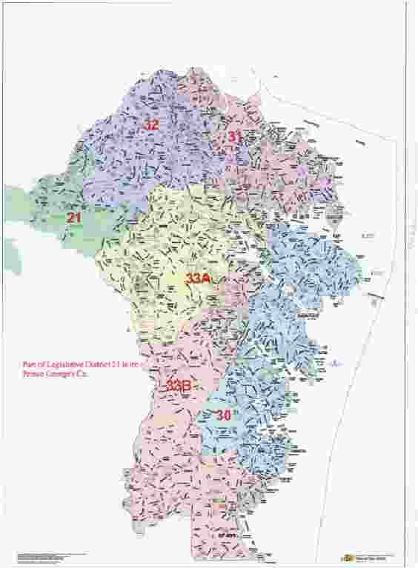
Legislative Districts

Slide 43
Questions to ponder:
1. Can Democrats be successful countywide?
Bateman, Weathersbee
Quality of candidate
Quality of opponent
Quality of campaign
Impact of larger trends – national, statewide
Changes in the composition of the electorate
Saliency of issues

Slide 44
Questions to ponder:
2. What is the future of District 32 Democratic seats
Democrats remain highly competitive
Are there new candidates in the pipeline – D. Jones?
What issues can Democrats successfully use in the district?
What vulnerabilities do Democrats have – on issues, in the composition of the electorate, in the recruitment of candidates?

Slide 45
Questions to ponder:
As chair of the AAC Dem Central Committee…
Identify potential candidates, groom them early
Identify key issues within each district
Identify how changes in the composition of the electorate might affect Dem candidates
Provide experience based campaign training
Conduct opposition research – identify Republican vulnerabilities, develop key talking points, test ideas on focus groups, conduct polls
Develop consistent outreach tools - a Democratic newsletter – online distribution, central location for all Dem events, solicit input from voters
Ensure turnout – close elections imply narrow victories!

