Slide 1
Overview of Recent Public Opinion in Anne Arundel County
By Dan Nataf, Ph.D.
Director, Center for the Study of Local Issues
Anne Arundel Community College
May 24, 2011
www2.aacc.edu/csli

Slide 2
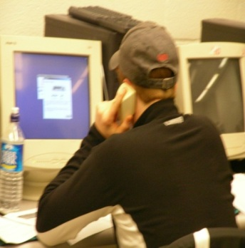
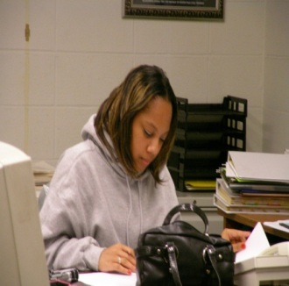
Overview of Survey Process
CSLI – Part of Sarbanes Center for Public and Community Service at Anne Arundel Community College
Operating since 1978
Mission: Provide students opportunities for engaged learning, community outreach
Main activity – public interest surveys
Respondents randomly chosen from universe of listed telephone numbers combined with computer generated numbers
Typical sample size: 400-900 respondents; students used as interviewers
Topics – wide ranging, economy, transportation, land use/growth, taxes/spending, schools…
Last survey – March 7-10, 2011 – focus of this presentation
537 completed surveys
Press releases available online.
since 1978
www2.aacc.edu/csli

Slide 3
Polling Results for AA County
Remarkable stability in right/wrong direction…

Slide 4
AA County Polling Results: Most Important Problem - Fall '04 to Spring '11
Economy – top concern with no recent changes

Slide 5
AA County Polling Results: Rate the Economy
Percentage saying “excellent” or “good” also stable since March 2009
2009
2010
2011
2009
2010
2011
2009
2010
2011

Slide 6
AA County compared to USA – County looks around 35% better

Slide 7
AA County Polling Results: Mostly stable findings in % saying a condition ‘applies’
Little change except for fewer losses in stocks/retirement accounts

Slide 8
The economy: what else applies?
Big jump in transportation costs

Slide 9
Biggest Economic Challenge Facing the County – Items Mentioned in 2005 and 2011
Budget and jobs rise in importance
Condition | Fall 2005 | Spring 2011
Balancing the county budget (less spending, more revenues) | 0 | 18
Providing enough jobs | 8 | 16
Providing enough skills/training or otherwise improving education/schools | 11 | 12
Managing growth/development | 27 | 8
Having enough infrastructure, roads, transportation | 3 | 7
All other answers | 51 | 39
Total | 100 | 100

Slide 10
Perceptions of Decreases in Government Services
Most don’t see an impact from govt. belt-tightening
Services mentioned | Cases | Percentage
Roads | 39 | 24
Schools/teachers | 31 | 19
Library | 24 | 15
College tuition | 12 | 7
Fire | 10 | 6
Seniors services | 10 | 6
Jobs/furloughs/pay cuts | 10 | 6
Police | 9 | 6
Staffing | 7 | 4
Child services | 6 | 4
MVA | 3 | 2
Mental health | 2 | 1
Total | 163 | 100
Answer | Percentage
Yes | 26
No | 70
Don’t know, no answer | 5
Total | 101

Slide 11
State and County Issues
Issue | Support | Oppose | Unsure
Imposing an additional fine of up to $1500 on drivers caught drunk driving | 86 | 13 | 1
Permitting the use of off-shore wind power near Ocean City | 80 | 10 | 10
Increasing the alcohol tax | 68 | 29 | 3
Permitting the purchase of marijuana for medical purposes | 65 | 29 | 7
Taking away drivers’ licenses from those who refuse to pay taxes | 64 | 32 | 3
Increasing the use of cameras to ticket those running red lights | 59 | 41 | 4
Making same sex marriages legal in Maryland | 47 | 46 | 7
Making preparations to implement President Obama’s health care reform law | 43 | 50 | 8
Limiting the use of binding arbitration when the county negotiates with public safety unions | 35 | 42 | 23
Allowing the children of illegal immigrants to pay in-state tuition for college | 33 | 63 | 4
Increasing university tuition to maintain the quality of higher education | 32 | 66 | 2
Reducing the pension and retiree health benefits of state workers | 28 | 65 | 7
Promising state workers no furlough days, and providing them with a $750 bonus | 25 | 59 | 16
Increasing the county income tax to the maximum allowed by law to avoid cuts in essential services | 25 | 68 | 7
Increasing the gasoline tax to bolster the transportation trust fund | 17 | 80 | 3

Slide 12
 | Support
Social Category | %
Party p=.01
Democrat | 57
Unaffiliated | 48
Republican | 35
Ideology p=.01
Liberal | 81
Moderate | 53
Conservative | 22
Religion p=.01
None/Non-practicing | 75
Jewish | 71
Spiritual but not part of organized religion | 64
Other | 46
Catholic | 43
Protestant | 40
Some other Christian | 38
Evangelical | 30
Marital Status p=01.
Single | 66
Married | 45
Gender p=.3
Female | 51
Male | 44
Demographics/Same Sex Marriage % saying “Support”
Age p=.07
18-30 | 53
31-40 | 51
41-50 | 51
51-60 | 53
61+ | 37
Race p=.3
Black | 30
White | 49
Other (including Hispanic, Asian and unspecified ‘other’) | 50

Slide 13
Watched, listened or read about…
 | Yes | No | Unsure /N.A. | Total
President Obama’s state of the union speech? | 72 | 28 | 1 | 101
Governor O’Malley’s inaugural speech or his state of the state speech | 41 | 58 | 1 | 100
Watched County Council hearings being broadcast on local cable stations anytime over the last year? | 19 | 80 | 1 | 100

Slide 14
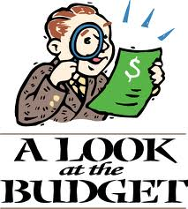
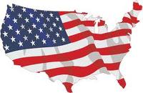
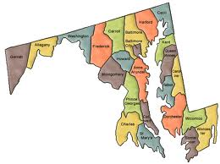
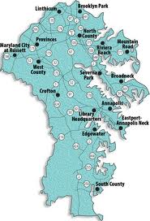
Estimations of Federal Budget
51% estimated
Estimations of State Budget
31% estimated
Estimations of County Budget
31% estimated
Estimates | %
Under $1 billion | 4
$1 billion to $500 billion | 17
$501 to $999 billion | 4
$1-1.999 trillion | 21
$2-2.99 trillion | 10
$3-4.99 trillion | 22
$5-6 trillion | 6
Over $6 trillion | 17
Total | 101
Estimates | %
Under $1 billion | 30
$1-5.99 billion | 26
$6 to $10.99 billion | 7
$11-15.99 billion | 4
$16-20.99 billion | 5
$21-30.99 billion | 3
$31-40 billion | 1
Over $40 billion | 24
Total | 100
Estimates | %
Under $5 million | 22
$5-50 million | 18
$51 to $100 million | 10
$101-350 million | 8
$351-650 million | 9
$651-999 million | 7
$1-1.99 billion | 14
$2-2.99 billion | 3
$4-6.99 billion | 4
Over $7 billion | 6
Total | 100

Slide 15
Presidential Job Approval: Recent Rise…

Slide 16
Presidential Job Approval: % approving of president’s job by party
Bush
Obama

