Slide 1
Overview of Recent Public Opinion in Anne Arundel County and 2010 Elections
By Dan Nataf, Ph.D.
Director, Center for the Study of Local Issues
Anne Arundel Community College
March 30, 2011

Slide 2
Topics
1. Recent CSLI survey results – March 7-10
2. Election results from 2010 – affecting Anne Arundel County

Slide 3
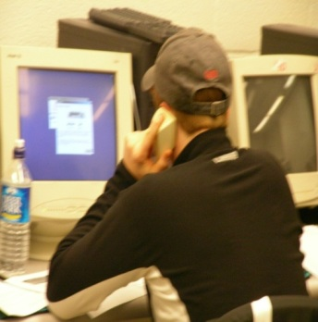
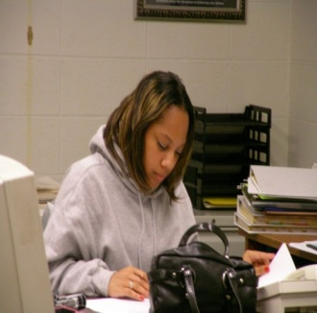
Overview of Survey Process
CSLI – Part of Sarbanes Center for Public and Community Service at Anne Arundel Community College
Operating since 1978
Mission: Provide students opportunities for engaged learning, community outreach
Main activity – public interest surveys
Respondents randomly chosen from universe of listed telephone numbers combined with computer generated numbers
Typical sample size: 400-900 respondents; students used as interviewers
Topics – wide ranging, economy, transportation, land use/growth, taxes/spending, schools…
Last survey – March 7-10, 2011 – focus on this presentation
www2.aacc.edu/csli
since 1978

Slide 4
Polling Results for AA County
Remarkable stability in right/wrong direction…

Slide 5
AA County Polling Results: Most Important Problem - Fall '04 to Spring '11
Economy – top concern with no recent changes

Slide 6
AA County Polling Results: Rate the Economy
Percentage saying “excellent” or “good” also stable since March 2009

Slide 7
AA County compared to USA – County looks around 35% better

Slide 8
AA County Polling Results: Mostly stable findings in % saying a condition ‘applies’
Little change except for fewer losses in stocks/retirement accounts

Slide 9
The economy: what else applies?
Big jump in transportation costs

Slide 10
Biggest Economic Challenge Facing the County – Items Mentioned in 2005 and 2011
Budget and jobs rise in importance
Condition | Fall 2005 | Spring 2011
Balancing the county budget (less spending, more revenues) | 0 | 18
Providing enough jobs | 8 | 16
Providing enough skills/training or otherwise improving education/schools | 11 | 12
Managing growth/development | 27 | 8
Having enough infrastructure, roads, transportation | 3 | 7
All other answers | 51 | 39
Total | 100 | 100

Slide 11
Perceptions of Decreases in Government Services
Most don’t see an impact from govt. belt-tightening
Services mentioned | Cases | Percentage
Roads | 39 | 24
Schools/teachers | 31 | 19
Library | 24 | 15
College tuition | 12 | 7
Fire | 10 | 6
Seniors services | 10 | 6
Jobs/furloughs/pay cuts | 10 | 6
Police | 9 | 6
Staffing | 7 | 4
Child services | 6 | 4
MVA | 3 | 2
Mental health | 2 | 1
Total | 163 | 100
Answer | Percentage
Yes | 26
No | 70
Don’t know, no answer | 5
Total | 101

Slide 12
State and County Issues
Issue | Support | Oppose | Unsure
Imposing an additional fine of up to $1500 on drivers caught drunk driving | 86 | 13 | 1
Permitting the use of off-shore wind power near Ocean City | 80 | 10 | 10
Increasing the alcohol tax | 68 | 29 | 3
Permitting the purchase of marijuana for medical purposes | 65 | 29 | 7
Taking away drivers’ licenses from those who refuse to pay taxes | 64 | 32 | 3
Increasing the use of cameras to ticket those running red lights | 59 | 41 | 4
Making same sex marriages legal in Maryland | 47 | 46 | 7
Making preparations to implement President Obama’s health care reform law | 43 | 50 | 8
Limiting the use of binding arbitration when the county negotiates with public safety unions | 35 | 42 | 23
Allowing the children of illegal immigrants to pay in-state tuition for college | 33 | 63 | 4
Increasing university tuition to maintain the quality of higher education | 32 | 66 | 2
Reducing the pension and retiree health benefits of state workers | 28 | 65 | 7
Promising state workers no furlough days, and providing them with a $750 bonus | 25 | 59 | 16
Increasing the county income tax to the maximum allowed by law to avoid cuts in essential services | 25 | 68 | 7
Increasing the gasoline tax to bolster the transportation trust fund | 17 | 80 | 3

Slide 13
 | Support
Social Category | %
Party p=.01
Democrat | 57
Unaffiliated | 48
Republican | 35
Ideology p=.01
Liberal | 81
Moderate | 53
Conservative | 22
Religion p=.01
None/Non-practicing | 75
Jewish | 71
Spiritual but not part of organized religion | 64
Other | 46
Catholic | 43
Protestant | 40
Some other Christian | 38
Evangelical | 30
Marital Status p=01.
Single | 66
Married | 45
Gender p=.3
Female | 51
Male | 44
Demographics/Same Sex Marriage % saying “Support”
Age p=.07
18-30 | 53
31-40 | 51
41-50 | 51
51-60 | 53
61+ | 37
Race p=.3
Black | 30
White | 49
Other (including Hispanic, Asian and unspecified ‘other’) | 50

Slide 14
Watched, listened or read about…
 | Yes | No | Unsure /N.A. | Total
President Obama’s state of the union speech? | 72 | 28 | 1 | 101
Governor O’Malley’s inaugural speech or his state of the state speech | 41 | 58 | 1 | 100
Watched County Council hearings being broadcast on local cable stations anytime over the last year? | 19 | 80 | 1 | 100

Slide 15
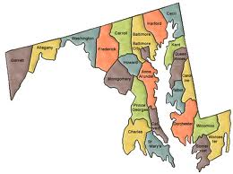
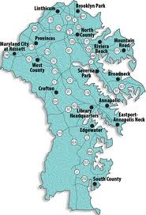
Estimations of Federal Budget
51% estimated
Estimations of State Budget
31% estimated
Estimations of County Budget
31% estimated
Estimates | %
Under $1 billion | 4
$1 billion to $500 billion | 17
$501 to $999 billion | 4
$1-1.999 trillion | 21
$2-2.99 trillion | 10
$3-4.99 trillion | 22
$5-6 trillion | 6
Over $6 trillion | 17
Total | 101
Estimates | %
Under $1 billion | 30
$1-5.99 billion | 26
$6 to $10.99 billion | 7
$11-15.99 billion | 4
$16-20.99 billion | 5
$21-30.99 billion | 3
$31-40 billion | 1
Over $40 billion | 24
Total | 100
Estimates | %
Under $5 million | 22
$5-50 million | 18
$51 to $100 million | 10
$101-350 million | 8
$351-650 million | 9
$651-999 million | 7
$1-1.99 billion | 14
$2-2.99 billion | 3
$4-6.99 billion | 4
Over $7 billion | 6
Total | 100

Slide 16
Presidential Job Approval: Recent Rise…

Slide 17
Presidential Job Approval: % approving of president’s job by party
Bush
Obama

Slide 18
2010 Elections

Slide 19
Statewide Races – AAC Results ‘06/’10
Very little change in Governor or Comptroller outcomes
Mikulski improves

Slide 20
Anne Arundel Consistently supports Rep. Gubernatorial Candidates
Gubernatorial Races – Anne Arundel County
O’Malley on low end of typical Dem vote deficit

Slide 21
Statewide Races: O’Malley vs. Ehrlich for Governor 2006-2010
Polls are in range, but with internal variation
 | Nov. 2006 | March 2010 |  | October 11-14, 2010 |  |  | Oct. 26-27 | Nov. 2
Candidate | Actual Vote | All Categories | Exclude some | All categories | Exclude some | Exclude all except voters | Exit Poll | Actual Vote
O’Malley | 42 | 35 | 43 | 29 | 32 | 42 | 46 | 43
Ehrlich | 56.9 | 47 | 57 | 40 | 45 | 59 | 51 | 54
Gap | 14.9 | 12 | 14 | 11 | 13 | 19 | 5 | 11
Other | -- | 3 | -- | 2 | -- | -- | 3 | --
Undecided | -- | -- | -- | 22 | 24 | -- | -- | --
Neither | -- | 5 | -- | 1 | -- | -- | -- | --
Unsure | -- | 10 | -- | 5 | -- | -- | -- | --
Total |  | 100 | 100 | 99 | 101 | 101 | 100

Slide 22
State Senate in AAC (Districts 30,31,32,33)
Dems experience lower percentages in all districts

Slide 23
Delegate Races in Districts 30,31,32,33: Dem-Rep Gap
Loses in 32 – what’s the future for Dems there?
Big Dem loss in 31
33b uncontested
33a only 1 Dem cand.
Race gets very close in 30

Slide 24
Senate and Delegate Minimum Winning Totals in Districts 30,31,32,33
 | Minimum winning vote |  | Seats
District | Senate | Delegates | Senate | Delegate
30 | 25253 | 22535 | Dem | D=1/R=2
31 | 25723 | 22436 | Rep | D=0/R=3
32 | 24762 | 18786 | Dem | D=3/R=0
33(a) | 43466 uncontested | 18603 | Rep | D=0/R=2
33b |  | 14623 |  | D=0/R=1

Slide 25
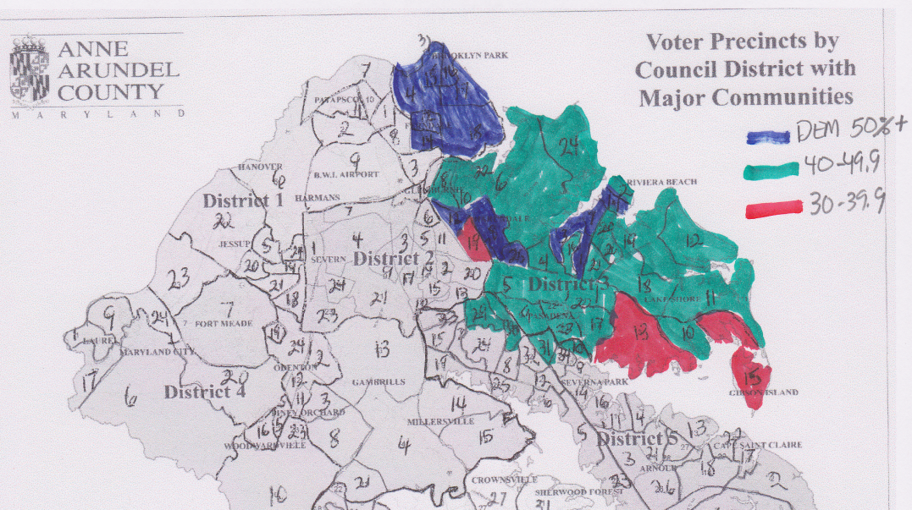
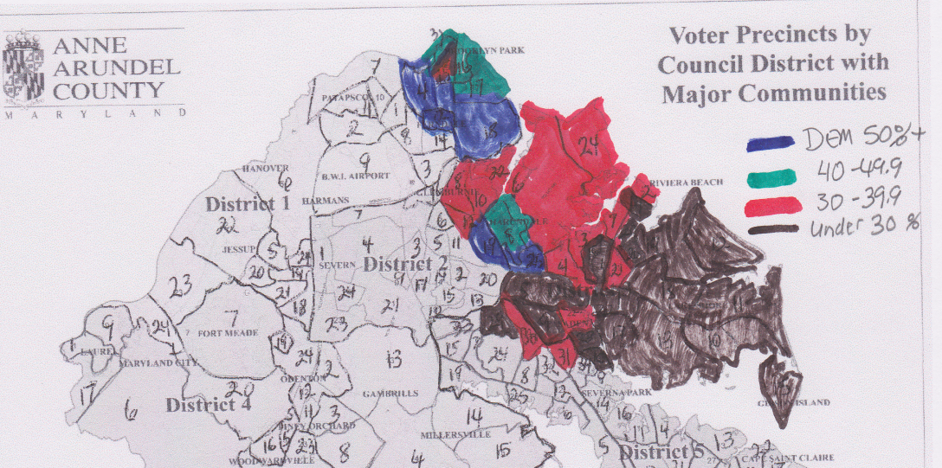
District 31: State Senate Races: 2006-2010
2006: Walter Shandrowski 49.1%
Brian Simonaire 50.8%
2010: Ned Carey 37.8%
Brian Simonaire 62.1%

Slide 26
District 31 – 2006 vs. 2010 Delegate Races
Candidate | 2010: % | Votes | Candidate | 2006: % | Votes
Chiappelli | 11.8 | 12943 | Cadden | 17.0 | 17529 | -4586
Towles | 10.9 | 11968 | Fleckenstein | 16.1 | 16651 | -4683
Ekert | 10.8 | 11856 | Reynolds | 14.0 | 14452 | -2596
Total | 11.2 | 36767 |  | 15.7 | 48632 | -11865
Democratic candidates can’t replicate 2006 results!

Slide 27
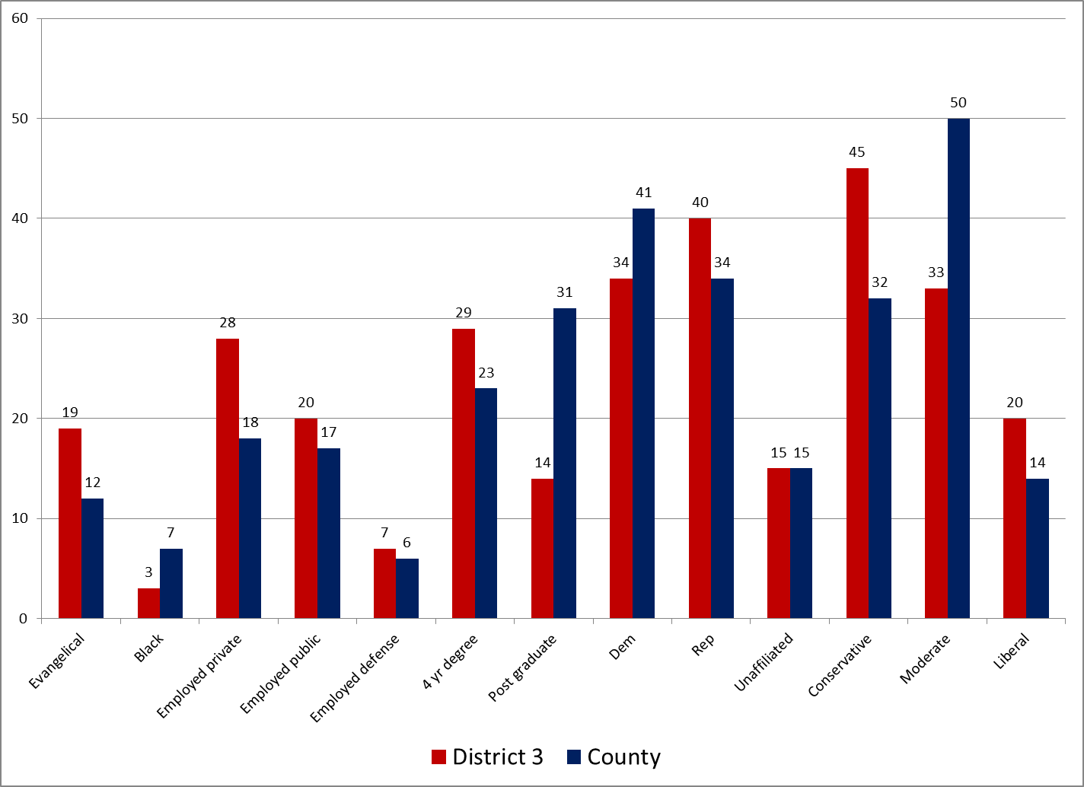
District 31: Demographic Info
Too many conservatives, not enough moderates

Slide 28
District 31: Issues and Conditions
Economic distress is high

Slide 29
County Elections: Slots at Arundel Mills
Opponents to the introduction of slot machines at Arundel Mills Mall are circulating a petition to put the county council’s decision to grant zoning needed for slots to referendum in November, potentially reversing the decision. Do you support or oppose this petition effort?
Will you be voting for or against Question A on the November ballot? A "for" vote would approve the County Council's zoning decision permitting slots in the county, including at Arundel Mills and Laurel. An 'against' vote would leave the county without slots zoning at any location.
Position | March ’10 | Oct. ‘10 | Exit Poll | Actual Vote
Support | 45 | 42 | 60 | 55.6
Oppose | 45 | 42 | 39 | 44.4
Gap | 0 | 0 | 21 | 11.2
Unsure | 7 | 16 | -- | --
No answer | 2 | -- | 1 | --
Total | 99 | 100 | 100 | 100
What happened to shift voter sentiment at last minute?

Slide 30
Question A: Election Day vs. Early Voting by Council District
Early voting a good predictor of election day votes
Early voted at West County

Slide 31
County Executive Vote 1994-2010
12425
Including Shay -1930
GAP
2716
23987
6151
3920
Only a few thousand votes separate Dem/Rep candidates

Slide 32
2010 County Exec Race Over Time
 | Nov. 2006 | June 2010 Online Poll | Sept. 2010 Online Poll | October 11-14, 2010 |  |  | Oct. 26-27 | Nov. 2
Candidate | Actual Vote | All Categories | All Categories | All categories | Exclude some | Exclude all except voters | Exit Poll | Actual Vote
Johnson/ Conti | 49 | 30 (Owens) 23 (Conti) | 28 | 21 | 24 | 37 | 39 | 44.0
Leopold | 51 | 52/54 | 54 | 34 | 38 | 59 | 50 | 50.5
Gap | 2 | 22/31 | 26 | 13 | 14 | 22 | 11 | 6.5
Other | -- | 15/16 | 10 | 2 | 3 | -- | -- | 5.4
Undecided | -- | -- | -- | 32 | 35 | -- | -- | --
Neither | -- | 4/7 | 9 | 2 | -- | -- | 3 | --
Unsure | -- | -- | -- | 10 | -- | -- | -- | --
Total |  | 101/100 |  | 101 | 100 | 101 | 100 | 100
Unlike Governor’s race, CE race much harder to predict –much tightening at the end…

Slide 33
Vote Composition: Exit Poll
Conti lags among Dem voters but gains a bit among unaffiliated

Slide 34
Voter Composition continued: Exit Poll
Conti lags among Dems, but gains among Reps

Slide 35
Vote by Ideology
Conti lags among liberals but does a bit better with conservatives

Slide 36
County Exec.: How informed were voters?
Leopold voters started and remained more informed
Voters seem informed by election

Slide 37
County executive choice: Whose stands do you favor? Sorted by Undecided/Don’t know (Oct. 11-14)
 | On this issue are you more favorable to Conti, Leopold or Shay?
Issue | Conti | Leopold | L-C | Shay | Undecided | Don’t know enough | Undec.+ don’t know enough
Allowing slots at Arundel Mills mall | 10 | 17 | 7 | 1 | 27 | 46 | 73
Improving transportation | 13 | 20 | 7 | 1 | 21 | 45 | 66
Protecting the needs of vulnerable populations in the county budget | 16 | 18 | 2 | 1 | 21 | 44 | 65
Maintaining high ethical standards | 17 | 17 | 0 | 3 | 24 | 39 | 63
Improving public schools | 13 | 24 | 11 | 1 | 19 | 43 | 62
Keeping neighborhoods safe | 13 | 24 | 11 | 1 | 21 | 41 | 62
Making County government more efficient | 12 | 29 | 17 | 2 | 21 | 37 | 58
Preserving the environment | 15 | 21 | 6 | 7 | 18 | 39 | 57
Managing growth | 13 | 29 | 16 | 2 | 18 | 38 | 56
Having the right experience for the job | 11 | 32 | 21 | 1 | 21 | 35 | 56
Keeping taxes low | 14 | 30 | 16 | 1 | 19 | 36 | 55
Encouraging economic development | 13 | 31 | 18 | 1 | 18 | 37 | 55

Slide 38
County executive choice: Whose stands do you favor? Sorted by those favoring Leopold over Conti (Oct. 11-14)
 | Conti | Leopold | L-C | Shay | Undecided | Don’t know enough | U
 |  |  |  |  |  |  | Undecided/Don’tknow enough
Having the right experience for the job | 11 | 32 | 21 | 1 | 21 | 35 | 56
Encouraging economic development | 13 | 31 | 18 | 1 | 18 | 37 | 55
Making County government more efficient | 12 | 29 | 17 | 2 | 21 | 37 | 58
Managing growth | 13 | 29 | 16 | 2 | 18 | 38 | 56
Keeping taxes low | 14 | 30 | 16 | 1 | 19 | 36 | 55
Improving public schools | 13 | 24 | 11 | 1 | 19 | 43 | 62
Keeping neighborhoods safe | 13 | 24 | 11 | 1 | 21 | 41 | 62
Allowing slots at Arundel Mills mall | 10 | 17 | 7 | 1 | 27 | 46 | 73
Improving transportation | 13 | 20 | 7 | 1 | 21 | 45 | 66
Preserving the environment | 15 | 21 | 6 | 7 | 18 | 39 | 57
Protecting the needs of vulnerable populations in the county budget | 16 | 18 | 2 | 1 | 21 | 44 | 65
Maintaining high ethical standards | 17 | 17 | 0 | 3 | 24 | 39 | 63

Slide 39
Issue Stands/Traits Most Shaping Choice for County Exec. (Exit Poll)
Issue/trait | Overall | Conti | Leopold | L-C
Balance budget | 30 | 21 | 44 | 23
Taxes | 21 | 10 | 34 | 24
Right experience | 22 | 15 | 32 | 17
Cost of living | 14 | 7 | 23 | 16
Strong leader | 16 | 11 | 24 | 13
Economy | 33 | 31 | 43 | 12
Crime | 14 | 9 | 20 | 11
Growth/devel. | 15 | 12 | 18 | 6
Familiar name | 4 | 1 | 7 | 6
Slots | 10 | 8 | 12 | 4
Constituent serv. | 9 | 8 | 11 | 3
Environment | 15 | 17 | 11 | -6
Schools | 21 | 26 | 19 | -7
Honesty | 13 | 21 | 8 | -13
Right moral outlook | 16 | 24 | 9 | -15
Party affiliation | 28 | 38 | 22 | -16
Leopold bets on experience and issues
Conti bets on character and party

Slide 40
Weathersbee vs. Bateman
Council District | Weathersbee ‘06 | Weathersbee ‘10 | Weathersbee ‘10-’06 | Bateman ‘10 | W-B
1 | 57.3 | 54.3 | -3 | 60.4 | -6.1
2 | 55.3 | 52.8 | -2.5 | 59.8 | -7.0
3 | 48.8 | 43.6 | -5.2 | 55.5 | -11.9
4 | 58.2 | 56.4 | -1.8 | 61.9 | -5.5
5 | 49.2 | 46.7 | -2.5 | 55.1 | -8.4
6 | 62.0 | 58.6 | -3.4 | 61.5 | -2.9
7 | 51.8 | 45.7 | -6.1 | 50.7 | -5.0
Total | 54.7 | 51.2 | -3.5 | 57.8 (up from 54% in ‘06) | -6.7
Weathersbee has losses in districts 3 and 7 in 2010 and no gains in any district
Bateman increases votes from ‘06 and wins majority in all districts in 2010

Slide 41
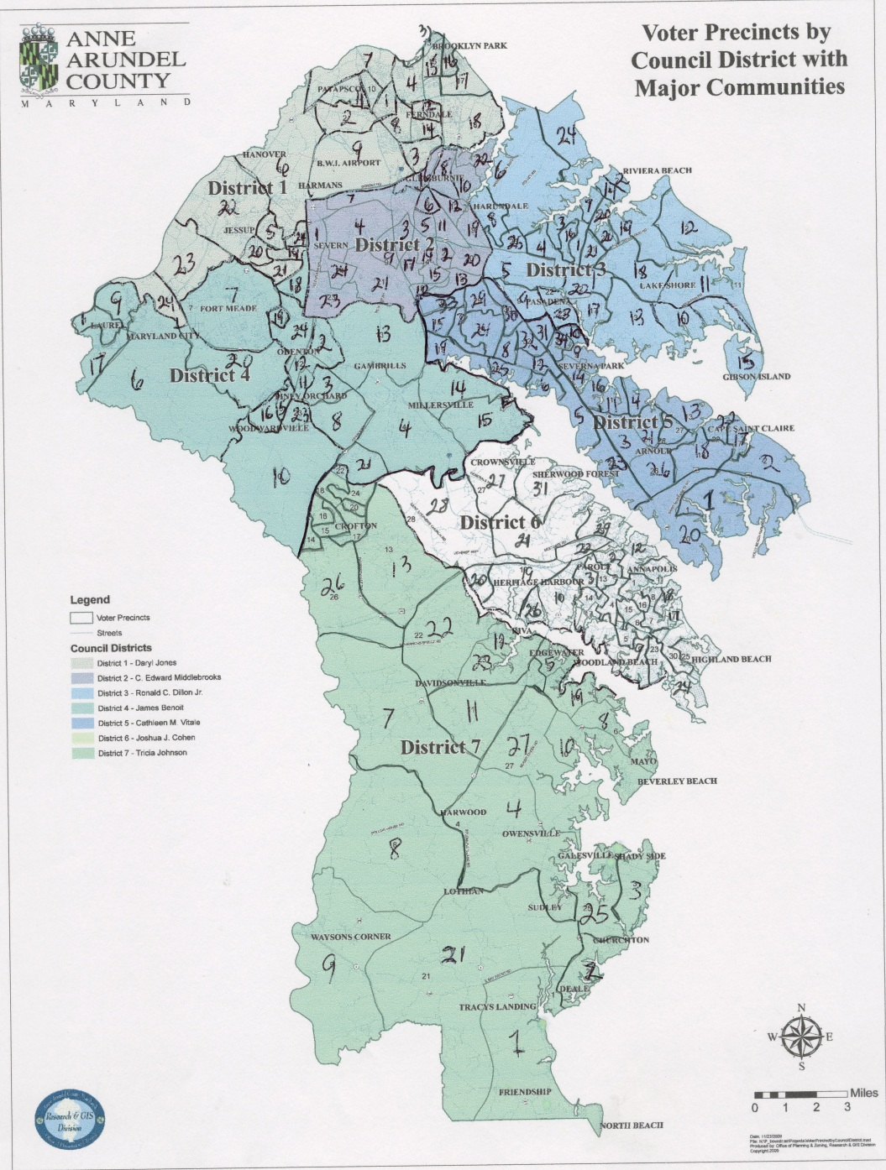
Council Districts Party Registration
53%D, 29%R, 18%U
42%D, 39%R, 19%U
49%D, 32%R, 18%U
48%D, 31%R, 18%U
37%D, 44%R, 20%U
47%D, 31%R, 18%U
36% D, 41%R, 19%U

Slide 42
Democratic Candidates by Council District

Slide 43
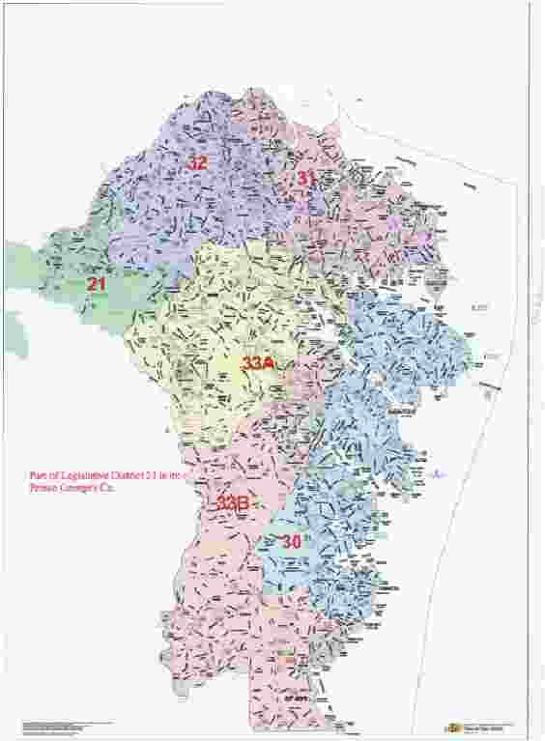
Legislative Districts

Slide 44
Questions to ponder:
1. Can Democrats be successful countywide and in ‘harder’ districts?
Bateman, Weathersbee
Quality of candidate
Quality of opponent
Quality of campaign
Impact of larger trends – national, statewide
Changes in the composition of the electorate
Saliency of issues

Slide 45
Questions to ponder:
2. What is the future of District 31 Democratic seats
Democrats demoralized?
Will the 2010 results undermine recruitment efforts?
What issues can Democrats successfully use in the district?
What vulnerabilities do Democrats have – on issues, in the composition of the electorate, in the recruitment of candidates?

Slide 46
Questions to ponder:
As chair of the AAC Dem Central Committee…
Identify potential candidates, groom them early
Identify key issues within each district
Identify how changes in the composition of the electorate might affect Dem candidates
Provide experience based campaign training
Conduct opposition research – identify Republican vulnerabilities, develop key talking points, test ideas on focus groups, conduct polls
Develop consistent outreach tools - a Democratic newsletter – online distribution, central location for all Dem events, solicit input from voters
Ensure turnout – close elections imply narrow victories!

Slide 47
National Politics: Exit Poll re: House Vote
Demographics of National House of Representatives Vote (vs. ‘08 Obama – National Exit Polls
Party identification in 2010: Dem/Rep at 35%, 29% Ind.
(vs. 39/32/29% in 2008)
Defection slightly higher among Dems 7% vs 5% Reps
Indep. vote sided strongly with Reps 56% not Dems 37% (vs. 41/52% in ‘08)
Women equally split (48 D; 49% R) (vs. 56, 43% in 2008)
Whites strongly Rep (60%) not Dem (37%) (vs. 55, 43% in 2008)
Only those with little (57%) or postgrad ed (53%) favored Dems

Slide 48
National Politics: Exit Poll re: House Vote
Demographics of National House of Representatives Vote (vs. ‘08 Obama – National Exit Polls
Vote by Age (08/10) | Dem ’08 | Dem ‘10 | Rep
18-29 18/12 | 66 | 55 | 42
30-44 29/24 | 52 | 46 | 50
45-64 37/43 | 50 | 45 | 53
65 and Older 16/21 | 45 | 38 | 59
Older voters worried about Medicare/Health care reform?

Slide 49
National Politics: House Vote
Libs and Moderates favored Dems (90, 55%) but were too small (20, 38%) a part of electorate vs Cons. (42%) who massively favored Reps (84)
(2008: Lib 22; Moderate 44; Cons. 34%)
Lost job – no effect(30%)? Yes (50 Dem; 46% Rep) No (45, 54%)
Union member (17%): Yes (61 Dem; 37% Rep) No (43, 54%)
2008 Presidential Vote: Obama (45%) 84,14%; McCain (45%) 7,91%, Other (4%) 33, 58%
Is vote support for Obama? Yes (23%) 96 Dem; 3% Rep; No (37%) 6, 92%, Not factor (38%), 52, 44%

Slide 50
National Politics: House Vote
Too many people strongly disapprove of the job Congress is doing…
How Congress is Handling its Job | Democrat | Republican
Strongly Approve (4%) | 82 | 16
Somewhat Approve (20%) | 78 | 20
Somewhat Disapprove (26%) | 57 | 41
Strongly Disapprove (48%) | 19 | 77
But unfavorable opinions are spread to both Dems and Reps
What is your opinion of… | Democrat | Republican
Democrats - favorable (44%) | 91 | 8
Republicans - favorable (41%) | 11 | 88

Slide 51
National Politics: House Vote
Govt. perceived as over-reaching…
Govt should do more ? | Dem | Rep
Yes, do more (38%) vs 51% in ’08 | 77 | 21
No, do less (56%) vs. 43% in ‘08 | 20 | 76
With too many dissatisfied with federal govt.
Opinion of Federal Government | Democrat | Republican
Enthusiastic (3%) | 92 | 6
Satisfied (21%) | 79 | 18
Dissatisfied (48%) | 41 | 55
Angry (25%) | 14 | 83

Slide 52
National Politics: House Vote
Economic anxieties favor Reps..
How worried about economic conds.? | Dem | Rep
Very Worried (49%) | 30 | 68
Somewhat Worried (37%) | 52 | 43
Not Too Worried (10%) | 81 | 18
Reversal of 2008 when those worried lined up behind Dems
Worried That Economic Crisis Will Hurt Your Family | Dem | Rep
Very Worried (48%) | 62 | 36
Somewhat Worried (33%) | 52 | 47
Not Too Worried (13%) | 33 | 63
Not Worried At All (5%) | 40 | 56

Slide 53
National Politics: House Vote
Stimulus not perceived as having done enough…
Stimulus Policy has | Dem | Rep
Helped (32%) | 86 | 13
Hurt (34%) | 10 | 87
Made No Difference (31%) | 39 | 57
While blaming Wall Street or Bush just wasn’t enough…
Who Do You Blame for Economic Problems? | Dem | Rep
Wall Street (35%) | 41 | 57
George W. Bush (29%) | 83 | 15
Barack Obama (24%) | 6 | 91

Slide 54
National Politics: House Vote
Health care reform was polarizing and insufficiently popular
What Should Congress Do With New Health Care Law? | Dem | Rep
Expand It (31%) | 84 | 15
Leave It As Is (16%) | 63 | 34
Repeal It (48%) | 11 | 86
And probably viewed as a distraction from the prime concerns of most citizens…
Most Important Issue Facing Country Today | Democrat | Republican
Economy (63%) | 43 | 54
Health Care (18%) | 51 | 47
Illegal Immigration (8% | 26 | 68
War in Afghanistan (7%) | 58 | 40

Slide 55
National Politics: House Vote
Now policy direction lacks consensus…and is polarizing
Bush-Era Tax Cuts Should Be Continued For... | Dem | Rep
All Americans (40%) | 14 | 84
Families Under $250,000 (36%) | 64 | 32
No One (15%) | 75 | 22
Highest Priority for Next Congress | Dem | Rep
Cutting Taxes (18%) | 26 | 71
Reducing Deficit (40%) | 32 | 65
Spending to Create Jobs (37%) | 68 | 30
Republicans face contradictory pressures – reduce deficit vs. cutting taxes

Slide 56
National Politics: House Vote
Dems disapprove of war in Afghanistan – losing the base?
U.S. War in Afghanistan | Dem | Rep
Approve (40%) | 24 | 75
Disapprove (54%) | 61 | 36
Should Same-Sex Marriages Be Legally Recognized? | Dem | Rep
Yes (41%) | 67 | 30
No (53%) | 27 | 70
While same sex marriage still troubled waters for Dems

Slide 57
Democratic Candidates by Council District
Districts 4 and 6 overperform
 | Obama | OMalley | Conti | DemCC | Mean | Party Reg | Mean-Reg.
CC1 | 49.2 | 45.8 | 47.4 | 52.5 | 48.7 | 51.7 | -3
CC2 | 48.5 | 42.8 | 46.2 | 45.5 | 45.7 | 48.1 | -2.4
CC3 | 35.7 | 30.8 | 35 | 41 | 35.6 | 41.7 | -6.1
CC4 | 57.1 | 51.9 | 53.8 | 59.5 | 55.6 | 47.1 | 8.5
CC5 | 42.8 | 37.1 | 38.7 | 36 | 38.6 | 36.6 | 2.1
CC6 | 58 | 51.7 | 48.1 | 53.1 | 52.7 | 46.1 | 6.6
CC7 | 43.8 | 39.8 | 39.9 | 36.4 | 40 | 37.6 | 2.4
District 3 underperforms!

