Slide 1
2016 Elections – What Happened and Why? Nov. 21, 2016
Dan Nataf, Ph.D.
Director, Center for the Study of Local Issues
Professor, Political Science
Anne Arundel Community College
www2.aacc.edu/csli

Slide 2
State and Local Outcomes
Maryland’s Democratic tendencies unabated for national elections (vs. state/local)
Anne Arundel goes against grain: Narrow Clinton victory – 1st majority for a Dem. Candidate since 1964

Slide 3
Eisen.
Nixon.
Reagan
Bush
Bush
Truman
Nixon
Trump
Maryland Picks Loser 6 Times: 1=‘48, ‘68, ‘00, ‘04, ‘16

Slide 4
Party Vote Differences: Govr./Pres. Years
Maryland Presidential Elections vs Gubernatorial – Blue vs. Purple

Slide 5
How Do Counties Compare?
Anne Arundel County: 48% Clinton vote; Trump 47%

Slide 6
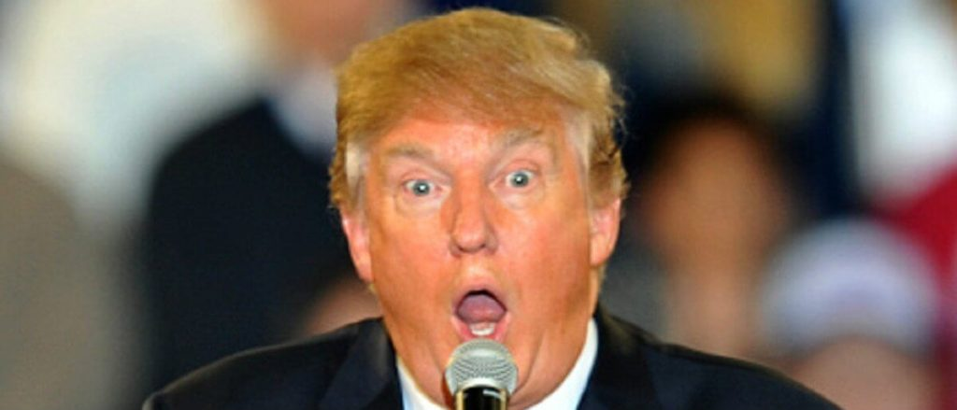
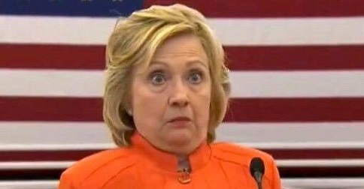
What happened NATIONALLY Nov. 8? How did Trump win since it was…
Completely unexpected!

Slide 7
How did the pollsters do: NY Times

Slide 8
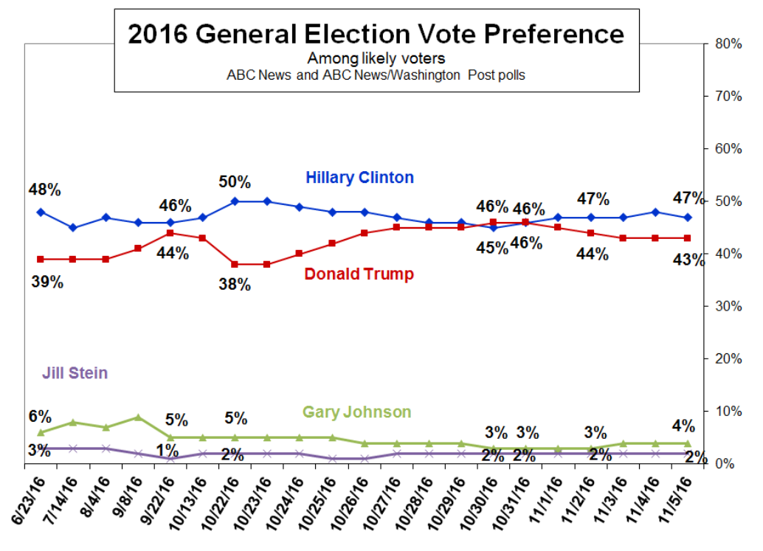
How did the pollsters do in 2016? ABC/WP Tracking Poll – Oct. – Nov. 7
Registered voters – add 3+/- to Romney for likely voters
Oct 11
Oct 3

Slide 9
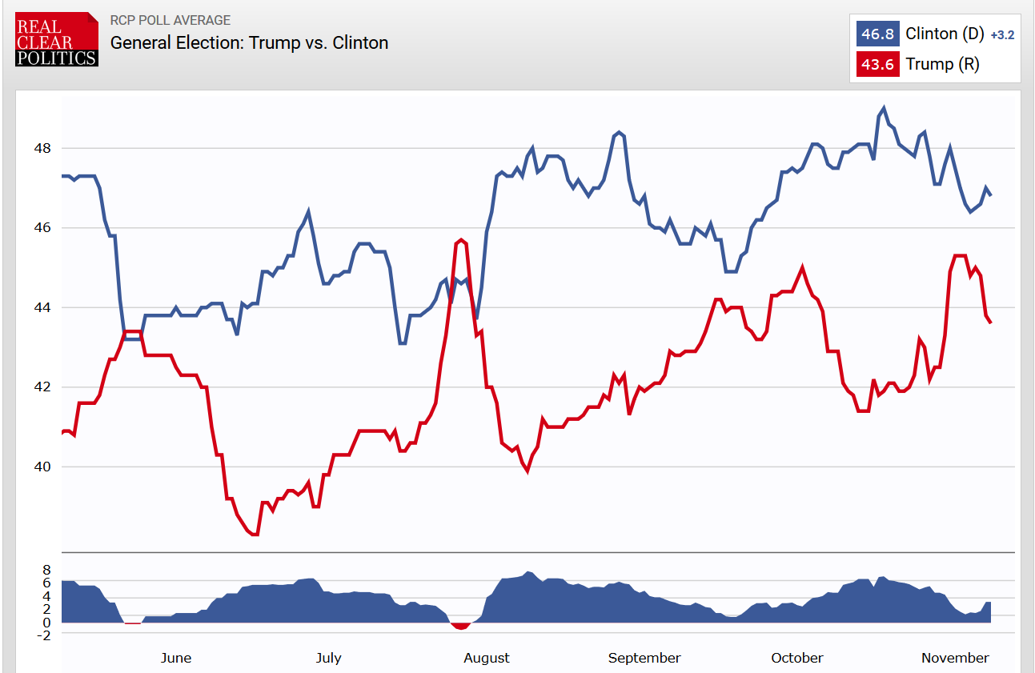
How did the pollsters do in 2016? RealClearPolitics – June – Nov. 8
Oct 11
Oct 3

Slide 10
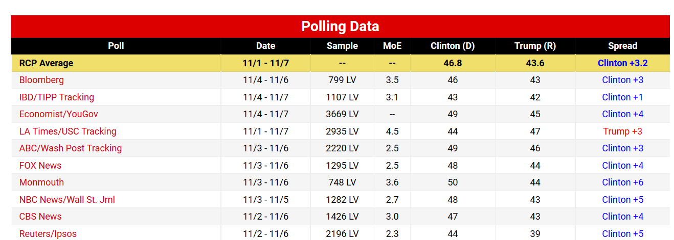
Last RealClearPolitics.com national polls Nov. 8

Slide 11
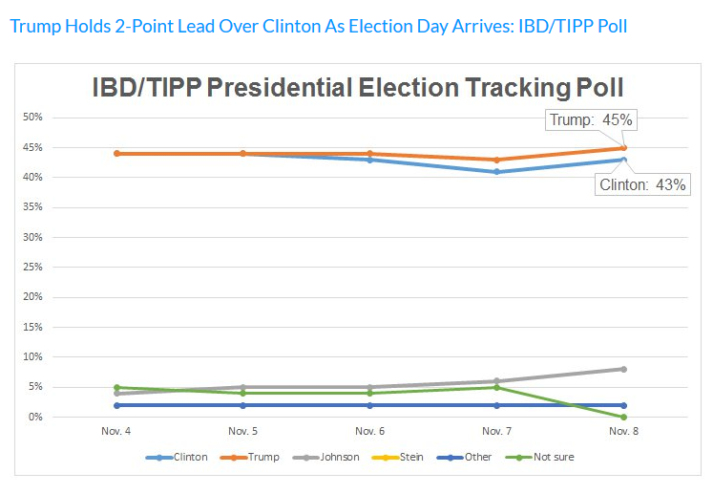
How did the pollsters do in 2016? IBD Tracking Nov.4-8
Oct 11
Oct 3
http://www.investors.com/politics/ibd-tipp-presidential-election-poll/

Slide 12
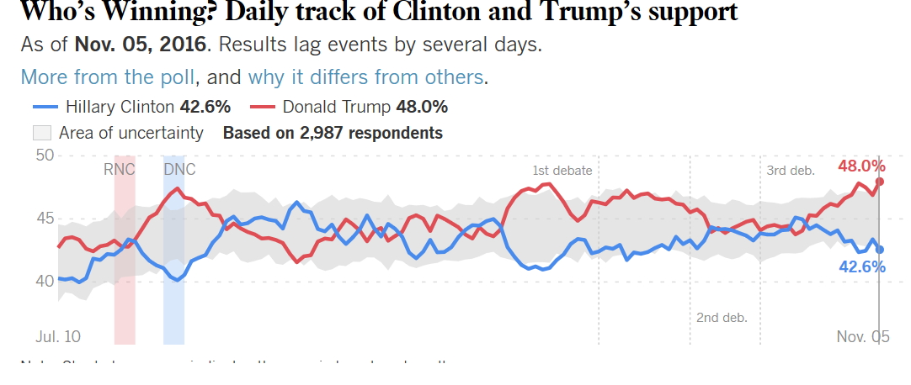
How did the pollsters do in 2016? LA Times/USC Tracking Poll – July. – Nov. 3
Oct 11
Oct 3

Slide 13
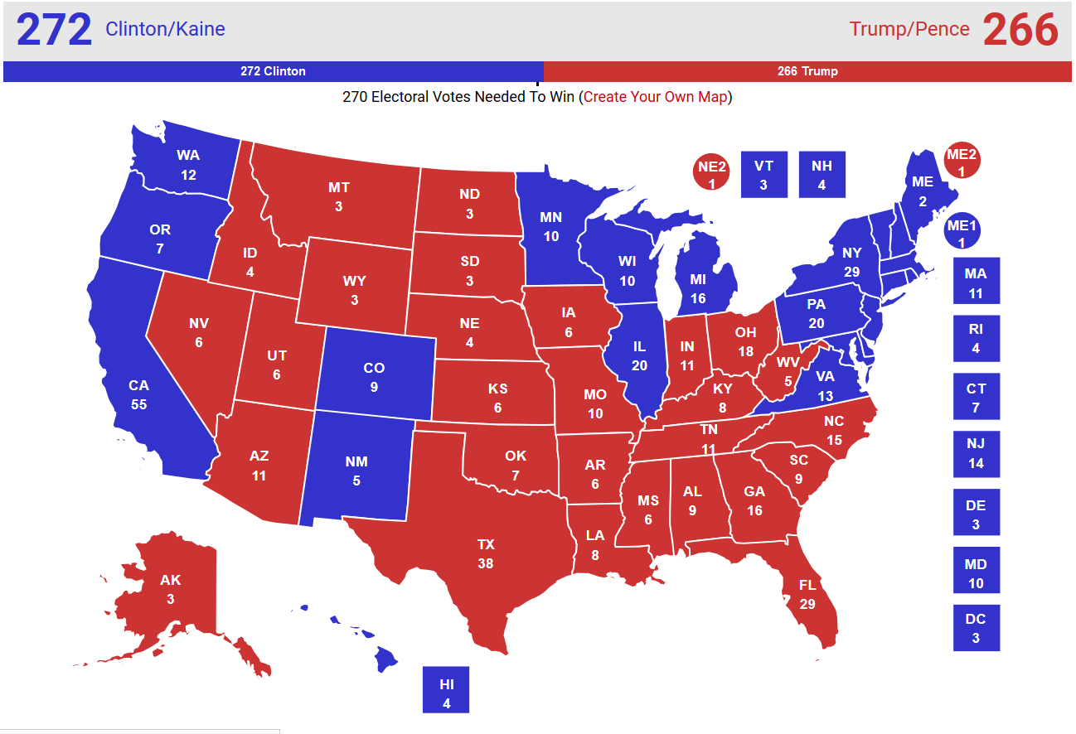
EC Prediction: RealClearPolitics.com

Slide 14
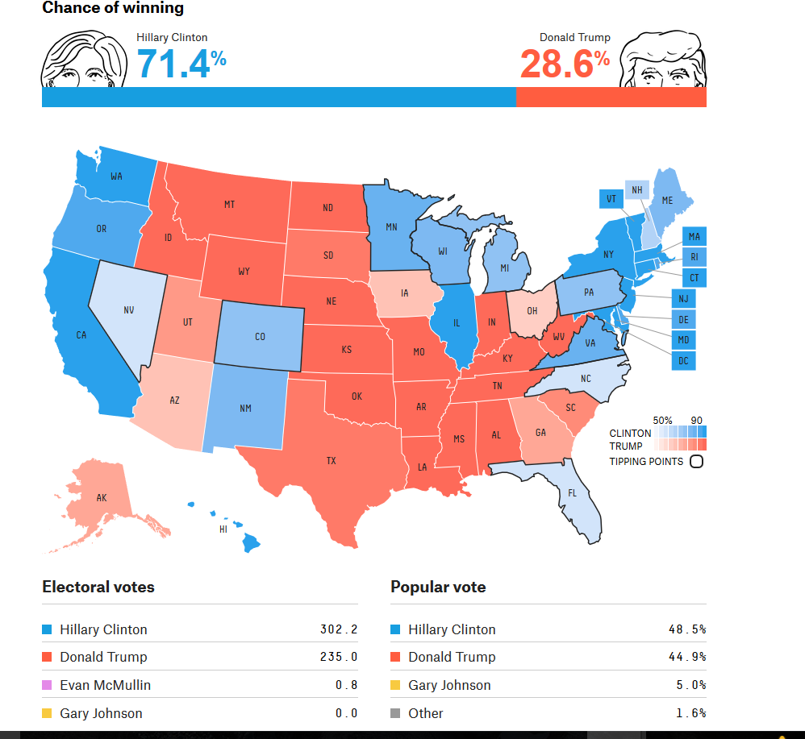
EC Prediction: Nate Silver – fivethirtyeight.com

Slide 15
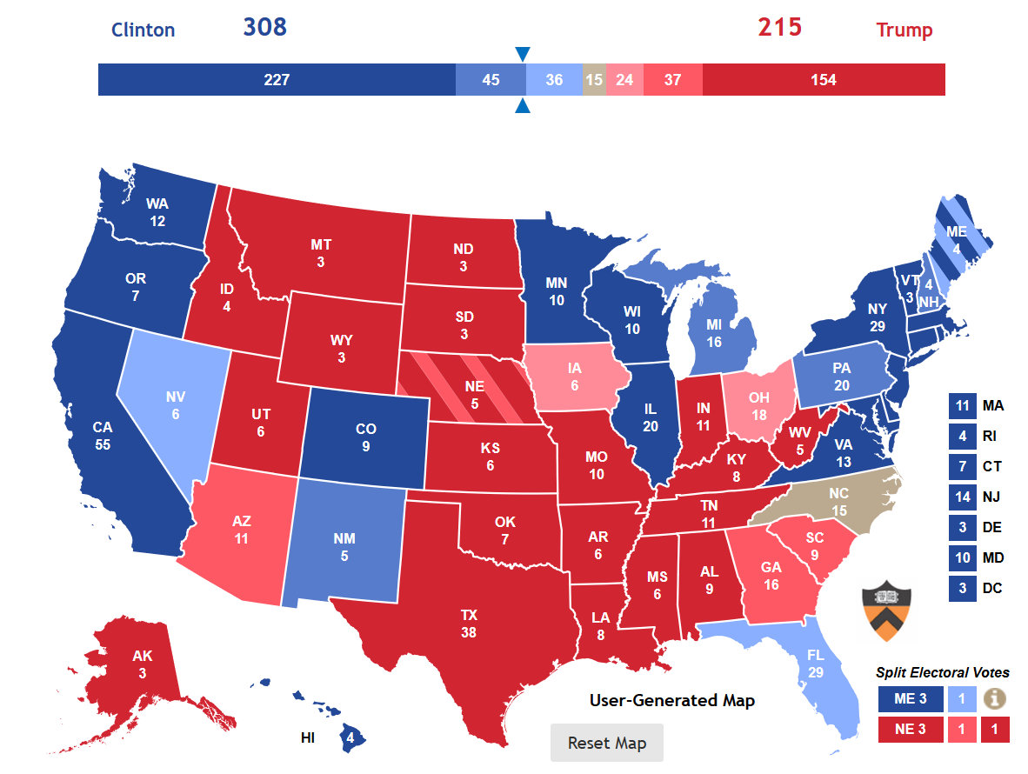
EC Prediction: Princeton Election Consortium

Slide 16
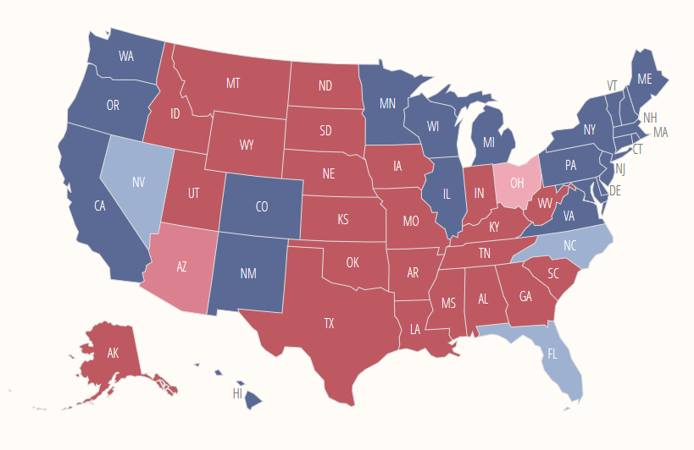
Predictions: Daily Kos http://elections.dailykos.com/app/elections/2016/office/president

Slide 17
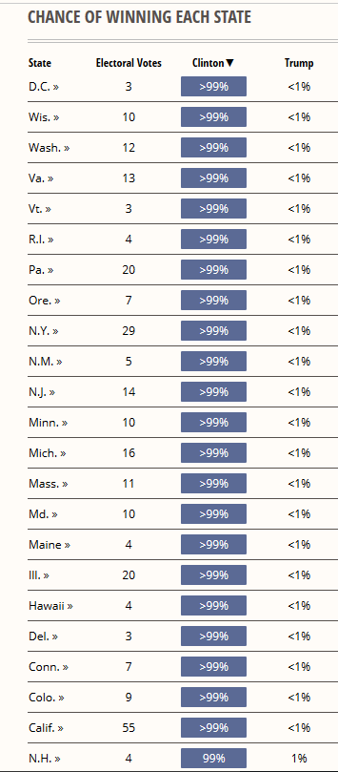
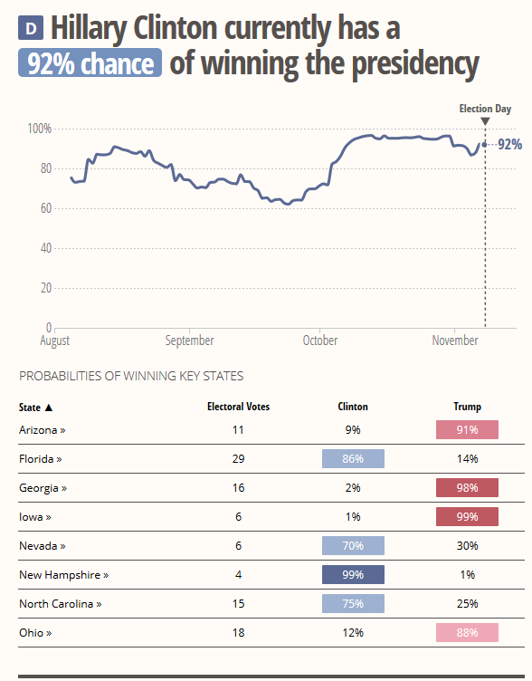
Predictions: Daily Kos

Slide 18
How did 2016 compare to previous elections?
 | 2008 | 2012 | 2016 | 2016-2008
Obama/Clinton % | 53 | 51.1 | 48 | -3.1
Popular vote | 69,456,897 | 65,915,795 | 62,523,126 | -3,380,669
Electoral College | 365 | 332 | 232 | -100
McCain/Romney/Trump | 46 | 47.2 | 47 | -.2
Popular vote | 59,934,814 | 60,933,504 | 61,201,031 | 267,527
Electoral College | 173 | 206 | 290 | 84
Total votes | 129,391,711 | 126,849,299 | 123,724,157 | -3,125,142
Less a Republican win than a Democratic loss…despite lead in popular vote – quirks of the Electoral College.

Slide 19
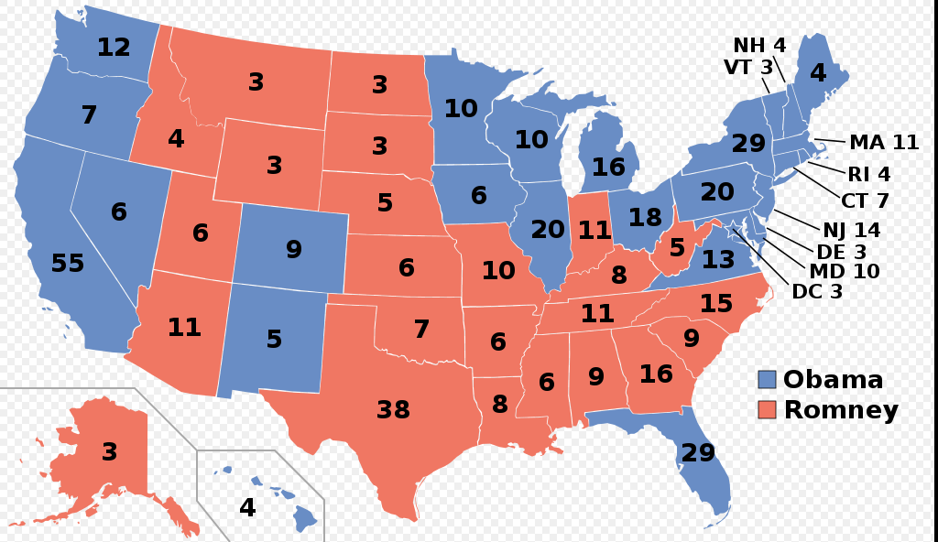
Electoral College 2012 vs. 2016

Slide 20
Battleground states: Lead by Winner
Close Clinton Victories | Lead | Close Trump Victories | Lead
Maine | 20,035 | Arizona | 84,904
Nevada | 26,434 | Florida | 119,770
Virginia | 185,689 | Iowa | 148,133
New Hampshire | 2,732 | Michigan | 11,612
Minnesota | 43,785 | Wisconsin | 27,257
Total | 278,675 | North Carolina | 176,529
 |  | Pennsylvania | 68,236
 |  | Total | 636,441
 |  | Trump lead | 357,766
Total difference: 0.29%

Slide 21
Rust-belt states

Slide 22
States with Biggest Decline in Clinton Votes: 2016-1996

Slide 23
Battleground States: Clinton underperforms

Slide 24
Clinton overperforms in CA, DC

Slide 25
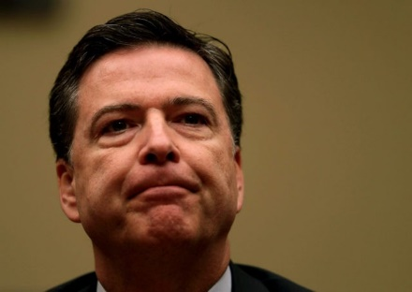
What explanations exist?
Clinton’s campaign has an answer: Jim Comey!
Other explanations:
Challenges with electorate esp. in certain areas
Third term – incumbent party fatigue
Tactical campaign mistakes
Message – campaign too focused on personality contrast not necessarily to Clinton’s favor
Messenger – both candidates had baggage; woman candidate breaks new ground
If the messenger was at least partly the problem, would Bernie Sanders have been more successful?

Slide 26
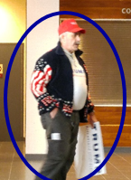
Why did she lose? Voters in certain areas wanted change
“Global forces that were driving a deep-seated anger at institutions the world over, and an angry alienated electorate at home that was frustrated with our political-economic system.” (Clinton post election analysis)
“There are many millions of people who did not vote for Donald Trump because of the bigotry and hate that fueled his campaign rallies. They voted for him out of frustration and anger – and also out of hope that he would bring change…” (Elizabeth Warren: Speech to AFL-CIO, Nov. 10, 2016

Slide 27
Voters were angry with the system! Bernie Sanders’ views…
“Donald J. Trump won the White House because his campaign rhetoric successfully tapped into a very real and justified anger, an anger that many traditional Democrats feel.
Millions of Americans registered a protest vote on Tuesday, expressing their fierce opposition to an economic and political system that puts wealthy and corporate interests over their own.
It is no shock to me that millions of people who voted for Mr. Trump did so because they are sick and tired of the economic, political and media status quo.”

Slide 28
Why was there a desire for change?
Economic recovery left some people and areas behind
Less educated
Areas with smaller populations
Different effects of the economy created fundamental differences in perceptions among different social groups

Slide 29
Langer Research Associates: AAPOR 2016

Slide 30
U6 Rate
Percent unemployed or marginally attached
Bureau of Labor Statistics

Slide 31
Long-term Unemployment
Percentage of those unemployed for 27 weeks or more
Bureau of Labor Statistics

Slide 32
Educated Minority of Population Captures Economic Gains
Median weekly earnings
1979-2014
Bureau of Labor Statistics
No Bachelor’s degree
Bachelor’s degree and higher
68% of U.S. population >25
-9.1%
+22.6%
http://www.census.gov/content/dam/Census/library/publications/2016/demo/p20-578.pdf and Langer Associates/AAPOR.

Slide 33
Erosion of Non-metro Areas

Slide 34
How groups voted – exit polls
Dislike Federal government, Obamacare
Desire for change, key issue
Race/gender
Education level and income
Age
Marital status and gender

Slide 35
Clinton Vote by Crim Justice, Obamacare, Fed. Govt, More Govt. (Exit Polls)
Angry voters favored Trump
All exit polls: http://www.cnn.com/election/results/exit-polls

Slide 36
Clinton Vote by Candidate Qualities and Most Important Issued (Exit polls)
But favored Clinton on economy
Plurality wanted change

Slide 37
Factors Influencing Vote (CSLI Fall 2016 survey)

Slide 38
Trump Voters with More Negative Perceptions of County, State, National Economies (CSLI Fall 2016 Survey)

Slide 39
Trump Voters Perceive More Economic Problems (CSLI Fall 2016 Survey)
Condition | Clinton | Trump | Trump -Clinton
Taxes are too high in relation to the govt. services provided | 43 | 79 | 36
Wages or salaries are not rising as fast as the cost of living | 52 | 61 | 9
Hard to afford the cost of education | 34 | 40 | 6
Unable to afford healthcare or medicine during the last year | 8 | 20 | 12
Received a salary increase or other increase in income recently | 31 | 27 | -4
Hard to afford the cost of food and groceries | 26 | 32 | 6
Found a new or better job recently | 9 | 6 | -3
Facing the possibility of unemployment | 12 | 12 | 0

Slide 40
Clinton Vote by Union, 1st Time Voter, Veteran (Exit polls)
Weak Clinton support among union HHs (below expectations) and veterans

Slide 41
Clinton Vote by Race and Gender (Exit polls)
Sharp distinctions by race/gender

Slide 42
Clinton Vote by Education and Income (Exit polls)

Slide 43
Clinton Vote by Age (Exit polls)
Clinton vote decreases with age – are older voters those left behind in new economy or nostalgic for “good old days?”

Slide 44
Clinton Vote by Marital Status and Gender (Exit polls)
Marital status clearly differentiates voter preferences: unmarried voters more likely to back Clinton

Slide 45
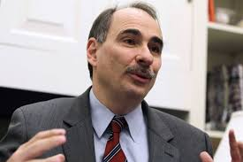
Why did she lose?
Third term fatigue – need compelling defense of the Obama record to convince voters to stick with incumbent party…
David Axelrod:
“There was an assumption that antipathy toward Trump would be enough to mobilize the base. [But this wasn’t true due to] a certain lethargy that sets in when you’ve had the White House for 8 years. Your troops just aren’t as hungry.”

Slide 46
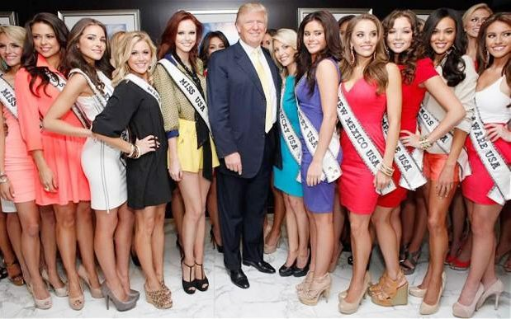
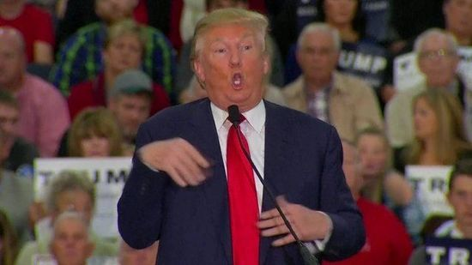
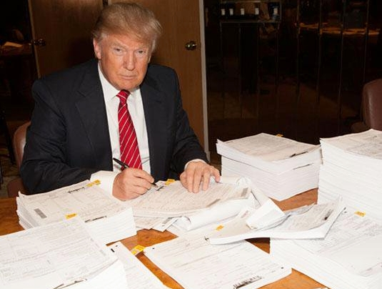
Why did she lose?
Message and campaign strategic mistakes
One dimensional campaign strategy: Attack Trump as an individual –
Temperament,
Inexperience,
Racist, misogynist,
Fomenter of Islamophobia, anti-immgrant
Poor business practices, bankruptcies,
Bully - too politically incorrect…
Research showed this to be his weak point…

Slide 47
Why did she lose?
Message and campaign strategic mistakes
One dimensional campaign strategy: Neglected evidence for broad change – angry “forgotten” electorate – Sanders’ win in Michigan
Lack of enthusiasm for Clinton – not enough disliking Trump
Lack of policy focus in general election meant “issues voters” felt neglected
Example: Clinton didn’t adapt her message to Rust Belt:
Wisconsin ads focused on Trump mocking disabled reporter, fears of war with Trump as president…
Where was the defense of Obama’s record?
Economic recovery, saving auto industry, low interest rates/inflation, 20 million with health insurance, avoiding war in the Middle East, Iran nuclear deal, climate change agreement, improved relations with Cuba, no scandals!

Slide 48
Most important reason shaping choice – CSLI Fall 2016 survey
Positive Reasons for Support | Clinton | Trump | Overall
Experienced | 18 | 1 | 9
Qualified | 15 | 1 | 8
Outsider, change | 0 | 10 | 5
Leadership | 1 | 8 | 4
Temperament, frank, stable | 6 | 3 | 4
Trusted | 1 | 4 | 2
Total | 41 | 27 | 33
Negative Reasons for Support | Clinton | Trump | Overall
Lesser evil | 16 | 8 | 13
Dislike Trump | 15 | 1 | 7
Dislike Clinton | 0 | 13 | 6
Both bad | 1 | 0 | 5
HC lies, crooked | 0 | 10 | 4
Trump crazy, idiot | 8 | 0 | 4
Not qualified DT | 3 | 0 | 2
Not qualified HC | 0 | 2 | 1
Total | 43 | 34 | 42
Clinton prevails on character which is mentioned by ¾ of all respondents
Policy/Vision Reasons for Support | Clinton | Trump | Overall
Vision/plans | 8 | 8 | 7
Foreign policy, national security, military | 3 | 6 | 4
Economy | 1 | 7 | 3
Immigration | 1 | 6 | 3
Govt like business/less govt. | 0 | 3 | 2
Social issues | 2 | 0 | 1
Taxes | 0 | 2 | 1
Law and order | 0 | 2 | 1
Supreme Court | 0 | 2 | 1
Total | 16 | 36 | 23
Trump prevails on policy and vision

Slide 49
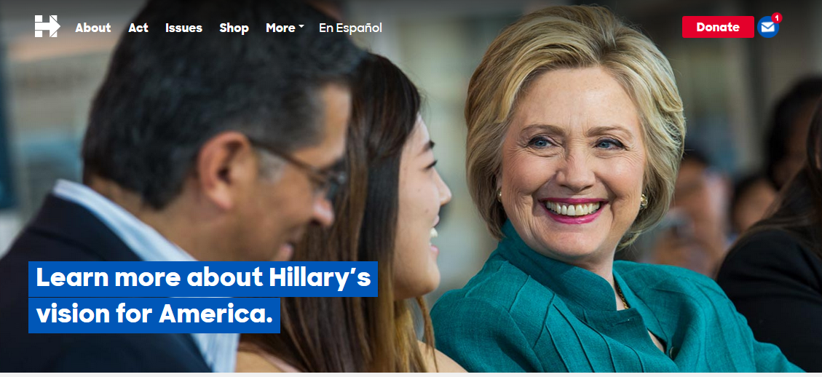
Why did she lose?
Was the message actually out of touch?…
HRC did say to “build an economy that works for everyone, not just those at the top.”
College tuition
Minimum wage
Men/women equal pay
Paid family leave
Why didn’t it work?
Lacked emotional connection…
Too complicated – too many issues
Not thematically linked – “stronger together?”
Overwhelmed by personality clashes
Not a credible messenger

Slide 50
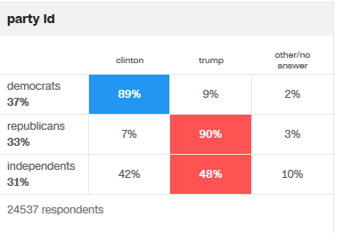
Why did she lose?
More strategic and tactical mistakes
Wasted resources in unnecessary states
Arizona – support woman Senate candidate against McCain
Time and $ better used in PA, MI, WI
Didn’t visit WI once during entire campaign
Another failure of research/polling unable to anticipate electorate’s mood
Wasted time targeting ads to Republicans – hoping for defections
Exit polls show she needed to worry more about Dems than Reps…

Slide 51
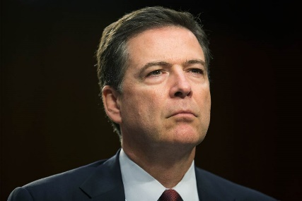
Why did she lose?
Comey and those damn emails…
Comey’s letter to Congress – how hard was the hit?
“It affected us a couple of ways. First it blocked out the sun. We really weren’t able to break through for a couple of days.” In addition, “it added to doubts about the ticket…” (Clinton post-election analysis)
Dampened enthusiasm generally, Clinton supporters prevalent in early voting, but decline on election day
Hardest hit: suburban, college-educated voters, late deciders (47% vs. 42% favoring Trump)
Effect greatest in battleground states with lots of undecided and last minute deciders
Why did it have to come down to this?

Slide 52
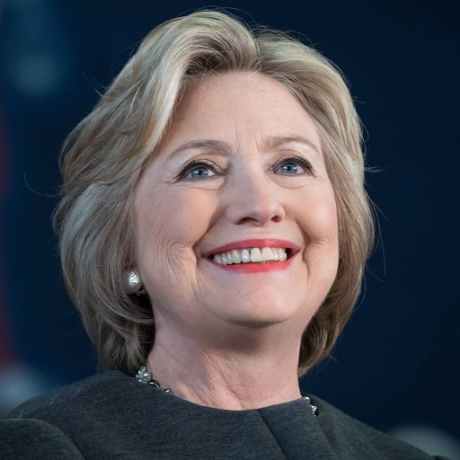
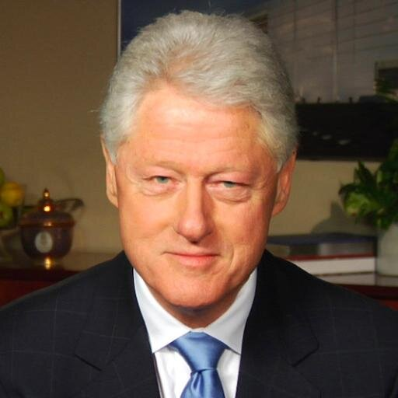
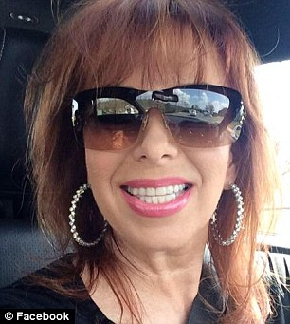
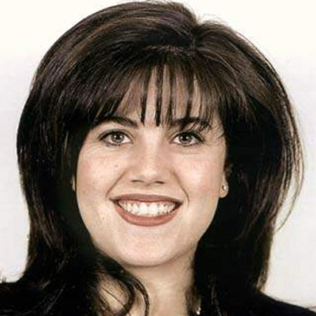
Why did she lose?
Flawed messenger hypothesis
Polls show Clinton wasn’t trusted - why?
Emails – poor judgment in official capacity
Benghazi – effectiveness as Sect. of State
Prospect of dynasty in a change election,
Elitism - Goldman speeches – not from Arkansas anymore
Clinton Foundation – pay to play? Road to riches?
Political opportunism – attached to Bill to ascend politically
What impact did Bill Clinton have on issues of inappropriate behavior toward women?

Slide 53
Why did he win? – Trump’s Victory In the Words of AACC Students
“It's so amazing how simple it actually is to be qualified for the presidency. I mean, take the election we just had, our new President-elect is a business man with no political background whatsoever.
This could actually be an asset for the American people in a way, taking one of us, people who are not involved in politics, and really diving into this political mess with an objective view to really see what needs to be fixed.
For so long, people have been elected from within the political family and often, the American people suffer and the government gets stronger. It makes us as American people wonder where we went wrong.”

Slide 54
Why did he win? – In the words of students – a “change” election
“I think his vote was based on the fact that he didn't have any political experience. A lot of Americans are tired of the political corruption within the government and they want someone who has no ties to any politics or political corruption.”
“I think it's a set of fresh eyes looking at America’s problems and I think it can be very beneficial for us now and in the future!”
I think his inexperience could also be an asset in giving a new point of view and with a background in business I believe this could be beneficial to us as Americans.

Slide 55
Why did he win? – In the words of students – a “change” election
“Politicians have been making promises to working class citizens for years and have not come through.”
“Also a lot of things have been promised to areas where there were big losses in the amount of jobs due to companies moving overseas that have never been fulfilled. So most of these working people were thinking that a change was needed.”

Slide 56
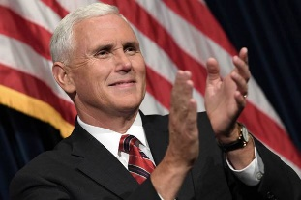
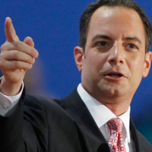
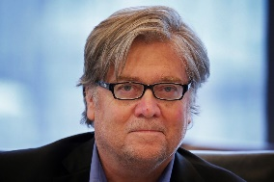
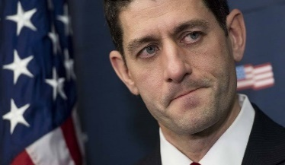
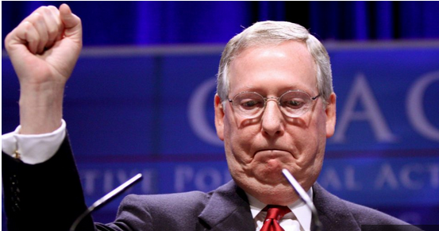
Can Trump sustain his message?
Fresh face – early evidence
Transition team – full of lobbyists and insiders
Mike Pence – longtime politician, insider
Chief of staff – RNC chair (Reince Preibus)
Steve Bannon – Breibart.com head now “chief strategist”
Mike Flynn/Jeff Sessions/Mike Pompeo – all focus on identity politics and immigration
Paul Ryan/Mitch McConnell – never bought into Trump’s economic and foreign policy message
4 elements fight for prominence within Republican Party

Slide 57
President Trump and Republicans
TRUMP and Reps.
Foreign Policy Hawks
*Project US power
*Trade policy as leverage
*Big military
*More aggressive stance
Forgotten people/Populist
*Immigration
*Law/Order
*Jobs/Industry
*Infrastructure
*Inequality
*Trade tariffs
Conservative ideologues
* Small govt.
*Constitutionalists
*End Obamacare
*Fiscal hawks
*Isolationists?
Big Business
*Low taxes
*Fewer regulations
*Free trade
*Less welfare/no min. wage
Can Democrats find some common causes with populists?

Slide 58
Trump’s Populism and Democrats
Trump Populists and Dems
Infrastructure *$Trillion program *Deficit spending
Middle East/ neo-isolationism
*Avoid combat
*Work with Russians in Syria
*Favor Israel?
Welfare/ inequality *Carried interest/hedge fund *Paid maternity leave
*Pay inequality *Minimum wage
*Limit Obamacare changes
Trade/China *Offshoring
*Free trade agreements
Liberal opposition
*Climate/environ.
*Racial issues/Bigotry/Women
*Immigration
*Taxes
*Guns
*Abortion
*Supreme Ct.

Slide 59
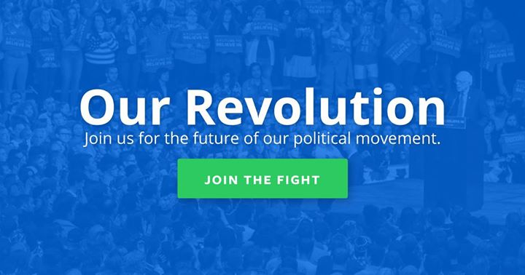
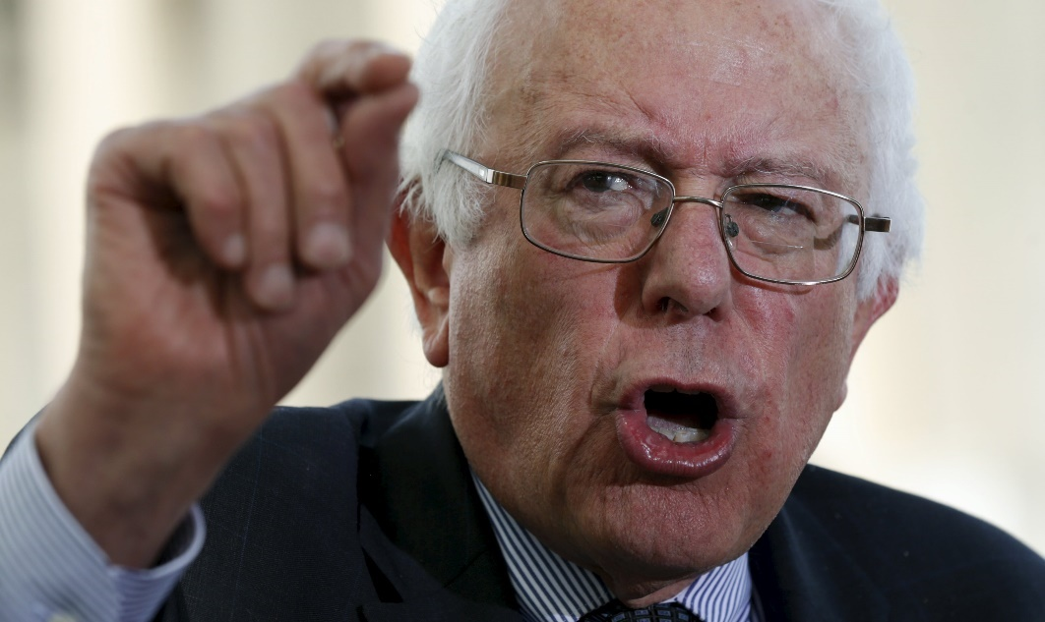
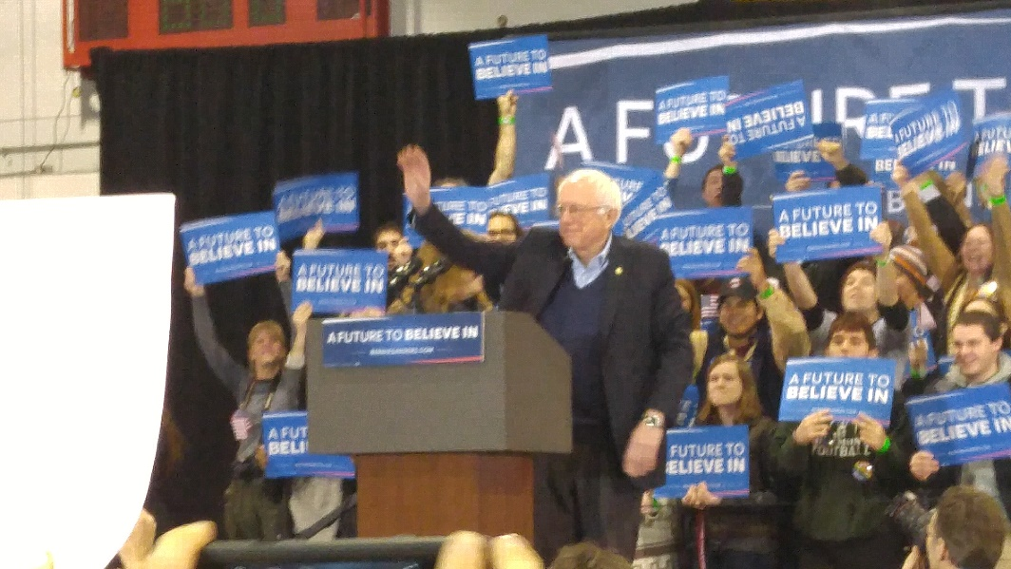
Would Bernie Sanders as the Democratic candidate have been more successful?

Slide 60
Sanders – would this change message have worked?
“Working families watch as politicians get campaign financial support from billionaires and corporate interests — and then ignore the needs of ordinary Americans. Over the last 30 years, too many Americans were sold out by their corporate bosses. They work longer hours for lower wages as they see decent paying jobs go to China, Mexico or some other low-wage country. They are tired of having chief executives make 300 times what they do, while 52 percent of all new income goes to the top 1 percent. Many of their once beautiful rural towns have depopulated, their downtown stores are shuttered, and their kids are leaving home because there are no jobs — all while corporations suck the wealth out of their communities and stuff them into offshore accounts.”

Slide 61
Sanders’ Beats Clinton in Key Rust Belt States during Primaries

Slide 62
Would Bernie Sanders Have Won?
 | Yes | No
Message and Mood of the Electorate | Had an “angry voter” message – “eat the rich/inequality” “rigged system” “I voted against Iraq” “I didn’t give high paid speeches to Goldman-Sachs” “not part of the establishment!” | Ultimately had “inclusiveness” theme like Clinton: Racial justice, environmental justice, social justice, economic justice… Would this have been enough in Wis/Mich/PA?
Campaign focus | Focused on key policies, not personality – easily recognizable, gave voters a clear choice | Would he have been tempted to taking advantage of Trump’s personal foibles – lost message? Was his message “too Left” for America?
Campaign financing | Relied on mass mobilization – not big money and media sympathy | Would he keep pledge not to use Super PACs in the general election? He couldn’t self-finance…
Personal characteristics | Modest lifestyle – no social climbing, not ethically challenged, no womanizing, message fit messenger | Was he too old? Too “left?” Too secular/Jewish? Lacking in ties to minorities? Would the Obama coalition been motivated?

