Slide 1
District 32 Republican Club Presentation
August 2, 2016
Dan Nataf, Ph.D.
Director, Center for the Study of Local Issues
Anne Arundel Community College
www2.aacc.edu/csli

Slide 2
Focus on 2016 Presidential Election
Current State of the Race
Recent polling
General attitudes shaping voting choices
Issues associated with candidates
Traits associated with candidates
Sources: CSLI survey, NY Times, YouGov, Realclearpolitics.com, transcripts of nominating speeches

Slide 3
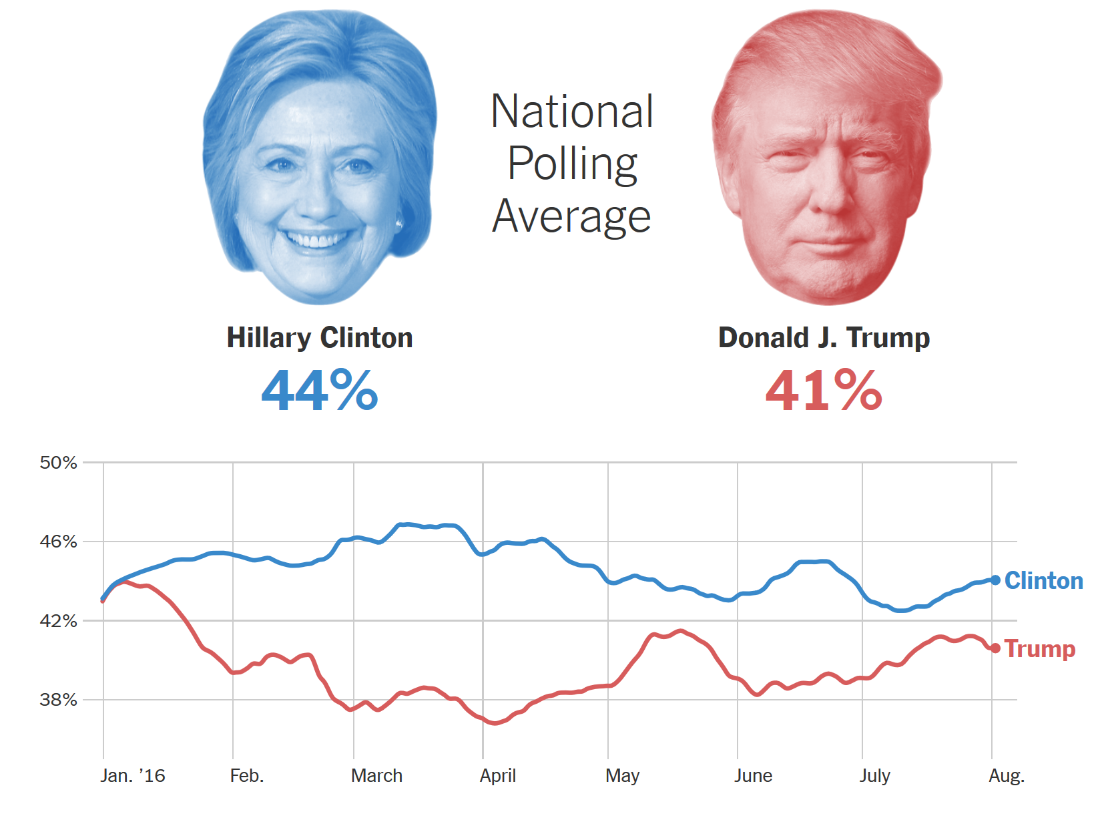
Hypothetical Trump vs. Clinton Match-up – NY TIMES
Source: NY Times, 8-2-16 http://www.nytimes.com/interactive/2016/us/elections/polls.html?_r=0

Slide 4
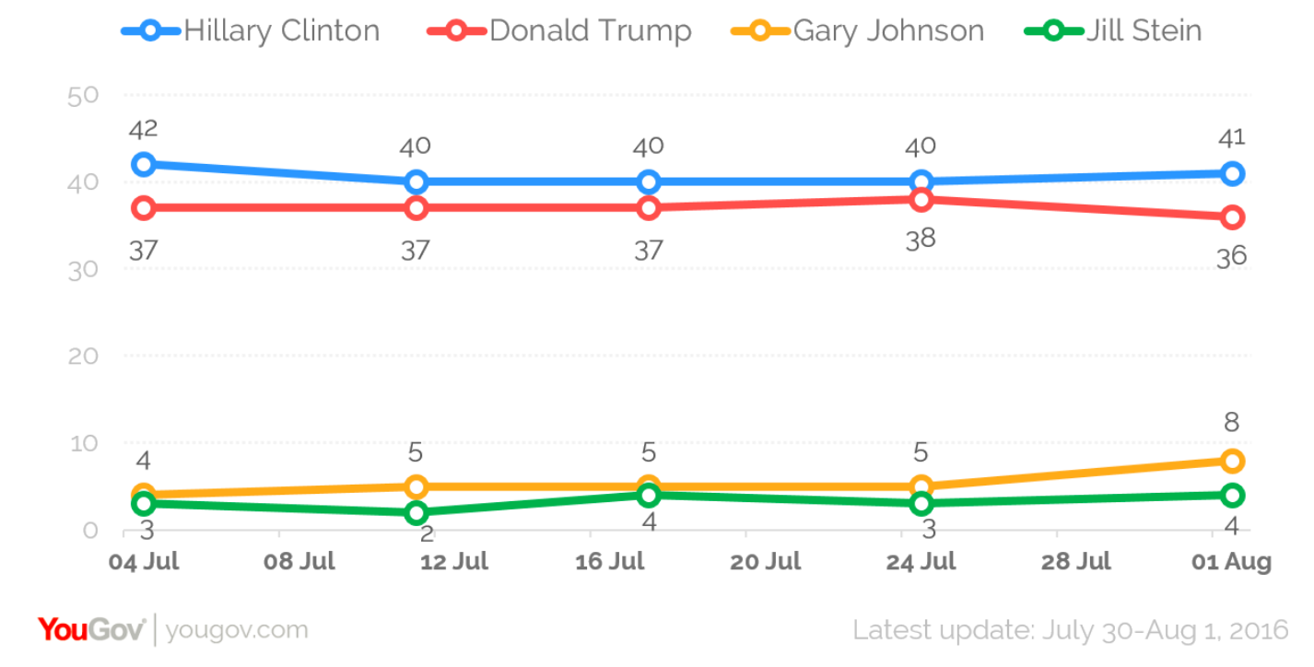
Hypothetical Trump vs. Clinton Match-up - YouGov
Source: YouGov, 8-2-16 https://today.yougov.com/news/2016/08/01/yougoveconomist-poll-july-30-august-1-2016/

Slide 5
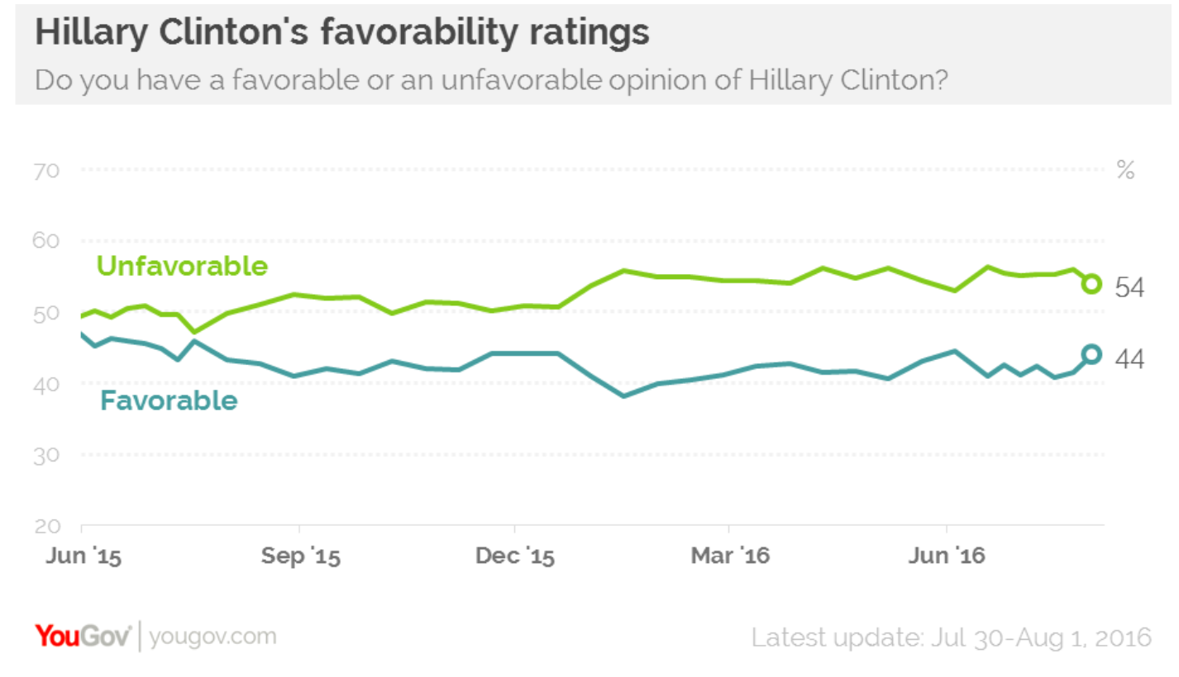
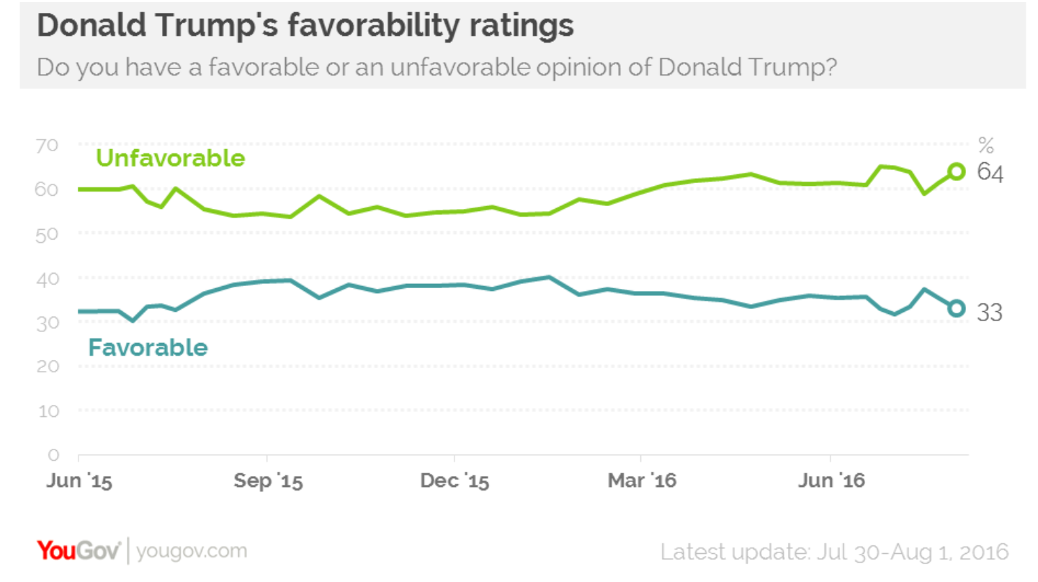
Trump vs. Clinton Favorability Match-up
Source: YouGov, 8-2-16 https://today.yougov.com/news/2016/08/01/yougoveconomist-poll-july-30-august-1-2016/

Slide 6
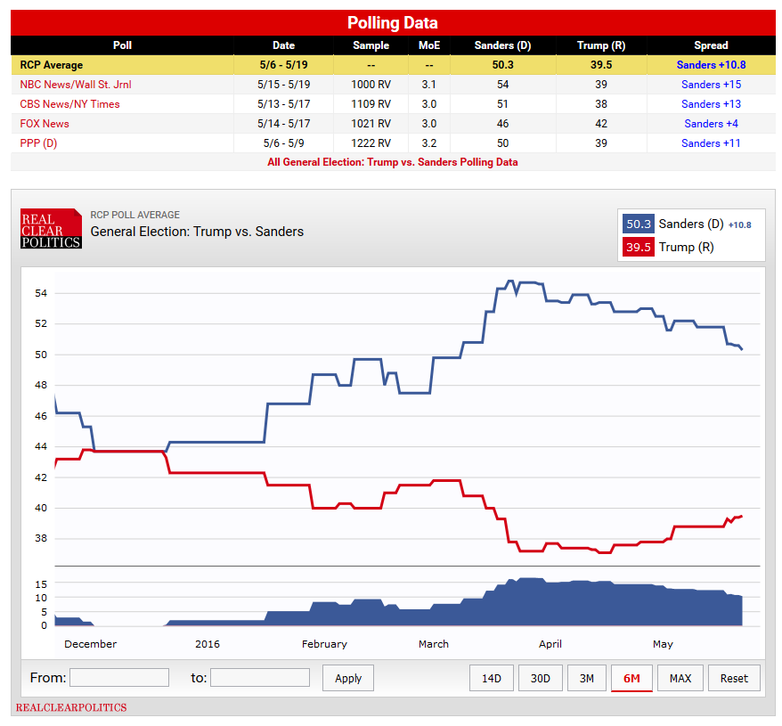
Hypothetical Trump vs. Sanders Match-up

Slide 7
Favorability of Others - YouGov
Individual | Favor | Disfavor | No opinion | Favor-Disfavor
Tim Kaine | 37 | 32 | 31 | +5
Mike Pence | 29 | 38 | 30 | -9
Bernie Sanders | 61 | 31 | 8 | +30
Hillary Clinton | 44 | 54 | 2 | -10
Donald Trump | 33 | 59 | 3 | -26
Barack Obama | 53 | 45 | 2 | +8

Slide 8
Voting Intentions of NON Clinton/Trump Primary - YouGov
Candidate | Dem Primary Sanders | Rep Primary Not Trump
Clinton | 49 | 17
Trump | 9 | 52
Johnson (Lib.) | 11 | 17
Stein (Green) | 19 | 1
Other | 5 | 4
Unsure/won’t vote | 7 | 9
28
18

Slide 9
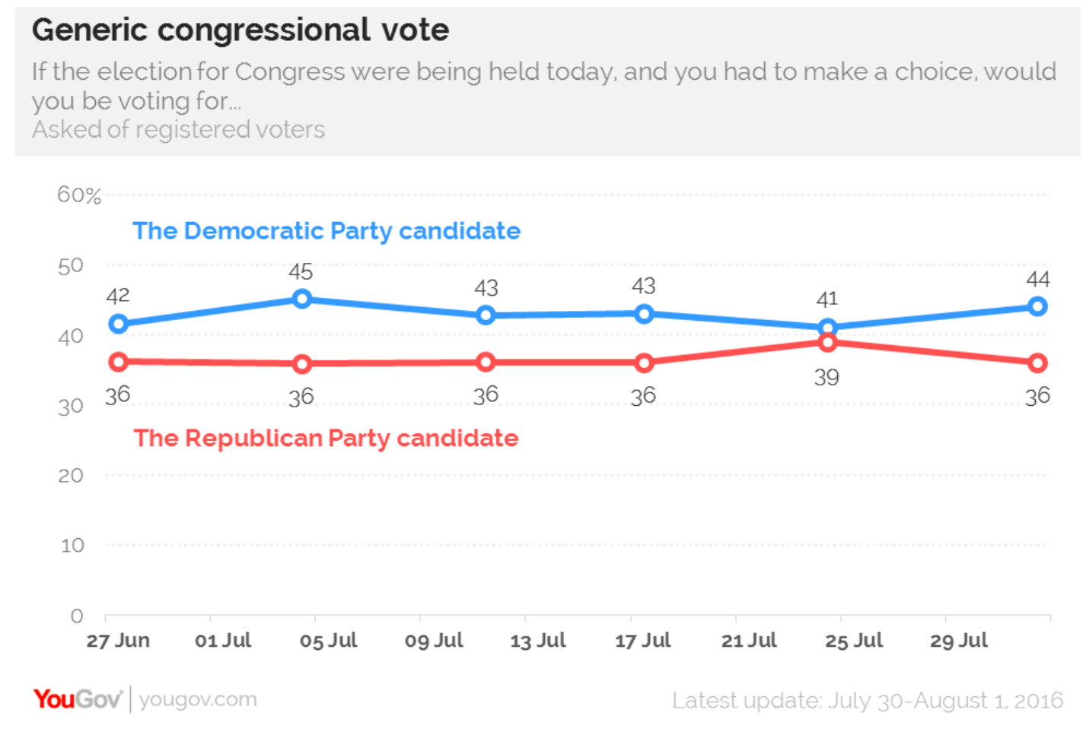
Generic Congressional Vote
Source: YouGov, 8-2-16 https://today.yougov.com/news/2016/08/01/yougoveconomist-poll-july-30-august-1-2016/

Slide 10
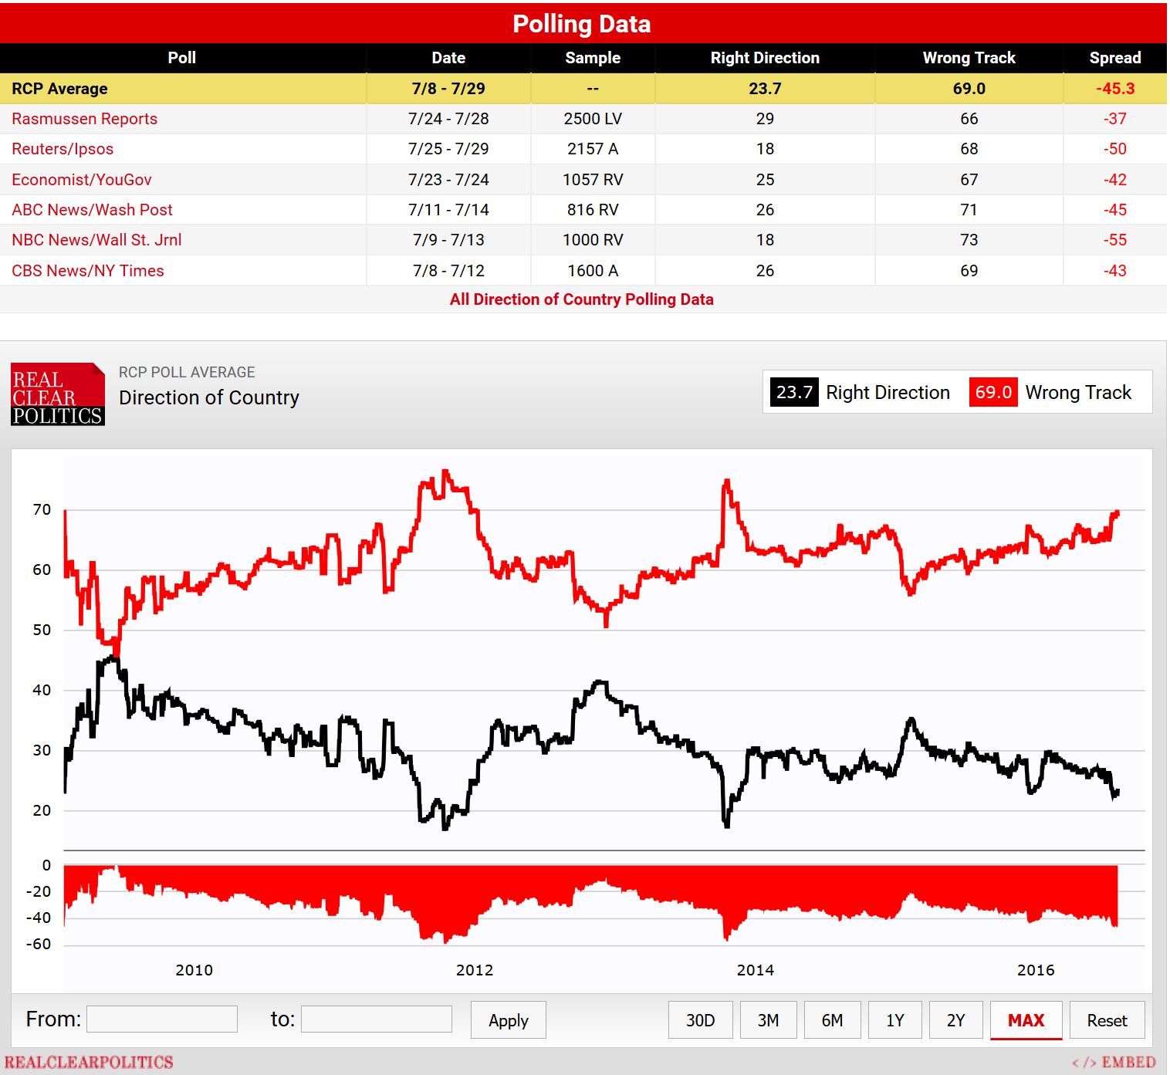
Right/Wrong Direction – National Polls ‘16

Slide 11
Right/Wrong Direction: County, State, Nation - Fall ‘12 to Spring ‘16
70
60
58
55
50
50
49
50
50
49
51
52
47
40
36
35
35
31
30
27
27
27
20
24
23
21
21
10
10
0
Fall '12
Spring '13
Fall '13
Spring '14
Fall '14
Spring '15
Fall '15
Spring '16
Nation
State
County
State direction | Hogan Approve | Hogan Disapprove
Right | 58 | 28
Wrong | 25 | 61
Unsure | 17 | 11
Total | 100 | 100
Nation direction | Obama Approve | Obama Disapprove
Right | 43 | 3
Wrong | 39 | 91
Unsure | 18 | 6
Total | 100 | 100

Slide 12
Better off Now vs. 8 Years Ago - YouGov
 | Clinton | Trump | Others
Better off now | 52 | 12 | 35
Better off 8 yrs. ago | 17 | 58 | 32
No difference | 28 | 23 | 29
Unsure | 3 | 8 | 4
Trump: “Household incomes are down more than $4,000 since the year 2000.” “President Obama has almost doubled our national debt to more than $19 trillion, and growing. And yet, what do we have to show for it? Our roads and bridges are falling apart, our airports are Third World condition, and 43 million Americans are on food stamps.”
Clinton: “I don't think President Obama and Vice President Biden get the credit they deserve for saving us from the worst economic crisis of our lifetimes. Our economy is so much stronger than when they took office. Nearly 15 million new private-sector jobs. Twenty million more Americans with health insurance. And an auto industry that just had its best year ever. Now that's real progress but none of us can be satisfied with the status quo.

Slide 13
US More Respected Compared to 8 Yrs. Ago?
 | Clinton | Trump | Others
More | 45 | 2 | 14
Less | 25 | 94 | 73
No difference | 22 | 2 | 10
Unsure | 8 | 2 | 3
Trump: “…our plan will put America first. Americanism, not globalism, will be our credo. As long as we are led by politicians who will not put America first, then we can be assured that other nations will not treat America with respect. The respect that we deserve.”
Clinton: “But just look for a minute at the strengths we bring as Americans to meet these challenges. We have the most dynamic and diverse people in the world. We have the most tolerant and generous young people we've ever had. We have the most powerful military. The most innovative entrepreneurs. The most enduring values — freedom and equality, justice and opportunity. We should be so proud that these words are associated with us. I have to tell you, as your Secretary of State, I went to 112 countries, and when people hear those words, they hear America.

Slide 14
How Important will inequality be as an issue in your vote for president this year?
 | Clinton | Sanders | Trump | Others
Very important | 65 | 69 | 19 | 34
Somewhat important | 29 | 22 | 27 | 19
Not very important | 4 | 4 | 28 | 27
Not at all important | 2 | 4 | 25 | 20
I don’t plan to vote | 0 | 0 | 0 | 0
Unsure | 0 | 0 | 1 | 0
Clinton: “A country where the economy works for everyone, not just those at the top…all children can dream…” “Wall Street, corporations, the super rich are going to start paying their fair share, because when 90% of the gains have gone to the top 1%, that’s where the money is…”
Trump: “Nearly 4 in 10 African American children are living in poverty, while 58% of African American youth are now not employed.”

Slide 15
How Important will Minimum Wage be as an issue in your vote for president this year?
 | Clinton | Trump | Others
Very important | 59 | 19 | 27
Somewhat important | 28 | 25 | 30
Not very important | 9 | 33 | 33
Not at all important | 3 | 9 | 9
I don’t plan to vote | 0 | 0 | 0
Unsure | 1 | 0 | 0
Trump: Not mentioned.
Clinton: “If you believe that companies should share profits, not pad executive bonuses, join us. If you believe the minimum wage should be a living wage… and no one working full time should have to raise their children in poverty, join us.”

Slide 16
How Important will healthcare be as an issue in your vote for president this year?
 | Clinton | Trump | Others
Very important | 78 | 65 | 62
Somewhat important | 15 | 25 | 29
Not very important | 4 | 9 | 8
Not at all important | 2 | 1 | 0
I don’t plan to vote | 0 | 0 | 0
Unsure | 1 | 0 | 0
Trump: “We will repeal and replace disastrous Obamacare. You will be able to choose your own doctor again.”
Clinton: “If you believe that every man, woman, and child in America has the right to affordable health care, join us.”

Slide 17
How Important will college tuition be as an issue in your vote for president this year?
 | Clinton | Sanders | Trump | Others
Very important | 45 | 52 | 10 | 31
Somewhat important | 34 | 37 | 27 | 28
Not very important | 12 | 8 | 32 | 18
Not at all important | 8 | 3 | 31 | 20
I don’t plan to vote | 0 | 0 | 0 | 1
Unsure | 2 | 0 | 0 | 2
Clinton: “Bernie Sanders and I will work together to make college tuition free for the middle class and debt free for all…” She mentions schools: “Where you can get a good job and send your kids to a good school, no matter what ZIP code you live in.”
Trump: Doesn’t say much about this or education in general. He does say,” We will rescue kids from failing schools by helping their parents send them to a safe school of their choice.” “We're going to work with all of our students who are drowning in debt to take the pressure off these people just starting out in their adult lives. Tremendous problem.”

Slide 18
How Important will Social Security be as an issue in your vote for president this year?
 | Clinton | Trump | Others
Very important | 71 | 69 | 55
Somewhat important | 17 | 24 | 32
Not very important | 8 | 5 | 10
Not at all important | 2 | 2 | 3
I don’t plan to vote | 0 | 0 | 0
Unsure | 2 | 0 | 0
Trump: Not mentioned.
Clinton: “If you believe we should expand Social Security…join us.”

Slide 19
How important will money in politics be as an issue in your vote for president this year?
 | Clinton | Sanders | Trump | Others
Very important | 53 | 65 | 39 | 52
Somewhat important | 30 | 25 | 35 | 33
Not very important | 11 | 6 | 16 | 10
Not at all important | 3 | 1 | 8 | 4
I don’t plan to vote | 1 | 2 | 1 | 1
Unsure | 2 | 1 | 2 | 1
Clinton: “Our economy isn’t working the way it should because our democracy isn’t working the way it should…” “That's why we need to appoint Supreme Court justices who will get money out of politics and expand voting rights,
not restrict them. And if necessary we will pass a constitutional amendment to overturn Citizens United.
Trump: “Big business, elite media and major donors are lining up behind the campaign of my opponent because they know she will keep our rigged system in place. They are throwing money at her because they have total control
over every single thing she does…”

Slide 20
How Important will Wall St. reform be as an issue in your vote for president this year?
 | Clinton | Sanders | Trump | Others
Very important | 52 | 67 | 26 | 32
Somewhat important | 32 | 23 | 40 | 41
Not very important | 9 | 7 | 22 | 20
Not at all important | 3 | 2 | 10 | 4
I don’t plan to vote | 2 | 0 | 0 | 0
Unsure | 3 | 1 | 2 | 1
Trump: Not mentioned.
Clinton: “I believe American corporations that have gotten so much from our country should be just as patriotic in return. Many of them are. But too many aren't. It's wrong to take tax breaks with one hand and give out pink slips with the other. And I believe Wall Street can never, ever be allowed to wreck Main Street again.”

Slide 21
How important will job creation be as an issue in your vote for president this year?
 | Clinton | Trump | Others
Very important | 71 | 69 | 66
Somewhat important | 25 | 27 | 27
Not very important | 3 | 3 | 4
Not at all important | 1 | 0 | 2
I don’t plan to vote | 0 | 0 | 1
Unsure | 0 | 1 | 0
Trump: “I have proposed the largest tax reduction of any candidate who has run for president this year…Reducing taxes will cause new companies and new jobs to come roaring back into our country. Believe me, it'll happen and it'll happen fast. Then we are going to deal with the issue of regulation, one of the greatest job-killers of them all.”
Clinton: “We will give small businesses, like my dad’s, a boost, make it easier to get credit.” “In my first 100 days, we will work with both parties to pass the biggest investment in new, good-paying jobs since World War II. Jobs in manufacturing, clean energy, technology and innovation, small business, and infrastructure. If we invest in infrastructure now, we'll not only create jobs today, but lay the foundation for the jobs of the future. And we will also transform the way we prepare our young people for those jobs.”

Slide 22
How Important will taxes be as an issue in your vote for president this year?
 | Clinton | Trump | Others
Very important | 54 | 65 | 60
Somewhat important | 36 | 29 | 36
Not very important | 7 | 4 | 3
Not at all important | 2 | 2 | 0
I don’t plan to vote | 0 | 0 | 0
Unsure | 2 | 1 | 0
Trump: “America is one of the highest-taxed nations in the world.” (See his comments under “job creation” where he promises a huge tax reduction)
Clinton: “Wall Street, corporations, and the super-rich are going to start paying their fair share of taxes.”

Slide 23
How Important will free trade agreements be as an issue in your vote for president this year?
 | Clinton | Sanders | Trump | Others
Very important | 31 | 41 | 43 | 34
Somewhat important | 47 | 34 | 37 | 46
Not very important | 11 | 16 | 13 | 14
Not at all important | 6 | 4 | 2 | 2
I don’t plan to vote | 0 | 0 | 0 | 0
Unsure | 5 | 4 | 4 | 4
Trump: “…we will fix his (Bernie Sanders’) biggest issue: trade deals that strip our country of its jobs and strip us of our wealth as a country. Millions of Democrats will join our movement too because we are going to fix the system so it works fairly and justly for each and every American.”
Clinton: “If you believe that we should say “no” to unfair trade deals, that we should stand up to China, that we should support our steelworkers and autoworkers and homegrown manufacturers then join us.”

Slide 24
How Important will national security be as an issue in your vote for president this year?
 | Clinton | Trump | Others
Very important | 69 | 88 | 66
Somewhat important | 24 | 10 | 24
Not very important | 4 | 2 | 7
Not at all important | 2 | 0 | 2
I don’t plan to vote | 0 | 0 | 0
Unsure | 1 | 0 | 0
Trump: “Not only have our citizens endured domestic disaster, but they've lived through one international humiliation after another… We all remember the images of our sailors being forced to their knees by their Iranian captors at gunpoint…the signing of the Iran deal, which gave back to Iran $150 billion and gave us absolutely nothing.” “In Libya, our consulate – the symbol of American prestige around the globe – was brought down in flames. America is far less safe – and the world is far less stable – than when Obama made the decision to put Hillary Clinton in charge of America’s foreign policy.”
Clinton: “I'm proud that we put a lid on Iran's nuclear program without firing a single shot – now we have to enforce it, and we must keep supporting Israel's security.” “I'm proud to stand by our allies in NATO against any threat they face, including from Russia.” “I've laid out my strategy for defeating ISIS. We will strike their sanctuaries from the air, and support local forces taking them out on the ground. We will surge our intelligence so that we detect and prevent attacks before they happen. We will disrupt their efforts online to reach and radicalize young people in our country.” “Do you really think Donald Trump has the temperament to be commander-in-chief? “

Slide 25
How Important will fighting terrorism be as an issue in your vote for president this year?
 | Clinton | Trump | Others
Very important | 66 | 88 | 62
Somewhat important | 25 | 9 | 23
Not very important | 5 | 2 | 11
Not at all important | 3 | 0 | 3
I don’t plan to vote | 1 | 0 | 0
Unsure | 0 | 0 | 1
Trump: “The attacks on our police, and the terrorism in our cities, threaten our very way of life. Any politician who does not grasp this danger is not fit to lead our country.” “The American people will come first once again. My plan will begin with safety at home – which means safe neighborhoods, secure borders and protection from terrorism.” “To make life safe for all of our citizens, we must also address the growing threats we face from outside America. We are going to defeat the barbarians of ISIS and we're going to defeat them fast. Once again, France is the victim of brutal Islamic terrorism.”
Clinton: “We will not ban a religion. We will work with all Americans and our allies to fight and defeat terrorism.”

Slide 26
How Important will law and order be as an issue in your vote for president this year?
 | Clinton | Trump | Others
Very important | 52 | 74 | 51
Somewhat important | 34 | 23 | 38
Not very important | 10 | 2 | 8
Not at all important | 3 | 1 | 2
I don’t plan to vote | 1 | 0 | 0
Unsure | 1 | 0 | 1
 | White | A-Am | Hispanic
Very important | 57 | 68 | 62
Somewhat important | 31 | 28 | 11
Not very important | 9 | 1 | 7
Not at all important | 2 | 1 | 4
I don’t plan to vote | 0 | 1 | 11
Unsure | 1 | 0 | 5
Trump: “…we have seen continued threats and violence against our law enforcement officials.” “I have a message to every last person threatening the peace on our streets and the safety of our police: When I take the oath of office next year, I will restore law and order to our country.” “I will work with, and appoint, the best and brightest prosecutors and law enforcement officials in the country to get the job properly done. In this race for the White House, I am the law-and-order candidate.”
Clinton: “We will reform our criminal justice system from end-to-end, and rebuild trust between law enforcement and the communities they serve.”

Slide 27
How important will police brutality be as an issue in your vote for president this year?
 | Clinton | Trump | Others
Very important | 61 | 24 | 41
Somewhat important | 25 | 29 | 31
Not very important | 11 | 25 | 16
Not at all important | 2 | 21 | 12
I don’t plan to vote | 0 | 0 | 0
Unsure | 0 | 1 | 0
 | White | A-Am | Hispanic
Very important | 37 | 77 | 49
Somewhat important | 30 | 15 | 20
Not very important | 19 | 6 | 15
Not at all important | 12 | 0 | 2
I don’t plan to vote | 0 | 1 | 8
Unsure | 0 | 1 | 5
Trump: No comments about police brutality.
Clinton: “…let's put ourselves in the shoes of young black and Latino men and women who face the effects of systemic racism, and are made to feel like their lives are disposable.”

Slide 28
How important will gun control be as an issue in your vote for president this year?
 | Clinton | Trump | Others
Very important | 73 | 46 | 47
Somewhat important | 19 | 16 | 34
Not very important | 4 | 18 | 8
Not at all important | 2 | 18 | 11
I don’t plan to vote | 0 | 0 | 0
Unsure | 1 | 1 | 0
Trump: “My opponent wants to essentially abolish the 2nd Amendment. I, on the other hand, received the early and strong endorsement of the National Rifle Assn. and will protect the right of all Americans to keep their families safe.”
Clinton: “I'm not here to repeal the 2nd Amendment. I'm not here to take away your guns. I just don't want you to be shot by someone who shouldn't have a gun in the first place. We will work tirelessly with responsible gun owners to pass common-sense reforms and keep guns out of the hands of criminals, terrorists and all others who would do us harm.”

Slide 29
How Important will immigration reform be as an issue in your vote for president this year?
 | Clinton | Trump | Others
Very important | 49 | 77 | 53
Somewhat important | 37 | 15 | 30
Not very important | 10 | 3 | 17
Not at all important | 2 | 4 | 0
I don’t plan to vote | 0 | 0 | 0
Unsure | 1 | 1 | 0
Trump: “We must immediately suspend immigration from any nation that has been compromised by terrorism until such time as proven vetting mechanisms have been put in place.” “Decades of record immigration have produced lower wages and higher unemployment for our citizens, especially for African American and Latino workers. We are going to have an immigration system that works, but one that works for the American people.” “Instead, my opponent wants sanctuary cities.” “We are going to build a great border wall to stop illegal immigration, to stop the gangs and the violence, and to stop the drugs from pouring into our communities.”
Clinton: “And we'll build a path to citizenship for millions of immigrants who are already contributing to our economy! I believe that when we have millions of hardworking immigrants contributing to our economy, it would be self-defeating and inhumane to try to kick them out. Comprehensive immigration reform will grow our economy and keep families together — and it's the right thing to do.”

Slide 30
How Important will climate change be as an issue in your vote for president this year?
 | Clinton | Trump | Others
Very important | 58 | 10 | 32
Somewhat important | 27 | 21 | 24
Not very important | 10 | 26 | 14
Not at all important | 3 | 42 | 18
I don’t plan to vote | 0 | 0 | 2
Unsure | 1 | 1 | 0
Clinton: “ I believe in science. I believe climate change is real and that we can save our planet while creating millions of good-paying clean energy jobs.” “I'm proud that we shaped a global climate agreement – now we have to hold every country accountable to their commitments, including ourselves.”
Trump: Never mentions it explicitly. He does say, “We are going to lift the restrictions on the production of American energy.”

Slide 31
How Important will religious liberty be as an issue in your vote for president this year?
 | Clinton | Trump | Others
Very important | 41 | 57 | 38
Somewhat important | 27 | 24 | 28
Not very important | 17 | 12 | 18
Not at all important | 12 | 6 | 15
I don’t plan to vote | 1 | 0 | 2
Unsure | 2 | 1 | 0
Trump: “An amendment which, by Lyndon Johnson, many years ago, threatens religious institutions with a loss of their tax-exempt status if they openly advocate their political views. I am going to work very hard to repeal that language and protect free speech for all Americans.”
Clinton: “We will not ban a religion. We will work with all Americans and our allies to fight and defeat terrorism.”

Slide 32
How important will the choice of the vice presidential running mate be as an issue in your vote for president this year?
 | Clinton | Trump | Others
Very important | 32 | 22 | 12
Somewhat important | 41 | 40 | 46
Not very important | 15 | 26 | 22
Not at all important | 8 | 12 | 16
I don’t plan to vote | 1 | 0 | 0
Unsure | 3 | 1 | 3
Trump: “I am proud to have at my side the next vice president of the United States: Gov. Mike Pence of Indiana. He is a man of character and accomplishment. He is the man for the job…”
Clinton: “And for those of you out there who are just getting to know Tim Kaine – you will soon understand why the people of Virginia keep promoting him: from city council and mayor, to Governor, and now Senator. And he'll make the whole country proud as our Vice President.”

Slide 33
How Important will LGBTQ equality be as an issue in your vote for president this year?
 | Clinton | Trump | Others
Very important | 48 | 8 | 19
Somewhat important | 27 | 19 | 28
Not very important | 10 | 25 | 20
Not at all important | 9 | 43 | 22
I don’t plan to vote | 0 | 1 | 9
Unsure | 5 | 5 | 3
Trump: “As your president, I will do everything in my power to protect our LGBTQ citizens from the violence and oppression of a hateful foreign ideology.”
Clinton: “And we will defend, we will defend all our rights – civil rights, human rights and voting rights… women's rights and workers' rights… LGBT rights and the rights of people with disabilities!”

Slide 34
Which of these is the most important issue?

Slide 35
Which is more important: picking a candidate who…

Slide 36
Words Associated with Clinton/Trump

