Slide 1
2018 Elections in USA, Maryland and Kent County
By Dan Nataf, Ph.D.
Director, Center for the Study of Local Issues
Professor, Political Science
Anne Arundel Community College
www2.aacc.edu/csli
ddnataf@aacc.edu 410-777-2733
December 13, 2018

Slide 2
Overview
National results: Split decision House/Senate
Maryland: Congressional Dems 7-1 hold in House remains; Cardin retains seat in US Senate
Governor’s race: “Hogan wave” is decisive
Other statewide races: Hogan success is outlier
Blue wave decisive in high turnout election
No Hogan coat-tails
Other statewide offices, Maryland General Assembly
Local results

Slide 3
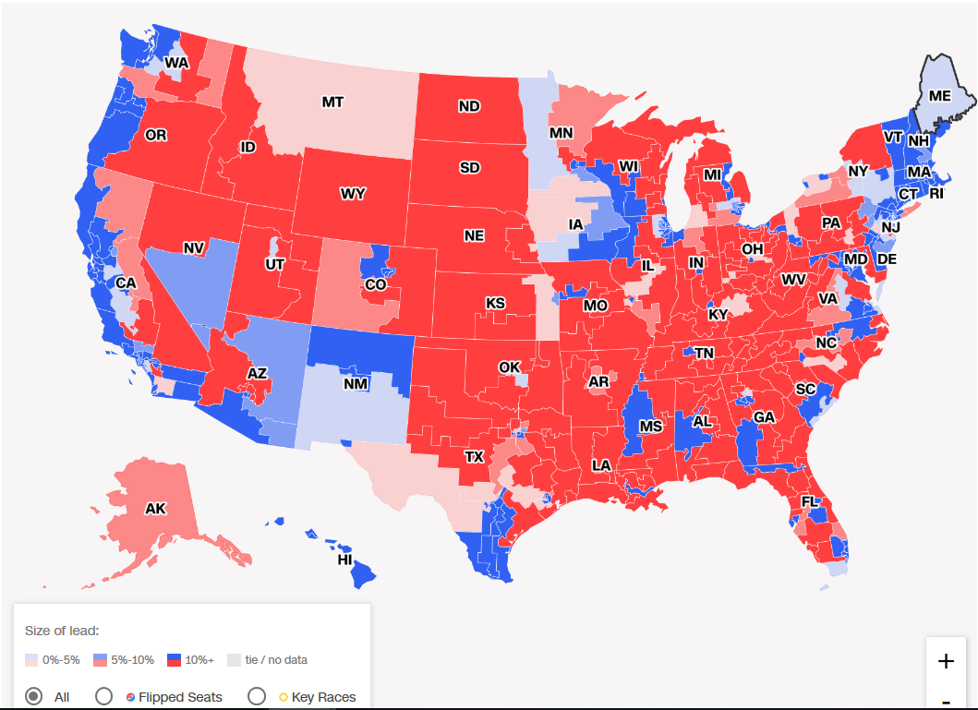
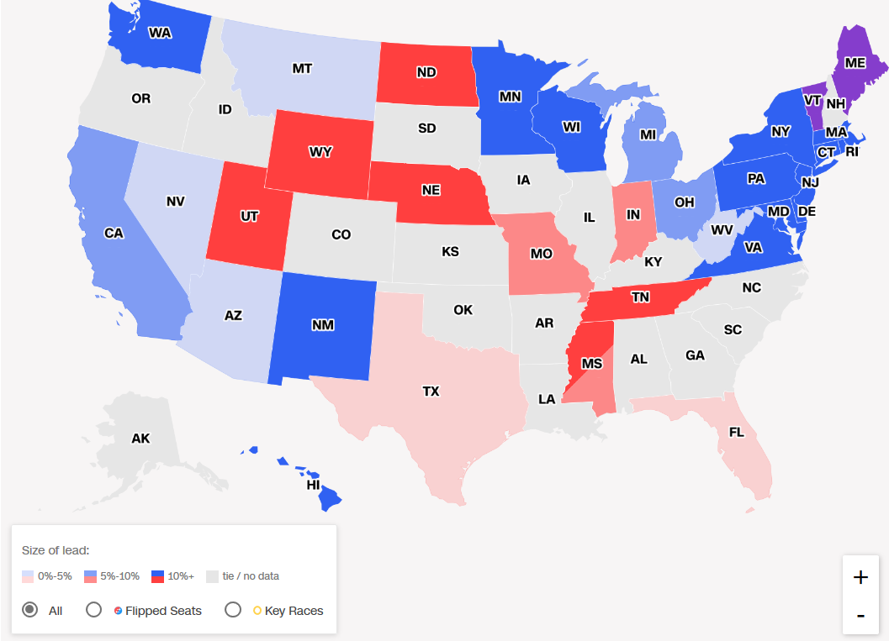
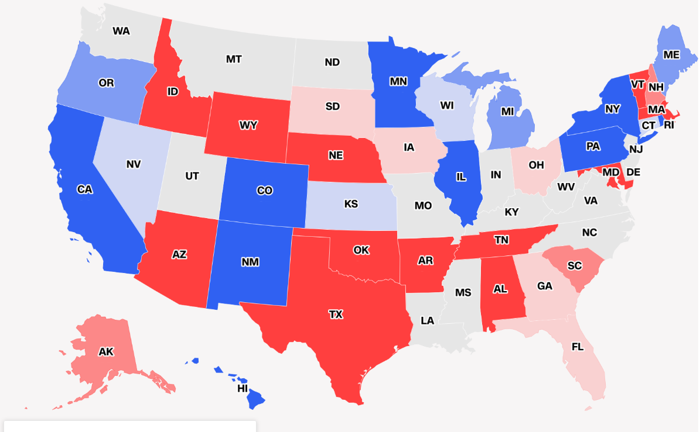
National Results
 | Democrats |  | Republicans
 | 2016 | 2018 | 2016 | 2018
House of Representatives | 194 | 235 | 241 | 199
Senate | 48 | 47 | 52 | 53
Governorships | 16 | 23 | 33 | 27
National Turnout:
Up to 48% from 39% in 2014
(56% in 2016)
“At Least 123 Women Will Be In The Next Congress. Just 19 Are Republicans.”
House of Reps
Senate
Governors

Slide 4
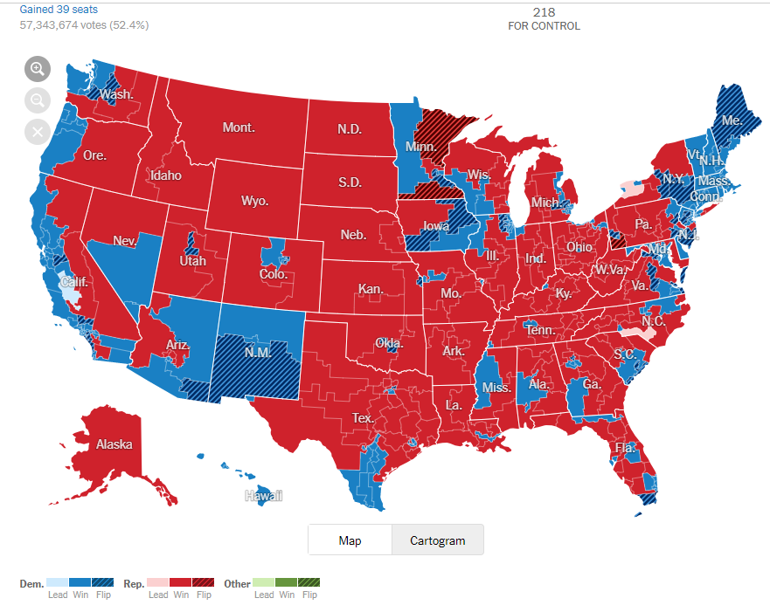
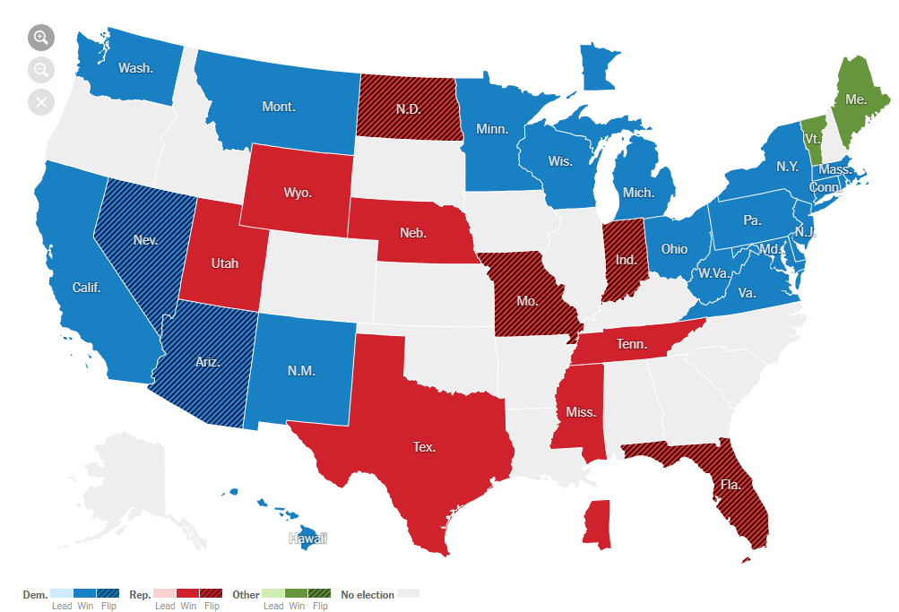
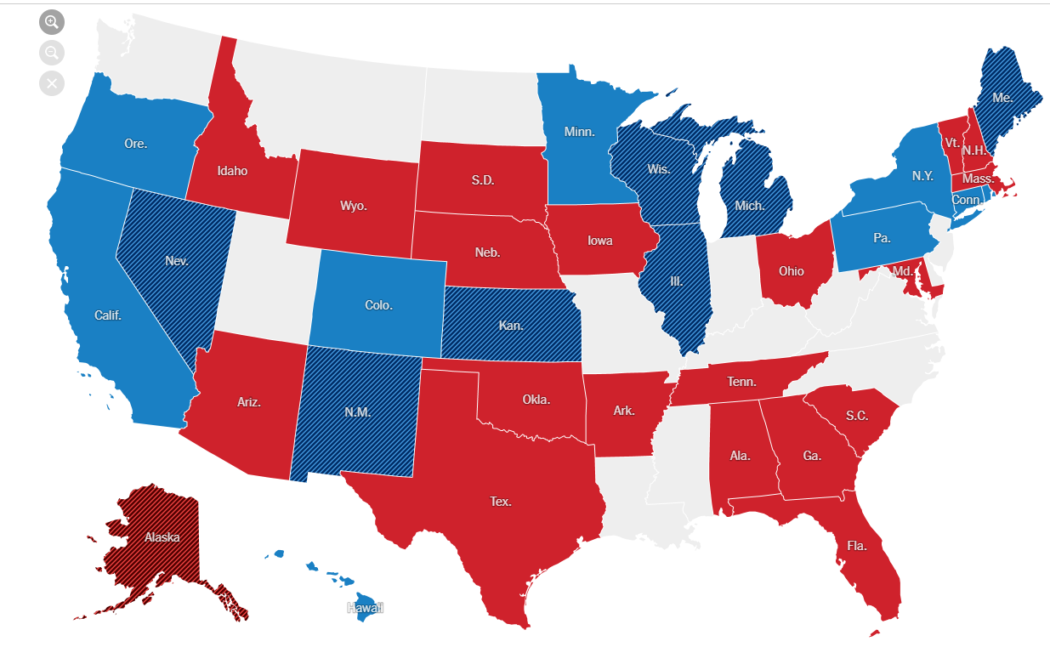
National Results
 | Democrats |  | Republicans
 | 2016 | 2018 | 2016 | 2018
House of Representatives | 194 | 235 | 241 | 199
Senate | 48 | 47 | 52 | 53
Governorships | 16 | 23 | 33 | 27
National Turnout:
Up to 49% from 37% in 2014
(56% in 2016)
“At Least 123 Women Will Be In The Next Congress. Just 19 Are Republicans.”
House of Reps
Senate
Governors

Slide 5
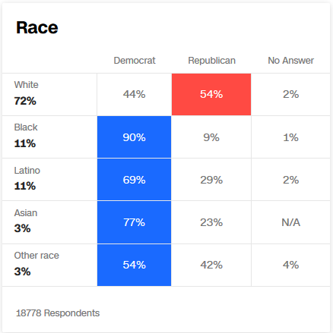
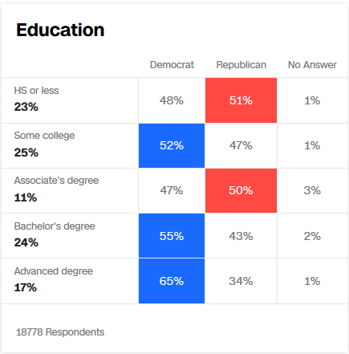
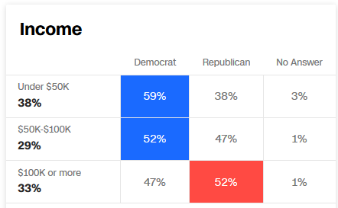
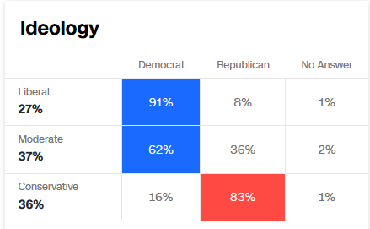
National Results: Gender, Age, Race, Ed, Income, Ideology
59% Women are Dem voters

Slide 6
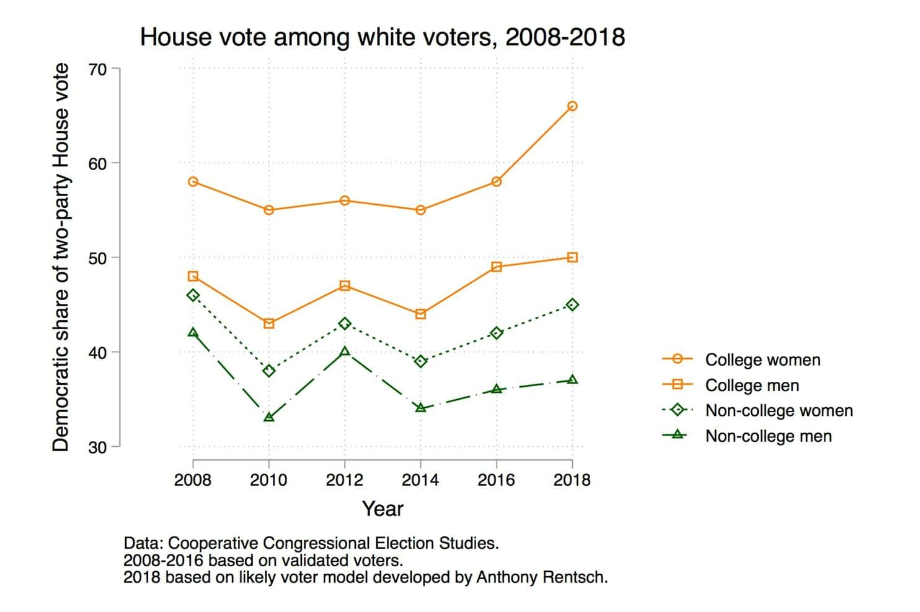
National Results: Age, Race ‘08-’18
Youth has swung Dem
College women have swung Dem

Slide 7
Old/New Economy Divide Splits Parties

Slide 8
Statewide Party Registration: 1994-2018

Slide 9
Party Registration in Kent County+, Oct. 2018

Slide 10
Turnout by County: 2014 vs. 2018

Slide 11
Dem Turnout by County: 2014 vs. 2018
Dems up 8% in KENT

Slide 12
Rep Turnout by County: 2014 vs. 2018
Dems up 13% in AAC

Slide 13
Race for Governor: Hogan Wave vs. Blue Wave
Hogan wins 56% to 42%
Highest percentage for Republican candidate for governor
Highest vote count for any candidate for governor
Jealous loses…
Lowest percentage for any recent Democratic candidate for gov.
Largest vote gap between a winning Republican and losing Democrat

Slide 14
Trends in Voting: Governor’s Races 1994-2018 (Total Vote)
1,410,195
1,535,329
1,693,014
1,734,710
1,821,280
1,703,290
2,165,955
294,217 vote Hogan/Jealous gap
268,642 vote O’Malley/Ehrlich gap
Notes:
Lowest Democratic vote for governor since 1994. Highest Republican count since 2002. Lowest total vote count since 1998. Registered voters numbered 2567894 in 1998; in 2014 they were 3616401 or over a million additional voters.

Slide 15
Jealous Loss is Across the Board: Core Jurisdictions (below average throughout ‘10, ’14,’16,’18)

Slide 16
Jealous Loss is Across the Board: Middle Jurisdictions (below average each year in each jurisdiction)

Slide 17
Jealous Loss is Across the Board: Lowest Jurisdictions (Under 35%+ average 2010, 2014, 2016, 2018)

Slide 18
Why did Hogan Win?
Hogan well liked – high job approval, endearing personal story
Hogan’s governing style emphasizing bipartisanship – diminishes Republican identification
Policy compromises with Democrats: e.g. insurance reform, fracking
Hogan’s anti-Trump stance – sure winner for Hogan, gets all the pro Trump votes without having to give them much
Hogan Blames Trump for Down-Ballot GOP Losses
““It was a repudiation of the president, who lost this state by 30 points,” Hogan said. “People came out and expressed their frustration against just about all Republicans”
Got moderate votes – less dependent on just conservatives

Slide 19
Candidates, Parties and Ideology F18
Schuh and Jealous over-rely on extremes

Slide 20
Why did Jealous Lose – Limited Primary Win
Limited Democratic support in divided primary – 40%
Jealous not well known – no previous candidacy - outsider
NAACP leadership not necessarily an asset
Business experience doesn’t compensate

Slide 21
Why did Jealous Lose – Divided Primary
Candidates | Votes | Percentage
H. Clinton | 573,242 | 63%
B. Sanders | 309,990 | 34%
Total | 883,232 | 100%
B. Jealous | 231,895 | 40%
R. Baker | 171,677 | 29%
Others | 182,09 | 31%
Non-Jealous voters | 353774
Total | 585,669 | 100%
Clinton vote minus total non-Jealous vote | 219,468
Where did Clinton vote go?
Total vote about equal to Clinton’s 2016 primary vote total (585,669/573,242)
Total non-Jealous vote (353,774) is 219,468 short of Clinton vote
Sanders supporters more motivated…

Slide 22
Why did Jealous Lose – Funding, Strategy, Campaign
Divisive primary depletes funds – campaign lacks money from start of general election
“Hogan has outraised Jealous more than 3 to 1, giving the governor a distinct upper hand not just along roadways, but in voters’ mailboxes and on their television screens.”
Strategy underestimates Hogan advantage:
“Jealous’ campaign insists that he is on track, following his underdog strategy to turn out 1 million Democratic voters by rallying those who stayed home in 2014 and hammering on the need to lower drug and health-care costs, close the achievement gap and pay teachers more money.”

Slide 23
Why did Jealous Lose – Dem Establishment Lukewarm
Limited Democratic “establishment” support (WAPO)
Unlike Hogan, who cast himself as an outsider but was deeply involved in the state GOP before running for governor, Jealous has lived most of his life outside Maryland and had few strong ties to the party establishment when he launched his campaign…He’s an outsider, he hasn’t gained a lot of traction, and many in the establishment in Annapolis and the state are keeping a distance from him.”
“Democratic leaders endorse Jealous, but Miller is less than enthusiastic”
“Leggett not ready to endorse Jealous; some other Democrats are tepid”

Slide 24
Why did Jealous Lose – Policies too progressive?
Policies may have been too “progressive”
“State Senate President Mike Miller blamed Jealous’s progressive policies for the loss. He said they are too liberal for Maryland.”
“If we’d had our county executive from Prince George’s County, Rushern Baker, the Democrat would have done a whole lot better. If we’d had the former chairman of the Board of Regents, who was that — Jim Shea, the Democrat would have done a whole lot better,” Miller said.

Slide 25
Why did Jealous Lose – Race?
Hard to estimate impact of race on votes – other factors already compelling
Possibly followed Anthony Brown’s limited ability to hold O’Malley’s percentage of vote especially in rural districts more likely to be respond to race…

Slide 26
2018: Blue Wave Elsewhere: Governor vs. Other Statewide Votes
Candidate | 2018 Vote Count | 2018 Percentage | 2014 Vote Count | 2014 Percentage
Franchot (Comptroller | 1536286 | 72 (+9) | 1061267 | 63
Cardin (US Senator) | 1407365 | 64 (+8) | 1474028 (2012) | 56
Frosh (AG) | 1392888 | 64 (+8) | 935846 | 56
Governor | 1230086 | 56 (+5) | 884400 | 51
2018: Incumbents sail to victory – name recognition, finances, party ID strong, clear record. Shows that Dem insiders more appealing than outsiders.
*Hogan’s increase in percentage lowest among all statewide candidates.

Slide 27
Congressional Races in Maryland - Primaries
Republicans in primaries greatly outnumbered by Democrats (183/582K)
Dem winners by larger percent (53R/73D)
 | Congressional Races | % Primary | PrimVote
CD1-D | Jesse Colvin | 38 | 37191
CD1-R | Andy Harris | 86 | 57046
CD2-D | Dutch Ruppersberger | 72 | 61181
CD2-R | Liz Matory | 42 | 17675
CD3-D | John Sarbanes | 82 | 78492
CD3-R | Charles Anthony | 44 | 15911
CD4-D | Anthony G. Brown | No contest | 80,699
CD4-R | George McDermott | No contest | 12485
CD5-D | Steny H. Hoyer | 84 | 86174
CD5-R | William A. Devine | 58 | 19757
CD6-D | David Trone | 40 | 60300
CD6-R | Amie Hoeber | 68 | 28882
CD7-D | Elijah Cummings | 92 | 89315
CD7-R | Richmond Davis | 31 | 11359
CD8-D | Jamie Raskin | 91 | 89582
CD8-R | John Walsh | 45 | 20271
 | Total Rep Vote | 53 | 183386
 | Total Dem Vote | 73 | 582,934

Slide 28
Congressional Races in Maryland - Primaries
Dem most contested CD:
CD1 – Colvin@38%
CD6 – Trone @40%
Dem lowest vote count in primary:
CD1 – Colvin 37191
CD6 – Trone 60300
Dem average: 72867 Rep average: 22923
Harris: 57046
 | Congressional Races | % Primary | Primary Vote
CD1-D | Jesse Colvin | 38 | 37191
CD1-R | Andy Harris | 86 | 57046
CD2-D | Dutch Ruppersberger | 72 | 61181
CD2-R | Liz Matory | 42 | 17675
CD3-D | John Sarbanes | 82 | 78492
CD3-R | Charles Anthony | 44 | 15911
CD4-D | Anthony G. Brown | No contest | 80,699
CD4-R | George McDermott | No contest | 12485
CD5-D | Steny H. Hoyer | 84 | 86174
CD5-R | William A. Devine | 58 | 19757
CD6-D | David Trone | 40 | 60300
CD6-R | Amie Hoeber | 68 | 28882
CD7-D | Elijah Cummings | 92 | 89315
CD7-R | Richmond Davis | 31 | 11359
CD8-D | Jamie Raskin | 91 | 89582
CD8-R | John Walsh | 45 | 20271
 | Total Rep Vote | 53 | 183386
 | Total Dem Vote | 73 | 582,934

Slide 29
Congressional Races in Maryland - General
Dem most contested CD:
CD1 – Colvin@39%
CD6 – Trone @58%
Dem lowest vote count in primary:
CD1 – Colvin 113414
CD6 – Trone 152853
General Voters/Colvin loss is 67459 votes vs. Dem average win is 87528
CD1 could be more competitive!
 | Candidate | Total Vote | Percentage
CD1-D | Jesse Colvin | 113414 | 39
CD1-R | Andy Harris | 180873 | 60
CD2-D | Dutch Ruppersberger | 162351 | 66
CD2-R | Liz Matory | 76591 | 31
CD3-D | John Sarbanes | 194577 | 69
CD3-R | Charles Anthony | 80883 | 29
CD4-D | Anthony G. Brown | 197439 | 78
CD4-R | George McDermott | 51687 | 20
CD5-D | Steny H. Hoyer | 204043 | 70
CD5-R | William A. Devine | 80229 | 28
CD6-D | David Trone | 152853 | 58
CD6-R | Amie Hoeber | 102172 | 39
CD7-D | Elijah Cummings | 194704 | 76
CD7-R | Richmond Davis | 55355 | 22
CD8-D | Jamie Raskin | 202133 | 67
CD8-R | John Walsh | 93503 | 31

Slide 30
CD1: Why did Colvin lose?
CD1 – Gerrymandered to concentrate Reps into a single district
Create 7-1 ratio of Dems to Reps among elected House Reps.
Is 7-1 ratio justified?
Republican total Congressional votes in general: 721,293 (33%)
Democratic total Congressional votes in general: 1,421,514 (65%)
Number of seats in House of Representatives based on vote share:
Republicans 2.64 (2-3)
Democrats 5.36 (5-6)

Slide 31
Could Dems afford to “give away” votes to make CD1 more competitive?
Average winning Dem candidate vote advantage over Reps in CD2-CD8: 109,669
Gap between Harris and Colvin in CD1: 67,459
Each Dem in CD2-CD7 would need to lose: 9,637
Dem average winning gap: 100,032
Minimum winning D/R gap: 50681 in CD6
Court orders review of CD6…

Slide 32
Is there a geographic problem in trying to make CD1 more competitive?

Slide 33
Could Dems afford to “give away” votes to make CD1 more competitive?
Court review of CD6…(WAPO article - Oct. 4, 2018)
“Federal judges in Maryland floated the idea Thursday of ­taking the state’s congressional voting map out of the hands of political leaders and leaving the drawing of electoral lines to an independent, nonpartisan com­mission.”
The court, as part of a settlement, could order the legislature to draw a new map…If lawmakers were unwilling or unable to do that, he added, the court could then give the job to an independent commission.
An attorney for a group of Maryland Republicans, “told the federal judges in Baltimore that new congressional districts designed by an independent commission would satisfy his clients. “We want the state to conduct elections with a neutrally drawn map.”
O’Malley now says he believes that redistricting should be done by an independent commission, not by lawmakers.
“Everyone condemns it, everyone says it’s terrible, but no one will fix it because no one wants to unilaterally disarm…

Slide 34
Other reasons Colvin lost…
Campaign
Policy focus
Ads – guns, Pelosi?
Lack of Democratic establishment support
Lack of money
Lack of endorsements
Lack of outreach – forums, door-to-door, etc.
Candidate himself
Personality or background out of sync with voters?

Slide 35
Maryland General Assembly: 2010-18 Results
Maryland House of Delegates | 2010 | 2014 | 2018
Democrats | 98 | 93 | 99
percentage | 69.5 | 66 | 70.2
Republicans | 43 | 47 | 42
percentage | 30.5 | 34 | 29.8
Senate
Democrats | 35 | 33 | 32
percentage | 74.5 | 70 | 68
Republicans | 12 | 14 | 15
percentage | 26.5 | 30 | 32
Democrats gain seats in House of Delegates, but lose a seat in the Senate

Slide 36
Maryland General Assembly: 2018 Results
Maryland House of Delegates | Uncontested | NonComp | Competitive
Democrats (N=99) | 44 | 47 | 7
percentage | 46% | 48% | 7%
Republicans (N=42) | 5 | 31 | 7
percentage | 12% | 72% | 16%
Senate
Democrats (N=32) | 12 | 18 | 2
percentage | 38% | 56% | 6%
Republicans (N=15) | 2 | 10 | 3
percentage | 13% | 67% | 20%
Overwhelming majority of seats are uncontested or non-competitive (more than 5% winning margin)

Slide 37
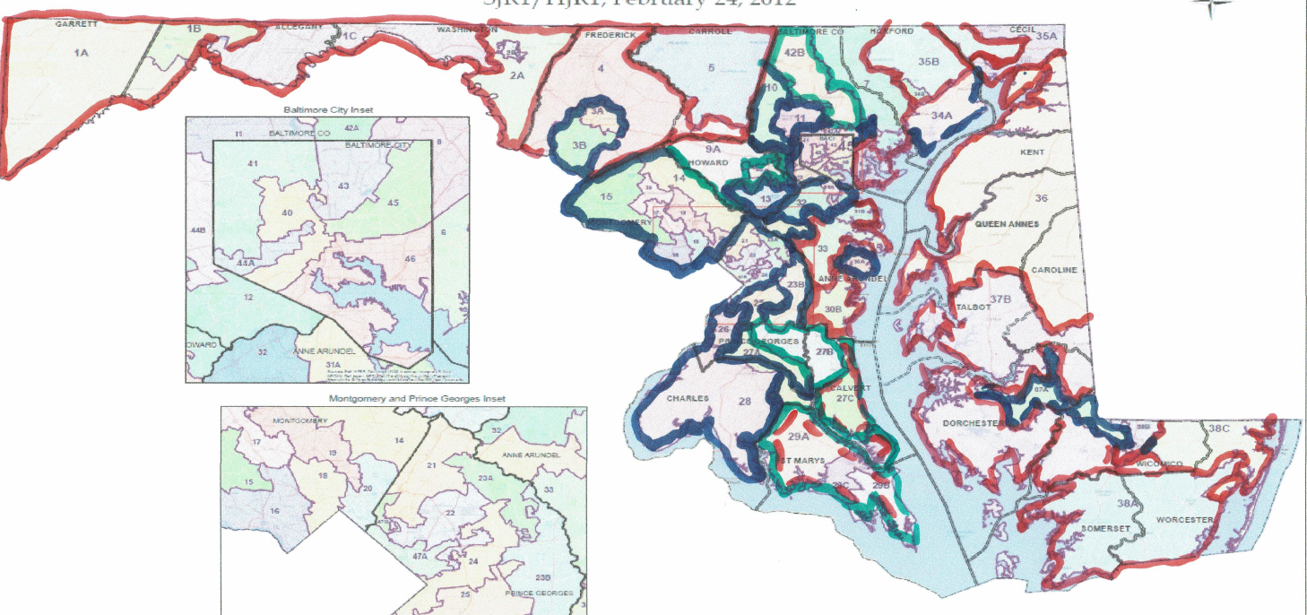
Maryland General Assembly: 2010-18 Results

Slide 38
How Did Kent County Vote? Dems=9 Reps=10 vs. QA Dems=1 Reps=20
 | Kent County Votes | Party | Percentage
Governor | Hogan | R | 74
 | Jealous | D | 25
Comptroller | Phukan | R | 30
 | Franchot | D | 70
AG | Wolf | R | 49
 | Frosh | D | 51
US Senate | Campbell | R | 41
 | Cardin | D | 53
CD1 | Harris | R | 45
 | Colvin | D | 54
State Senate | Hershey | R | 57
 | Sinclair | D | 43
Delegates | Jacobs | R | 28
 | Arentz | R | 18
 | Ghrist | R | 16
 | Woodward | D | 15
Commissioners | Jacobs | R | 18
 | Mason | R | 17
 | Fithian | D | 17
State's Attorney | Strong | R | 41
 | Digregory | D | 59
Sheriff | uncontested | R | 100
Clerk Court | uncontested | D | 100
RegisterWills | uncontested | D | 100
Orphans Ct | Nickerson, Carroll, Boyer | R, R, D | 25

Slide 39
Possible 2022 Futures - Maryland
Governor /Turnout post-Trump
Is Hoganism without Hogan possible? Boyd Rutherford?
Will second term be like the first?
Third term fatigue – possible Rutherford hurdle
Lt. Governor’s curse – another Rutherford hurdle
Viability of Democratic candidate
Which issues will be salient – governing style?
What is the profile of a viable Democratic alternative?
All major Democratic county executives will be in first terms
Can the progressive vs. “Establishment” divide be overcome?
Can Democrats limit themselves to “viable candidates” in primary?
What are the lessons of 2018 –Trump victory impacts turnout, helps Democrats generally – will it be a factor in 2022?

Slide 40
Possible 2022 Futures – Maryland/Kent County
Congressional 2022: Redistricting under Hogan and Democratic MGA
Will Hogan/courts force a changed, more competitive map for Congress in Maryland
Will CD1 be a sufficiently large beneficiary to make the district competitive?
Local Politics
Are underlying conditions making Kent County purple likely to change? More like QA?
Will candidate recruitment for MGA be successful when prospects of success are small?
Can races for county commissioner be more competitive?

