Slide 1
CSLI Survey– Fall 2016 Presentation of Findings
Dan Nataf
Director, Center for the Study of Local Issues
Anne Arundel Community College
www2.aacc.edu/csli
ddnataf@aacc.edu
410-777-2733

Slide 2
Most Important Problem: S08 to F16

Slide 3
Most Impt. Problem by Pres. Choice

Slide 5
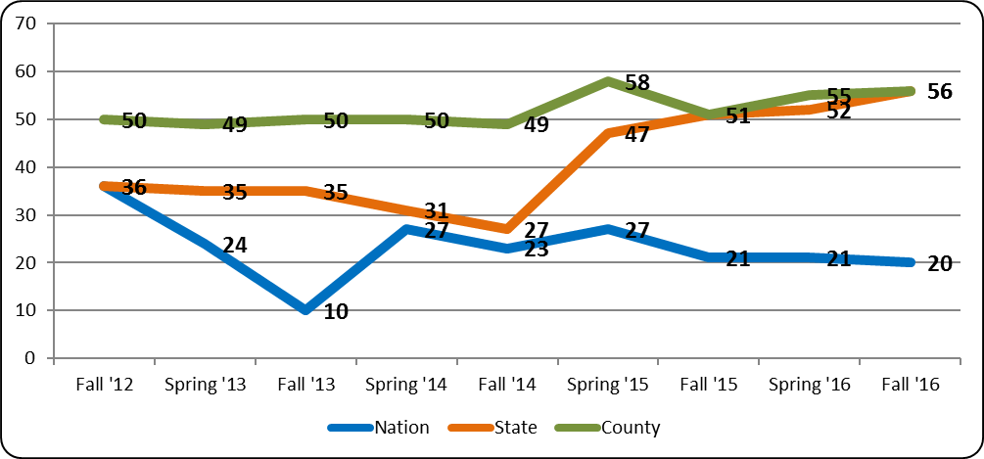
Right/Wrong Direction – County, State, Nation: Fall ‘12 to Fall ‘16

Slide 6
Right/Wrong Direction – Presidential Choice

Slide 7
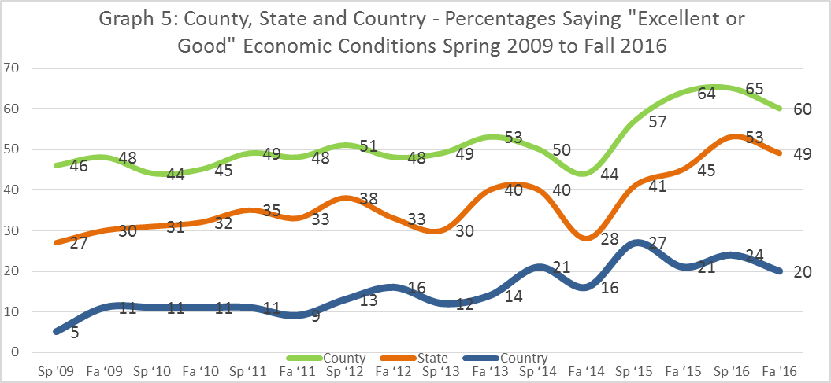

Slide 9
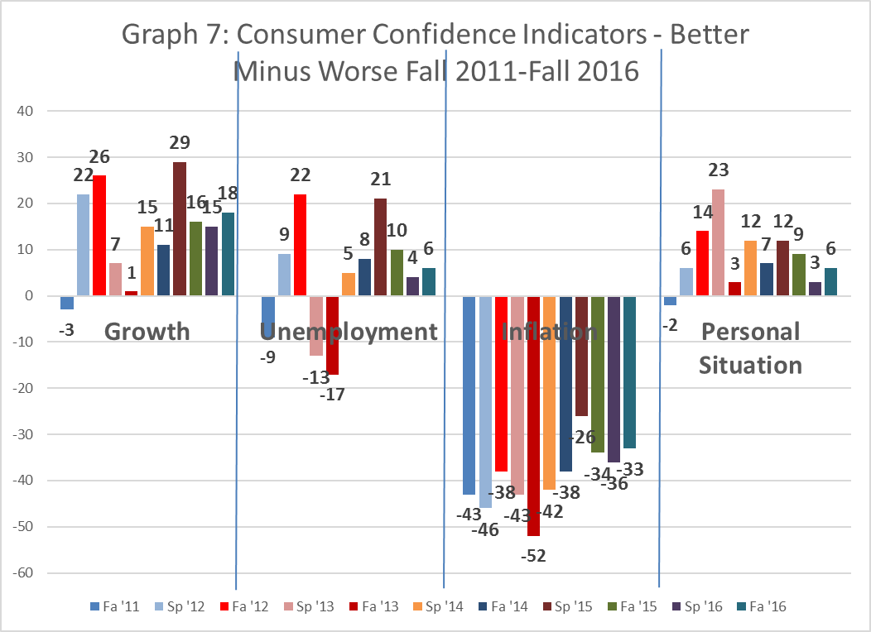
Economic Conditions over the next 12 Months
 | Better |  | Same |  | Worse |  | Unsure/NA |  | Total
 | HC | DT | HC | DT | HC | DT | HC | DT | HC | DT
Economic growth | 34 | 22 | 47 | 50 | 8 | 20 | 12 | 7 | 101 | 99
Unemployment | 34 | 18 | 46 | 42 | 8 | 32 | 12 | 8 | 100 | 100
Inflation | 9 | 9 | 41 | 31 | 39 | 52 | 11 | 8 | 100 | 100
Your personal financial situation | 20 | 17 | 59 | 58 | 16 | 19 | 6 | 6 | 101 | 100

Slide 10
Economic Conditions - Applies
Condition | Clinton | Trump | Clinton-Trump
Taxes are too high in relation to the govt. services provided | 43 | 79 | -36
Wages or salaries are not rising as fast as the cost of living | 52 | 61 | -9
Hard to afford the cost of education | 34 | 40 | -6
Unable to afford healthcare or medicine during the last year | 8 | 20 | -12
Received a salary increase or other increase in income recently | 31 | 27 | 4
Hard to afford the cost of food and groceries | 26 | 32 | -6
Found a new or better job recently | 9 | 6 | 3
Facing the possibility of unemployment | 12 | 12 | 0

Slide 11
Economic Indicators and Income
Condition | Under $75,000 | $75,000+ | Under $75k- Over 75K Sp ’16 Fa ‘16
Hard to afford cost of food and groceries* | 41 | 23 | 27 | 18
Unable to afford healthcare or medicine during the last year* | 22 | 9 | 14 | 13
Hard to afford the cost of education* | 45 | 35 | 8 | 10
Taxes are too high in relation to the government services provided* | 56 | 64 | 8 | -8
Wages or salaries are not rising as fast as the cost of living | 64 | 56 | 5 | 9
Facing the possibility of unemployment | 12 | 11 | -1 | 1
Found a new or better job recently* | 8 | 8 | -6 | 0
Received a salary increase or other increase in income recently* | 23 | 35 | -20 | -12

Slide 12
Proposal Agreement
 | Not at all | Somewhat | Mostly | Completely | Unsure | No answer
Change the start of the school year until after Labor Day | 15 | 9 | 11 | 56 | 5 | 4
Build another bridge to the Eastern Shore | 15 | 15 | 16 | 44 | 8 | 2
Local government should not promote much more development in the county | 21 | 20 | 11 | 41 | 6 | 1
County government should expand its mosquito spraying program. | 13 | 19 | 16 | 40 | 11 | 2
The Board of Education should treat transgender pupils on the basis of the gender with which they identify, not their birth gender. | 33 | 12 | 10 | 36 | 7 | 4
Salary increases for county workers should keep pace with or exceed that of private sector workers | 18 | 22 | 19 | 35 | 4 | 3
I would support an increase in county property or income taxes if the added revenue went only to public schools. | 46 | 14 | 11 | 25 | 3 | 1
The County already has enough public access points to the Bay - no need to add more. | 40 | 14 | 10 | 18 | 14 | 4
Former county executive John Leopold should run again for public office | 58 | 8 | 3 | 7 | 19 | 5
The county is currently doing enough to combat heroin use and addiction. | 42 | 24 | 9 | 5 | 19 | 2

Slide 13
Agreement - Statements by Candidate
 | Clinton | Trump | HC-DT
The Board of Education should treat transgender pupils on the basis of the gender with which they identify, not their birth gender. | 59 | 13 | 46
I would support an increase in county property or income taxes if the added revenue went only to public schools. | 36 | 12 | 24
Salary increases for county workers should keep pace with or exceed that of private sector workers | 46 | 28 | 18
County government should expand its mosquito spraying program. | 40 | 39 | 1
Former county executive John Leopold should run again for public office | 8 | 8 | 0
Local government should not promote much more development in the county | 46 | 47 | -1
Build another bridge to the Eastern Shore | 43 | 47 | -4
The county is currently doing enough to combat heroin use and addiction. | 3 | 7 | -4
The County already has enough public access points to the Bay - no need to add more. | 14 | 21 | -7
Change the start of the school year until after Labor Day | 42 | 73 | -31

Slide 14
Worries - Ranked
 | Not at all | Only a little | A fair amount | Great deal | N.A. | Total
The rising cost of a college education | 9 | 11 | 22 | 58 | 0 | 100
Our nation’s ability to confront terrorism | 9 | 12 | 20 | 58 | 1 | 100
The financial burdens of retirement | 8 | 12 | 24 | 55 | 1 | 100
The tendency for corporations to send jobs overseas | 8 | 16 | 22 | 53 | 2 | 101
Race relations | 7 | 14 | 33 | 46 | 1 | 101
Illegal immigration | 16 | 20 | 18 | 46 | 1 | 101
The decline of America as a world power | 18 | 15 | 24 | 42 | 1 | 100
Climate change, extreme weather, sea level rise | 20 | 16 | 25 | 39 | 2 | 101
Bullying in our schools (k-12) | 12 | 21 | 30 | 35 | 2 | 100
The need for ever increasing skills to obtain or keep a good job | 12 | 20 | 32 | 34 | 2 | 100
Over-regulation of business | 24 | 21 | 19 | 33 | 4 | 101
Discrimination against gays, lesbians or transgendered people | 19 | 21 | 30 | 28 | 2 | 100
Difficulties for women to get ahead | 20 | 23 | 30 | 26 | 1 | 100
Impact of free trade | 16 | 27 | 26 | 25 | 7 | 101
Crime in my neighborhood | 26 | 35 | 19 | 20 | 0 | 100

Slide 15
Worries: Clinton-Trump

Slide 17
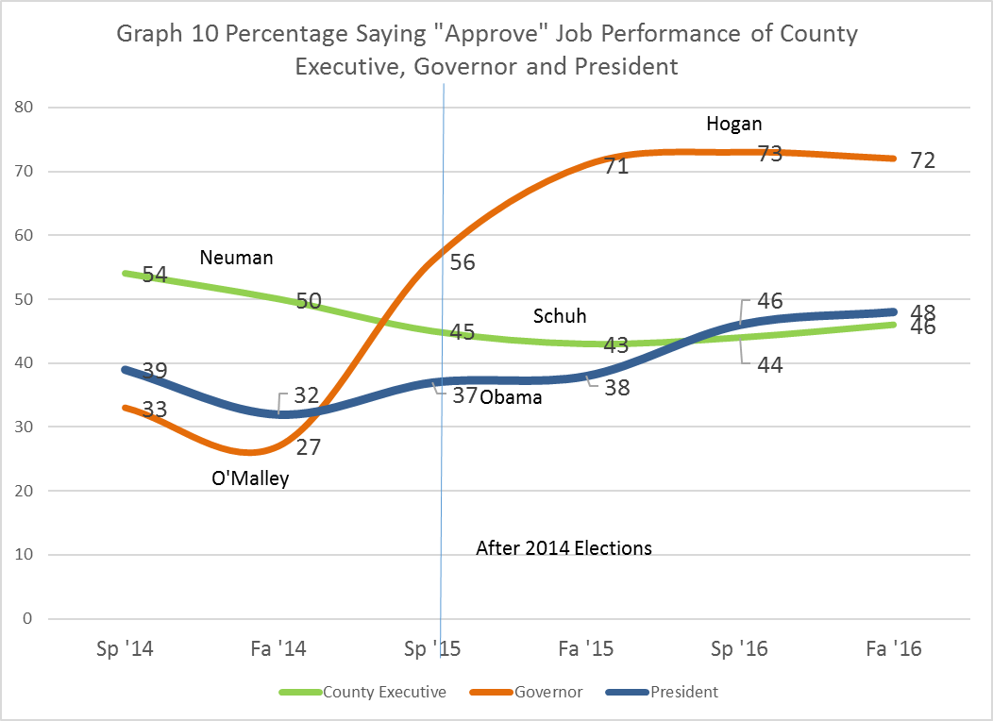
Job approval, Spring 2014/Fall 2016
 | NA
Schuh | 38
Hogan | 13
Obama | 6

Slide 18
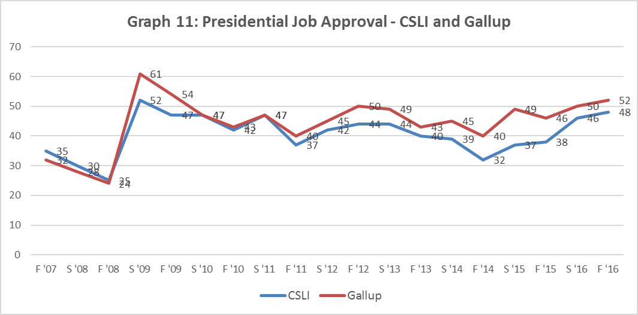
Presidential Job Approval Fall 2007 to Fall 2015

Slide 19
Presidential Job Approval – Party/Ideol.

Slide 20
Presidential Preferences Overall
Candidate | Overall Fa ‘16 | Official Results 2012 | Official Results 2008
Hillary Clinton (Dem) | 40 | 48.7 | 48.2
Donald Trump (Rep) | 34 | 48.8 | 50.2
Gary Johnson (Lib) | 5 | 1.4 | .5
Jill Stein (Green) | 1 | .7 | .9 (includes Nader)
Undecided | 11
Wouldn’t vote for either | 10
Total | 101

Slide 21
Presidential Preferences by Party
Candidate/Party | Democrat | Republican | Unaffiliated
Hillary Clinton | 73 | 9 | 33
Donald Trump | 8 | 62 | 30
Gary Johnson | 1 | 8 | 7
Jill Stein | 1 | 0 | 5
Undecided | 9 | 10 | 18
Wouldn’t vote | 8 | 11 | 8
Total | 100 | 100 | 101

Slide 22
Factors Shaping Vote by Candidate
Item | Clinton | Trump | Overall | HC-DT
The ability of the candidate to work with Congress | 89 | 60 | 77 | 29
The candidate’s personal background is appealing | 39 | 21 | 30 | 18
The candidate’s ability to relate to people like yourself | 52 | 45 | 50 | 7
My dislike for the other candidate | 71 | 67 | 62 | 4
I trust the candidate to make the right decisions | 83 | 81 | 79 | 2
The need to fill Supreme Court vacancies | 81 | 79 | 75 | 2
The candidate has the right ideas for improving the economy | 79 | 86 | 81 | -7
The candidate’s choice for vice president | 37 | 51 | 39 | -14
The candidate will better defend America’s national interests | 76 | 91 | 82 | -15
I want a candidate who can shake up the status quo | 29 | 77 | 57 | -48

Slide 23
Most important factor shaping choice
Positive Reasons for Support | Clinton | Trump | Overall
Experienced | 18 | 1 | 9
Qualified | 15 | 1 | 8
Outsider, change | 0 | 10 | 5
Leadership | 1 | 8 | 4
Temperament, frank, stable | 6 | 3 | 4
Trusted | 1 | 4 | 2
Total | 41 | 27 | 33
Negative Reasons for Support | Clinton | Trump | Overall
Lesser evil | 16 | 8 | 13
Dislike Trump | 15 | 1 | 7
Dislike Clinton | 0 | 13 | 6
Both bad | 1 | 0 | 5
HC lies, crooked | 0 | 10 | 4
Trump crazy, idiot | 8 | 0 | 4
Not qualified DT | 3 | 0 | 2
Not qualified HC | 0 | 2 | 1
Total | 43 | 34 | 42
Policy/Vision Reasons for Support | Clinton | Trump | Overall
Vision/plans | 8 | 8 | 7
Foreign policy, national security, military | 3 | 6 | 4
Economy | 1 | 7 | 3
Immigration | 1 | 6 | 3
Govt like business/less govt. | 0 | 3 | 2
Social issues | 2 | 0 | 1
Taxes | 0 | 2 | 1
Law and order | 0 | 2 | 1
Supreme Court | 0 | 2 | 1
Total | 16 | 36 | 23

Slide 24
Presidential Choice and Demographics: Age

Slide 25
Gender and Presidential Choice

Slide 26
Race and Presidential Choice

Slide 27
Marital Status and Presidential Choice

Slide 28
Income and Presidential Choice

Slide 29
Education and Presidential Choice

Slide 30
Employment and Presidential Choice

Slide 31
Religion and Presidential Choice
 | None | Non-pract. | Evang. | Cath. | Prot. | Christ. Otr. | Jewish | Spritual
Clinton | 64 | 48 | 35 | 23 | 45 | 33 | 66 | 41
Trump | 17 | 25 | 31 | 43 | 34 | 42 | 26 | 26
Johnson | 5 | 10 | 1 | 5 | 5 | 9 | 0 | 0
Stein | 4 | 0 | 0 | 1 | 0 | 0 | 0 | 7
Undecided | 4 | 17 | 21 | 14 | 11 | 4 | 8 | 13
Wouldn't vote | 7 | 0 | 12 | 15 | 6 | 12 | 0 | 14

