Slide 1
Learning with the Center for the Study of Local Issues: Introductory Meeting
Agenda:
Review Mission/History of CSLI
Understanding surveys
Your role
Review previous findings
Questionnaire
Next steps
Dan Nataf, PhD, Director
Center for the Study of Local Issues
Careers 132
Anne Arundel Community College
101 College Parkway
Arnold, MD 21012-1895
http:www2.aacc.edu/csli
ddnataf@aacc.edu
410.777.2733

Slide 2
CSLI History and Mission
Historical Background: In business since 1978!
1. Creation and operation as part of Division of Social Sciences: 1978-1999 – a community college ‘research center’
2 .Operation as part of Sarbanes Center for Public and Community Service 2006-present

Slide 3
CSLI Flowchart
Sarbanes Director
Director
Assistant
Interns/
Students
AACC Administration
Center for Study of Local Issues
Assistance
Faculty, students community members, politicians, administrators, Capital editor
Advisory Board
Advisory Board

Slide 4
CSLI History and Mission
CSLI Mission – four elements
1. Provide students opportunities to better understand applied social science research methods while encouraging civic awareness and engagement
Serve community and local government by offering research services and communicating survey findings
Provide opportunities for faculty professional development
Help AACC understand its environment through relevant data collection and analysis

Slide 5
CSLI History and Mission
Mission: Provide students opportunities to better understand applied social science research methods while encouraging civic awareness and engagement
Activities providing student opportunities:
Participation in community surveys Participation in client based research projects Student internships CSLI student club

Slide 6
CSLI Survey Process
Radio Interview
Survey Design with Advisory Board Prior to March and October Surveys
Student Final Meeting
Newspaper Article
Press Release
Community Presentations
Data Entry and Analysis
Student Telephone Interviews – 4 nights+Web panel
350-800 completions
Student Recruitment
Student Intro Meeting
First Night Training

Slide 7
CSLI: The Semi-annual Survey
Extent of Student Participation Varies…
Semi-annual survey – how students participate
Up to five contacts with CSLI
Introductory meeting
2-3+ nights of telephone interviews
Final meeting – review of survey process, findings, SPSS/hypotheses testing
Short paper (varies by instructor)
Some instructors only require 1 meeting – for less credit or minimum compliance

Slide 8
CSLI: The Semi-annual Survey
Semi-annual Surveys -
Why is your role so important?
How do surveys work?
Identify a population whose characteristics and attitudes are interesting to us
Our population – Residents of Anne Arundel County at least 18 years of age
Our goal – Ask a small group (the “sample”) questions
Generalize the findings to the whole population (the “universe”)

Slide 9
CSLI: The Semi-annual Survey
Semi-annual Surveys -
Why is your role so important?
How do surveys work? (continued)
Find a proper sample size: costs vs. margins of error – Example: Population of 100k+, confidence interval 95%
Error | Sample Size
3 | 1111
4 | 584
5 | 384
7 | 204
10 | 100

Slide 10
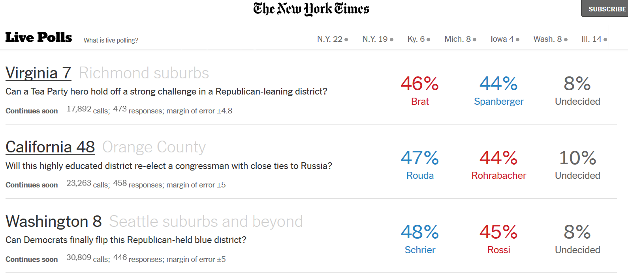
How many calls did the New York Times have to make when polling during the 2018 mid-terms?
38 calls/complete
51 calls/complete
69 calls/complete

Slide 11
CSLI: The Semi-annual Survey
How do surveys work? (Data collection methods)
Choices:
1. Face to face – personal interviews
=>2. Telephone – personal interviews
3. Self-administered - by mail, exit poll, group setting
=> 4. Online – a version of ‘self administered’

Slide 12
CSLI: The Semi-annual Survey
How do surveys work? ( Data collection continued)
How do we choose who shall participate in survey?
(1) Randomly select from listed phone numbers (2) Use computer generated “likely unlisted residential numbers within your target jurisdiction”
(3) Add in some random cell phone/targeted numbers
CSLI’s lists of numbers are a 70/30 landline/targeted percent mix
We start with over 11,000 phone numbers!

Slide 13
CSLI: The Semi-annual Survey
How do surveys work? ( Survey assumptions)
What are we assuming in using telephone numbers?
That everyone in our target universe is equally likely to have a phone and willing/able to answer a survey
Could other methods be used to ensure more complete representation?
Ideally, yes! But the other data collection methods are harder to implement and/or more expensive…

Slide 14
CSLI: The Semi-annual Survey
How do surveys work? (Sources of error)
What are other data collection challenges?
* Interviewer bias
* Social desirability (“Halo effect”)
* Unclear questions
* Non-attitudes
* Non-response bias (both overall and for items) * Unequal representation of subgroups
None of these is necessarily a fatal flaw, but should make us sensitive that there are more sources of error than just the statistical ‘margin of error’

Slide 15
CSLI: The Semi-annual Survey
Semi-annual Surveys: Recent Major Topics
Major issues facing the county
Economic conditions and concerns in the county
Cost of higher education
County schools
County infrastructure needs
Death Penalty
Presidential job approval/election prediction
Gun control
Marijuana use
Drug abuse
Elections – “horserace” “key issues”
Lots of demographic info: age, income, employment situation, race, religion, gender, party, ideology

Slide 16
Presidential Job Approval: CSLI vs. Gallup

Slide 17
Job Approval

Slide 18
Most important problem
Most important problem
Drugs/crime
High taxes
Economy
Growth/dev.
Education
Transp.
Environment

Slide 19
R/W Direction – All Levels

Slide 20
R/W Direction by Demographics
Right Direction Percentages for County, State and Nation by Vote for Governor and Party, Fall 2018
Hogan voters much more likely than Jealous voters to say “right direction” at every jurisdiction.
 | Overall | Hogan Voters | Jealous Voters | Republicans | Democrats
County | 57 | 67 | 29 | 67 | 47
State | 63 | 73 | 38 | 70 | 58
Nation | 31 | 44 | 0 | 60 | 10
 | Overall | Hogan Voters | Jealous Voters | Republicans | Democrats
County | 57 | 67 | 29 | 67 | 47
State | 63 | 73 | 38 | 70 | 58
Nation | 31 | 44 | 0 | 60 | 10

Slide 21
Rate Econ Cond. All Levels

Slide 22
Economic Conditions and Gender
 | Overall | Men | Women | M-W
Hard to afford the cost of food and groceries | 20 | 14 | 26 | -12
Wages or salaries are not rising as fast as the cost of living | 46 | 42 | 51 | -9
Health care insurance is unavailable, too expensive or inadequate/ | 35 | 31 | 39 | -8
Hard to afford the cost of education | 32 | 29 | 35 | -6
Facing the possibility of unemployment | 7 | 7 | 8 | -1
Found a new or better job recently | 13 | 13 | 12 | 1
Received a salary increase or other increase in income recently | 36 | 39 | 34 | 5
Taxes are too high in relation to the govt. services provided | 57 | 62 | 54 | 8

Slide 23
Economic Conditions by Income
Less presence of negative economic conditions at higher income

Slide 24
Agreement Regarding Guns S18
Statement/proposal | Agree | Disagree | Unsure/DK
Mandatory background checks for all gun sales | 96 | 3 | 1
National testing for knowledge and proficiency in gun use prior to purchase | 82 | 14 | 4
Impose mandatory minimum sentences for those convicted of using guns in commission of a crime | 80 | 12 | 9
Armed police officers at all Maryland public schools | 75 | 15 | 10
Federal ban on high capacity gun magazines | 74 | 23 | 3
A national ban on assault style weapons | 70 | 25 | 5
Metal detectors at all Maryland public schools | 69 | 22 | 9
Passing more gun control restrictions by Congress | 66 | 31 | 3
Fear that a mass shooting might occur in a school near you | 61 | 30 | 10
A liability insurance requirement for gun owners | 58 | 29 | 13
Allowing teachers at Maryland public schools to carry guns | 26 | 66 | 8

Slide 25
Support for Statements
Clinton Voters Favor Most
Trump Voters Favor Most

Slide 26
Party and Gender by Federal Issues (% Agreeing)

Slide 27
Party and Gender by State Issues - % Agreeing

Slide 28
Party and Gender by Local Issues - % Agreeing

Slide 29
County: Better, Same, Worse
Issues | Gotten better | Stayed about the same | Gotten worse | Unsure/ NA
Controlling crime such as gang violence | 18 | 37 | 31 | 15
Improving the local economy | 37 | 44 | 11 | 8
Reducing poverty and homelessness | 12 | 43 | 28 | 17
Reducing traffic congestion | 5 | 21 | 71 | 3
Managing growth and development | 13 | 25 | 55 | 7
Improving the environment | 24 | 42 | 26 | 8
Improving ethics in government | 16 | 36 | 36 | 12
Keeping taxes low | 16 | 51 | 26 | 7
Improving the efficiency of local government | 15 | 48 | 21 | 16
Improving the academic performance of our children | 19 | 39 | 28 | 14
Reducing the opioid epidemic | 15 | 21 | 52 | 12
Making life more affordable in the county | 9 | 43 | 40 | 8
Improving the overall quality of life in our county | 21 | 55 | 18 | 6

Slide 30
County: Worse Minus Better
Worse Scores Highest
Better Scores Highest

Slide 31
County Issues - F’18 vs F’15

Slide 32
Presidential Vote ’16 by Ideology and Party
 | Overall | Liberal | Moderate | Cons. | Dems | Reps | Unaffiliated
Clinton | 39 | 79 | 46 | 9 | 76 | 6 | 30
Trump | 38 | 4 | 25 | 77 | 9 | 72 | 33
Someone else | 8 | 3 | 13 | 5 | 5 | 13 | 6
Didn’t vote | 11 | 14 | 10 | 6 | 9 | 6 | 19
NA/DK | 3 | 0 | 5 | 4 | 1 | 3 | 13
Total | 99 | 100 | 99 | 101 | 100 | 100 | 101
Women predominate - Dems
Men predominate - Rep

Slide 33
Vote for Governor/County Executive
 | Overall | Dem Strong | Dem Somewhat | Dem Not | Rep Strong | Rep Somewhat | Rep Not
Ben Jealous | 14 | 50 | 19 | 0 | 0 | 0 | 0
Larry Hogan | 68 | 20 | 46 | 80 | 100 | 94 | 77
Someone else | 1 | 0 | 0 | 0 | 0 | 0 | 5
Undecided | 16 | 26 | 33 | 17 | 0 | 5 | 15
None | 1 | 4 | 2 | 2 | 0 | 0 | 0
NA | 1 | 0 | 0 | 3 | 0 | 1 | 3
Total | 101 | 100 | 100 | 102 | 100 | 100 | 100
 | Overall | Dem Strong | Dem Somewhat | Dem Not | Rep Strong | Rep Somewhat | Rep Not | Unaffil.LD | Unaffil LR | Unaffil noL
Steuart Pittman | 33 | 77 | 63 | 16 | 3 | 8 | 14 | 65 | 3 | 15
Steve Schuh | 38 | 6 | 11 | 48 | 61 | 61 | 33 | 4 | 66 | 13
Undecided | 27 | 17 | 24 | 37 | 31 | 31 | 51 | 32 | 23 | 63
None | 1 | 0 | 0 | 0 | 0 | 0 | 2 | 0 | 8 | 0
NA | 1 | 0 | 2 | 0 | 0 | 0 | 0 | 0 | 0 | 10
Total | 100 | 100 | 100 | 101 | 95 | 100 | 100 | 101 | 100 | 101

Slide 34
Gov/CE by Partisanship

Slide 35
Vote for County Exec – Most Important Factor

Slide 36
Vote for County Exec – Highest Priority
Development, Education, Drugs, Environment, County Salaries Strongest for Pittman
Taxes, Development, Education, Drugs, Crime, Economy Strongest for Schuh

Slide 37
Issue Favored by Pittman/Schuh Voters

Slide 38
Support for Various Issues (F’17)
Statement, proposal or action | Support | Oppose | NA/DK
A needle exchange program for heroin users in the county | 51 | 32 | 17
Using school redistricting to reduce racial disparities among county schools | 42 | 46 | 12
The removal of 19th century Supreme Court Justice Roger Taney’s statue from the area near the State House | 27 | 51 | 22
More federal efforts to fight anti-Semitism | 64 | 16 | 20
President Trump did not sufficiently condemn white supremacists and neo-Nazis in Charlottesville | 53 | 38 | 9
Passing a Republican health insurance alternative to the Affordable Care Act | 41 | 43 | 16
Taking military action against North Korea if it continues its nuclear program | 37 | 42 | 21
The idea that NFL owners should fire any player who protests during the national anthem. | 36 | 54 | 9
Reversing the DACA policy by making the children of illegal immigrants eligible for deportation | 28 | 60 | 12
The removal of all Confederate statues or names from public lands or buildings | 27 | 63 | 11
The policy of not allowing transgendered people in the military | 24 | 63 | 13

Slide 39
National Issues (S’18)
Statements/proposal | Agree | Disagree | Unsure/DK
Russian meddling in our elections is a serious threat to American democracy | 66 | 24 | 10
The Republican tax plan passed late last year will be good for the economy and benefit you personally | 34 | 44 | 22
Infrastructure improvements should be funded by a 25-cent increase in the federal gas tax | 30 | 51 | 20
President Trump’s tariffs will save jobs and boost our economy | 30 | 50 | 20
Deport the DACA children of illegal immigrants | 18 | 71 | 10
National Issues by Party Registration % Agree
Statements/proposal | Dems | Reps | Unaffil.
Russian meddling in our elections is a serious threat to American democracy | 83 | 52 | 63
The Republican tax plan passed late last year will be good for the economy and benefit you personally | 13 | 61 | 31
Infrastructure improvements should be funded by a 25-cent increase in the federal gas tax | 39 | 23 | 34
President Trump’s tariffs will save jobs and boost our economy | 15 | 57 | 21
Deport the DACA children of illegal immigrants | 12 | 29 | 21

Slide 40
Perceived Levels of Discrimination Against Certain Groups (F’17)
 | A lot | Some | Little or no | DK/NA
Transgendered people | 53 | 29 | 12 | 5
African-Americans | 42 | 38 | 19 | 1
People with a criminal record | 38 | 44 | 14 | 5
People with physical or mental disabilities | 36 | 44 | 17 | 4
Hispanics | 35 | 42 | 22 | 3
Women | 25 | 46 | 26 | 3
Native-Americans | 21 | 40 | 32 | 7
People without a college degree | 11 | 44 | 40 | 5
White men | 7 | 28 | 63 | 2
Atheists | 7 | 32 | 51 | 9

Slide 41
Perceived Levels of Discrimination Against Certain Groups (F’17)

Slide 42
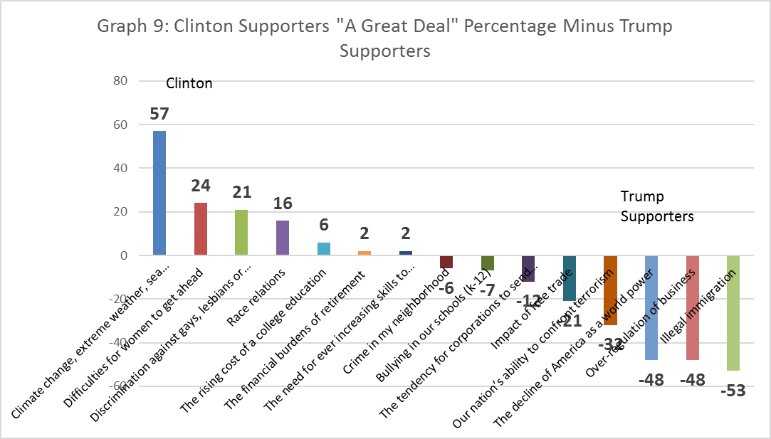
Worries: Clinton-Trump, F ‘16

Slide 43
State and Local Issues - % Agree S’18
 | Overall | Dems | Reps | Dem-Rep | Unaffil.
Businesses with at least 15 workers should provide them with 5 paid sick days per year | 71 | 79 | 54 | 25 | 82
Maryland should pass a health care mandate forcing those without insurance to purchase it or face a fine | 27 | 36 | 17 | 19 | 29
County public schools do a great job educating students | 49 | 56 | 42 | 14 | 62
Recreational marijuana should be made legal, regulated and taxed | 58 | 62 | 49 | 13 | 64
While costly, building a MagLev train from Baltimore to Washington is a good idea | 42 | 45 | 33 | 12 | 42
Teacher compensation in county public schools is inadequate | 63 | 68 | 59 | 9 | 59
Land developers have too much influence on local land use and zoning decisions | 72 | 77 | 73 | 4 | 69
Anne Arundel police are professional and free from corruption | 41 | 43 | 48 | -5 | 30
The county has done a good job balancing demands for new development with measures ensuring our quality of life | 30 | 27 | 32 | -5 | 30
County police are understaffed and not well compensated | 53 | 51 | 59 | -8 | 47
The Chesapeake Bayhawks lacrosse team proposal about building a stadium and eventually other fields, hotels and commercial development in the former Crownsville hospital location. | 38 | 34 | 44 | -10 | 35
Members of the Maryland General Assembly should be limited to serving only two terms. | 68 | 58 | 83 | -25 | 65

Slide 44
Satisfaction with Conditions (F’17)
 | Very+ Somewhat Sat. | Very satisfied | Somewhat satisfied | Somewhat dissatisfied | Very dissatisfied | NA/DK
Ability to get a good public school education | 82 | 39 | 43 | 9 | 7 | 4
Ability of neighbors with different political views to get along | 76 | 26 | 50 | 16 | 4 | 4
Access to affordable health care | 69 | 26 | 43 | 15 | 8 | 8
Ability of different races to get along | 62 | 20 | 42 | 26 | 8 | 4
The responsiveness of local elected officials to key problems | 58 | 13 | 45 | 20 | 12 | 11
The county’s ability to maintain and improve infrastructure like roads | 52 | 13 | 39 | 30 | 16 | 3
The county’s response to sea level rise and climate change | 47 | 15 | 32 | 22 | 9 | 22
The effectiveness of the county’s response to rising opioid use | 46 | 12 | 34 | 27 | 12 | 12
The tax levels in this county compared to levels in other counties | 46 | 10 | 36 | 27 | 12 | 15
Affordability of retirement living | 42 | 11 | 31 | 28 | 17 | 14

