Slide 1
2010 Elections: Consolidation of a Blue Maryland?
By Dan Nataf, Ph.D.
Director, Center for the Study of Local Issues
Anne Arundel Community College
www2.aacc.edu/csli

Slide 2
2010 Elections: Consolidation of a Blue Maryland?
Key questions:
To what extent did the 2010 elections represent a reaffirmation of Democratic ascendancy in Maryland?
Can we expect the political environment to get more competitive in the future?
What does the political situation portend for Democrats’ governing style and priorities?

Slide 3
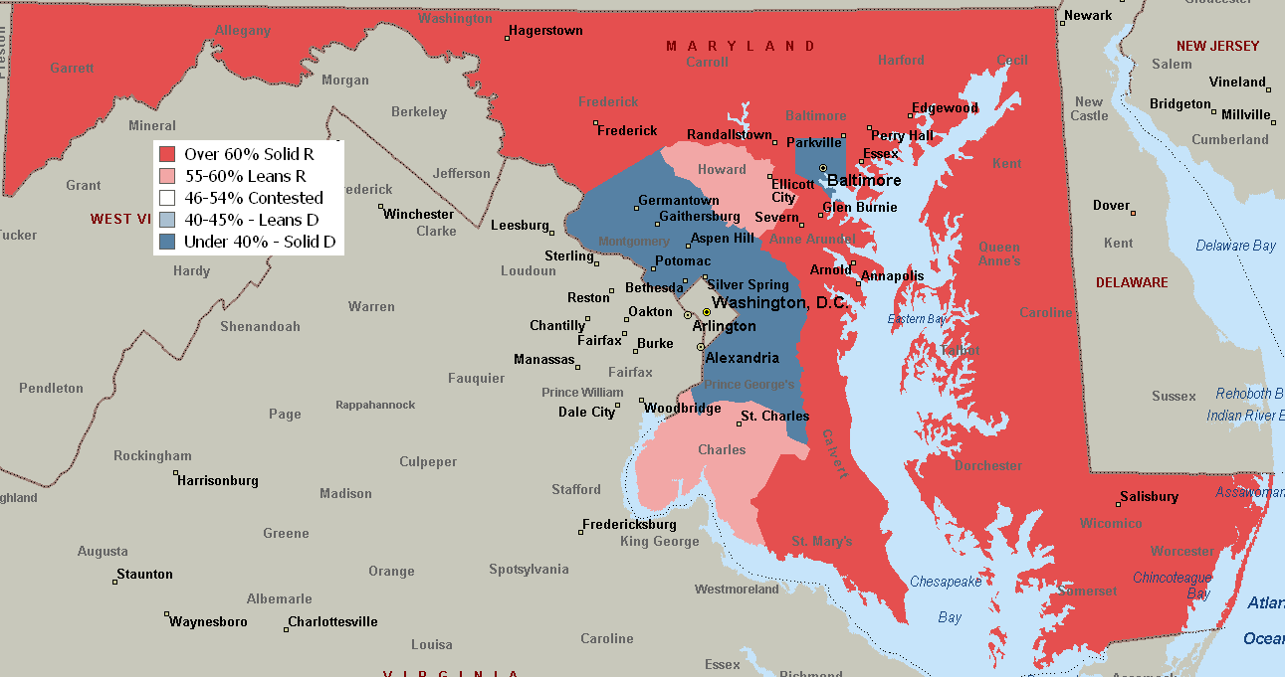
2010 Elections: Consolidation of a Blue Maryland?
Ehrlich’s 2002 victory – The rise of ‘red’ Maryland over ‘blue?’
Notes:
Wins over 70% of vote in 6 counties (Carroll, Caroline, Harford, Queen Anne, Garrett, Talbot)
Wins 60-69% of vote in 12 counties (Washington, Somerset Cecil, Dorchester, Frederick, Kent, Worcester, Wicomico, Allegany, St. Mary’s, Baltimore
Wins 50-59% of vote in 2 counties (Charles, Howard)
Loses (below 40%) in 3 jurisdictions ( Montgomery, Baltimore City and Prince George’s)

Slide 4
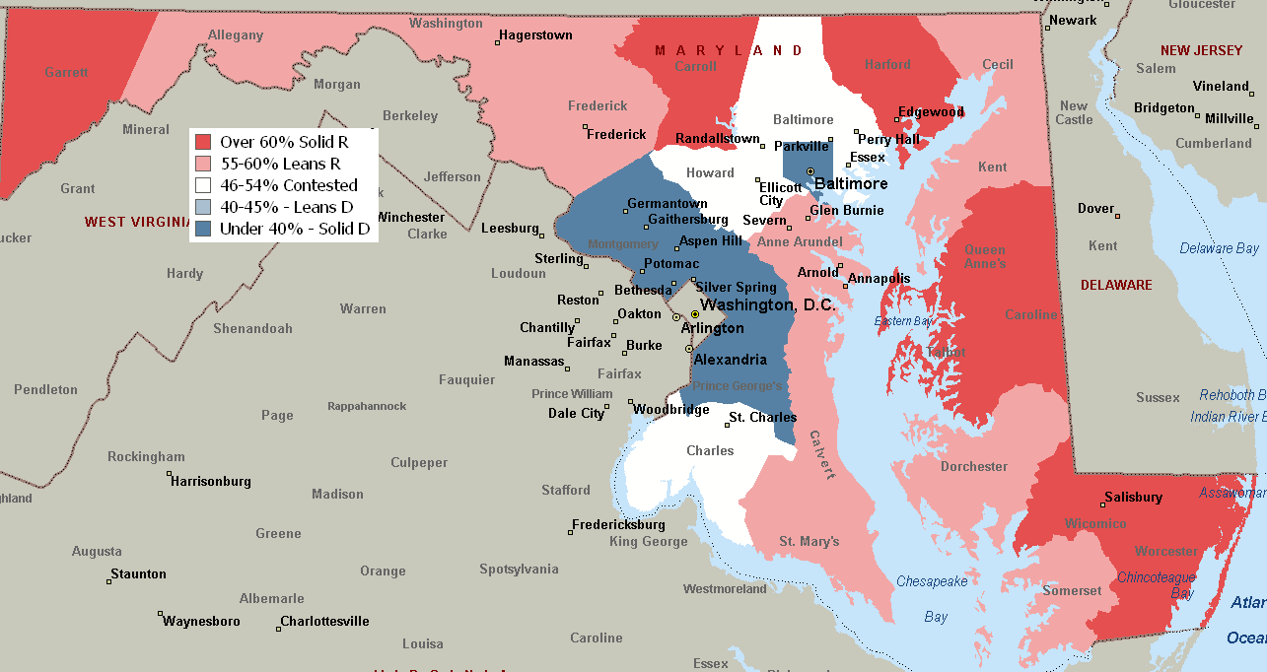
2010 Elections: Consolidation of a Blue Maryland??
Ehrlich’s 2006 Loss– Beginning of ‘blue’ Maryland’s consolidation over ‘red’
Notes:
Charles and Howard move away from Ehrlich, rural areas less homogeneously supportive

Slide 5
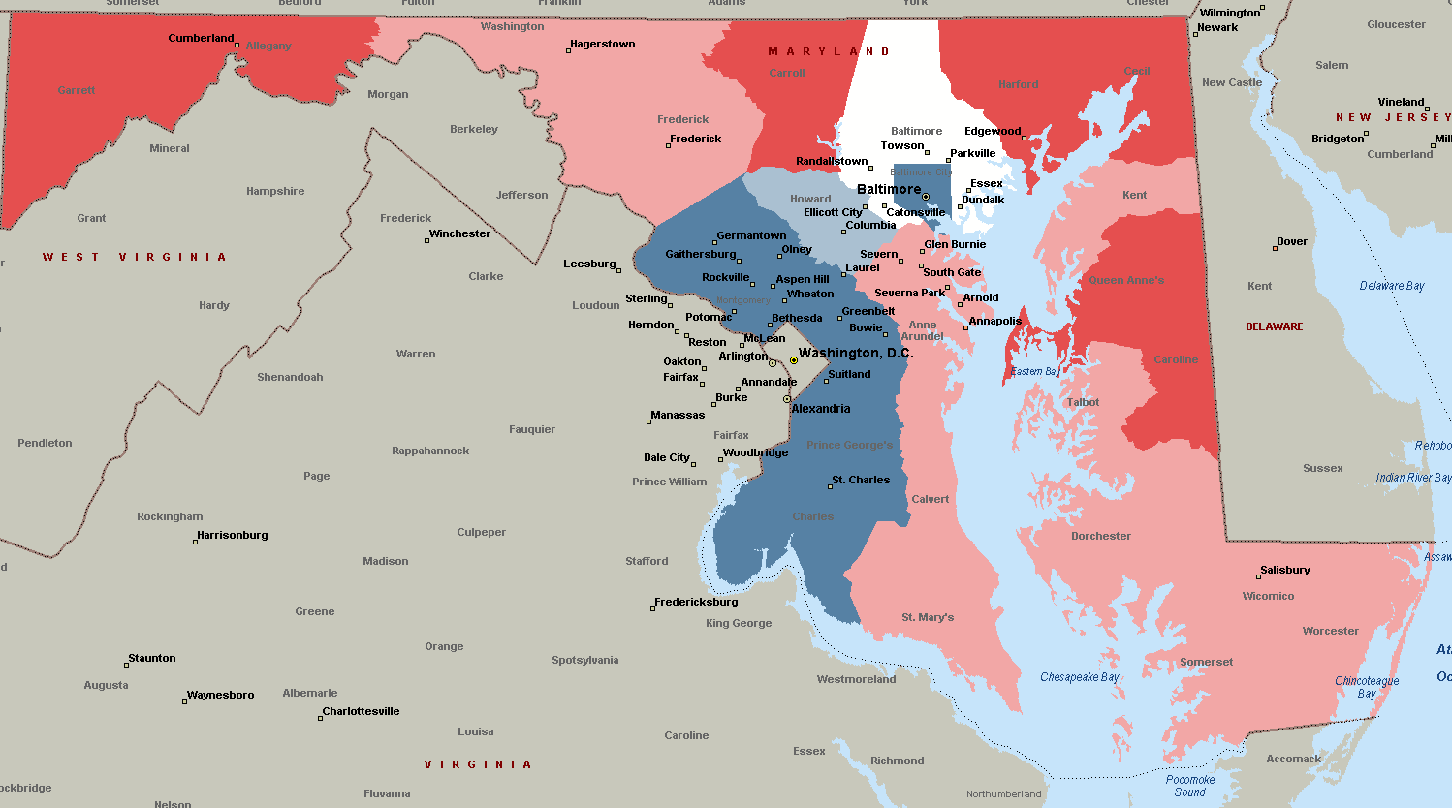
2010 Elections: Consolidation of a Blue Maryland?
Ehrlich’s 2010 Loss – Confirms ‘blue’ Maryland over ‘red’
Notes:
Charles joins blue zone; Howard flirts with it. Baltimore County still contested – 50/50%

Slide 6
2010 Elections: Consolidation of a Blue Maryland?
2010 – Strong party line vote – bad news for Republicans
Notes:
All other Republican statewide candidates did more poorly in 2002 than they had in 1998.
1994 had been much more of a consistent Republican tide with candidates for comptroller, US Senate and AG moving up with Sauerbrey
In 2006, Republican statewide candidates were bunched up – making it appear more like a ‘party line’ vote rather than a vote for Bob Ehrlich

Slide 7
2010 Elections: Consolidation of a Blue Maryland?
Notes:
Ehrlich losses are greatest in urban Balt-Wash metro area, doesn’t equal 2002 in any county

Slide 8
Jurisdiction % of Govr Vote | Ehrlich ‘10 | Rep Local offices* | Rep MGA | Rep Score
Carroll 3.4% | 73 | 100 | 100 | 91
Garrett .5 | 73 | 88 | 100 | 87
Caroline .5 | 67 | 75 | 100 | 81
Queen Anne's 1.1 | 68 | 75 | 100 | 81
Allegany 1.2 | 63 | 100 | 75 | 79
Frederick 4.0 | 56 | 100 | 75 | 77
Cecil 1.6 | 63 | 100 | 67 | 76
Talbot .9 | 61 | 65 | 100 | 75
Harford 5.1 | 66 | 61 | 91 | 73
Washington 2.1 | 61 | 75 | 93 | 73
Wicomico 1.6 | 56 | 90 | 63 | 70
Kent .4 | 56 | 42 | 100 | 66
Calvert 1.7 | 56 | 100 | 33 | 63
St. Mary's 1.7 | 58 | 100 | 25 | 61
Worcester 1.2 | 60 | 86 | 33 | 60
Somerset .4 | 58 | 45 | 50 | 51
Dorchester .6 | 59 | 20 | 75 | 51
Anne Arundel 10.9 | 56 | 29 | 63 | 49
Baltimore 15.5 | 50 | 14 | 36 | 33
Howard 5.8 | 45 | 10 | 27 | 27
Charles 2.5 | 38 | 0 | 0 | 13
Montgomery 15.8 | 31 | 0 | 0 | 10
Baltimore City 8.7 | 16 | 0 | 0 | 5
Prince George's 12.6 | 11 | 0 | 0 | 4
2010 Elections:
Jurisdictions by Republican Score
Strong R 60+ Rep score
Leans R
55-59 Rep score
Contested
45-54 Rep score
Leans D
40-44 Rep score
Strong D
0-39 Rep score
“Rep local offices” = state’s attorney, sheriff, council only
Notes:
Howard is smallest of ‘strong D’ counties, but is larger than 9 of 12 ‘strong R’ counties.

Slide 9
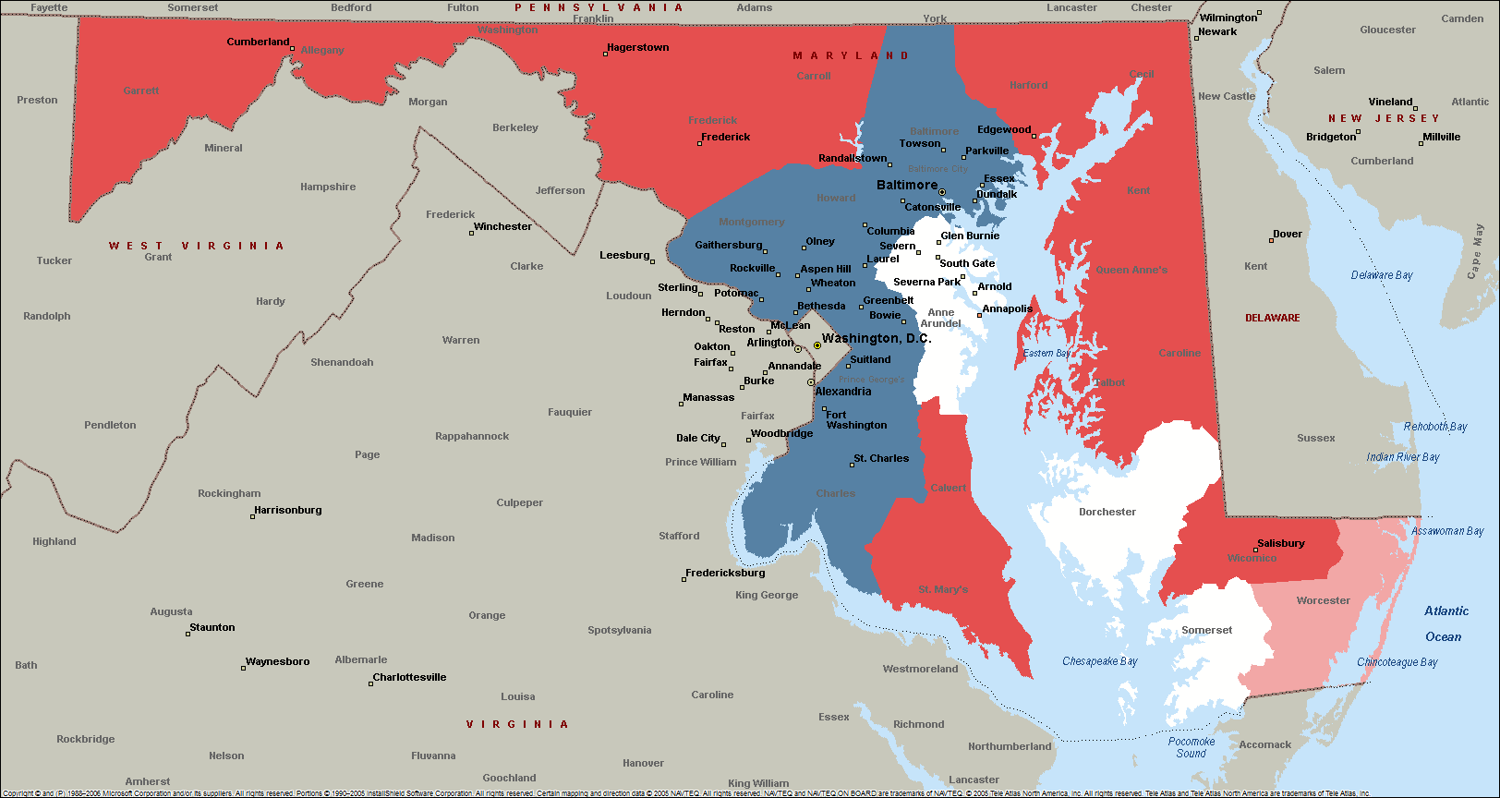
Composite Picture – Polarization, Few Transitions
2010 Elections: Consolidation of a Blue Maryland?
Notes:
Even Baltimore County is bluer than the O’Malley vote would predict. The exurbs and rural areas are pretty red. Ehrlich was from the BC– what Rep will be in the future?

Slide 10
Polarization within the House of Delegates…
2010 Elections: Consolidation of a Blue Maryland?
General Assembly - House of Delegates – Democratic Hegemony Reinforced
Party | House of Delegates - Seats |  |  | Votes | Solid D <39 Rep Vote | Lean D 40-45 | Contested 46-54 | Lean R 55-60 | Solid R >60
Overall | 2002 | 2006 | 2010 | 2010 | 80 | 4 | 19 | 8 | 30
Democrat | 98 | 104 | 98 | 16935 (63%) | No Contest |  |  |  | No Contest
Republican | 43 | 37 | 43 | 9924 (37%) | 35 |  |  |  | 4
Notes:
Republicans increased their presence in the House of Delegates, adding 6 seats. However, Dems have nearly three times as many seats with limited competition, including 35 (vs. 4) completely uncontested seats.

Slide 11
Maryland Senate
2010 Elections: Consolidation of a Blue Maryland?
General Assembly - Senate – Democratic Hegemony Continues
Party | Senate |  |  | Average # of Votes (contested elections only)
 | 2002 | 2006 | 2010 | Uncontested | Ave. votes | Contested | 2010 | Gap
Democrat | 33 | 33 | 35 | 15 (43%) | 27347 | 20 | 26705 D 8426 R | 18279
Republican | 14 | 14 | 12 | 4 (33%) | 37377 | 8 | 29648 R 15911 D | 13737
Overall | 47 | 47 | 47 | Gap 11 | 10030 | 12
Notes:
Rep lost two seats in the Senate, and trends looked unfavorable – Dems have 4X as many uncontested seats and the gap between Dems and Reps is much greater in the remaining contested seats currently controlled by Democrats than is the gap between Reps and Dems in those contested seats which Reps currently control.

Slide 12
Trends in Party Registration –Democratic Hegemony Likely to Continue
2010 Elections: Consolidation of a Blue Maryland?
1957279
Notes:
Both Democrats and Republicans have declined, with unaffiliated voters on the increase.
The may increase the volatility of the electorate – producing unpredictable outcomes depending on campaign, candidates and circumstances.
The combined percentage of combined Republican and unaffiliated voters is about 43% - so how do Republican statewide candidates win as did Ehrlich in 2002?

Slide 13
How do Republican Candidates Win without Party Registration Advantages – Data from Anne Arundel County Exit Polls - 2006/2010
2010 Elections: Consolidation of a Blue Maryland?
Party Registration | Ehrlich |  | O’Malley |  | Others
Year | ’06 56.9 | ’10 54.2 | ’06 42 | ’10 43.4 | ‘10
Democrats 44% | 17 | 15 | 79 | 84 | 1
Republicans 36.5% | 89 | 89 | 10 | 9 | 2
Unaffiliated 18.8% | 54 | 44 | 40 | 39 | 13
Notes:
Democratic defectors more numerous than Republican defectors, both years. Drop in unaffiliated support for Ehrlich. Democrats were relatively happy with their choice.

Slide 14
What TRAITS were salient in Governor’s Race in 2010? Data from Anne Arundel County Exit Poll
2010 Elections: Consolidation of a Blue Maryland?
Traits | %
Right experience | 37
Party affiliation | 34
Strong leader | 33
Right moral outlook | 29
Honesty | 25
Effective manager | 23
Familiar name | 9
Traits favorable to Ehrlich | %
Honesty | 58
Right experience | 55
Right moral outlook | 55
Strong leader | 52
Traits favorable to O’Malley | %
Familiar name | 68
Effective manager | 51
Party affiliation | 49 (47 Ehr)
Notes:
Experience, party affiliation and strong leadership were the key traits. These favored Ehrlich somewhat, except for party affiliation. Name familiarity and effectiveness as a manager favored O’Malley.

Slide 15
What ISSUES were salient in Governor’s Race in 2010? Data from Anne Arundel County Exit Poll
2010 Elections: Consolidation of a Blue Maryland?
Issues | %
Economy | 48
Budget | 38
Schools | 31
Taxes | 30
Environment | 24
Crime | 21
Slots | 20
Cost of living | 18
Planning | 11
Issues favorable to Ehrlich | %
Taxes | 74
Balance budget | 67
Cost of living | 62
Economy | 63
Crime | 61
Issues favorable to O’Malley | %
Environment | 75
Schools | 68
Planning | 52
Slots | 48 (vs. 45 Ehr)
Notes:
Ehrlich appealed to some traditional Republican issues such as balancing the budget, the economy and taxes. O’Malley was somewhat more favored by those concerned with education, the environment and planning.

Slide 16
2010 Elections: Consolidation of a Blue Maryland?
Conclusions about the Electoral Scene
Many reasons to expect Democratic hegemony to remain
Party registration advantage relatively stable
Large population concentrations in urban, established suburban areas with strong Democratic leanings
Dominance greater at the local level than suggested by gubernatorial vote.
Coalition of African-Americans, trade unions, government workers, liberals seems durable
High probability of Democratic victory creates positive momentum – easier recruitment of qualified candidates, larger pool of potential candidates, abundant financing
Democratic performance strong despite adverse national climate

Slide 17
2010 Elections: Consolidation of a Blue Maryland?
Conclusions about the Electoral Scene
Republican ascendancy unlikely for the foreseeable future
Ehrlich’s 2002 success based on unique circumstances, unlikely to be repeated – personal attraction not party realignment
Who will the Republicans nominate in the future – farm team not obvious
Party registration numbers are too compelling – create disincentives for credible Republicans to run
Maryland voters are habituated to voting for Democrats – and Republicans don’t even compete in numerous jurisdictions
Rural jurisdictions can’t do it without greater support from suburbs/exurbs

Slide 18
2010 Elections: Consolidation of a Blue Maryland?
Conclusions about the Electoral Scene
Republican ascendancy unlikely for the foreseeable future
Issues that form the heart of Republican conservatism not very attractive to enough Maryland voters – small government, low taxes, morals, immigration vs. reliance on govt. for jobs, education, environment, safety net
What groups will be growing in the electorate – and how will this change the political balance? Will BRAC bring many new conservatives?
National environment – if it doesn’t work when there is a Republican wave nationally, when will it?

Slide 19
2010 Elections: Consolidation of a Blue Maryland?
Election Implications about Governing
The Democrats Under O’Malley – two possible scenarios:
(1) Democrats govern as if they were Republicans – Bipartisan fiscal conservatism
Larry Hogan scenario:
Structural deficit is main problem
No tax increases
No budget gimmicks
He believes that O’Malley won as a fiscal conservative: “Mr. O'Malley racked up an impressive victory over a popular former governor. He did so by convincing voters he was the true fiscal conservative in the race.”

Slide 20
2010 Elections: Consolidation of a Blue Maryland?
Election Implications about Governing
The Democrats Under O’Malley – Larry Hogan scenario: Democrats govern as if they were Republicans
“Rather than treat state government as a holistic entity in which every program is equally important, and where every special interest group must be placated, he should target his spending priorities the same way Maryland families and small businesses do every day.
That will require clearly identifying priorities, proposing specific if sometimes painful and unpopular spending reductions, educating Marylanders as to the necessity for such cuts during tough times, and building a bipartisan consensus in the legislature to bring about a lasting solution to the state's seemingly permanent structural deficit.”
“…rather than thinking in terms of merely slowing the growth of state spending, he should advocate net, across-the-board reductions; get serious about targeting waste and inefficiency; eliminate duplicative or ineffective programs; and take a zero-based approach to budgeting.
http://www.baltimoresun.com/news/opinion/oped/bs-ed-omalley-budget-20110124,0,985407.story

Slide 21
2010 Elections: Consolidation of a Blue Maryland?
Election Implications about Governing
The Democrats Under O’Malley – Larry Hogan scenario: Democrats govern as if they were Republicans
Assumptions:
O’Malley (and Democrats) were elected based on high saliency of fiscal conservatism to voters
Not generally true
Coalitions assembled by Democrats would be receptive to austerity
Not generally true
Swing voters might be attracted to austerity
Possibly true, but Republicans unlikely to marshal a serious opponent so no real threat
Maryland is like New Jersey or Virginia
Unlikely – much more ‘blue’ – a similar stance would be politically unrewarded
There is no choice but to govern this way
It’s a question of degree…

Slide 22
2010 Elections: Consolidation of a Blue Maryland?
Election Implications about Governing
The Democrats Under O’Malley – One Maryland Scenario: Democrats steer middle road through austerity and liberal priorities
Achievements noted in inaugural speech:
Job creation - “Maryland employers created the best year of net new job creation since 2000”
Investment: Continued investment in job-creating industries like biotechnology, life sciences, renewable energy, and research and development
Safety net: Extended healthcare coverage to more than 240,000 Marylanders in the last four years, half of whom are children.
Crime: Driven crime down to their lowest rates ever recorded in Maryland
Education: Record investments in public K-12 education for the last four years
Austerity: Cut state government spending $5.6 billion and reduced the size of government

Slide 23
2010 Elections: Consolidation of a Blue Maryland?
Election Implications about Governing
The Democrats Under O’Malley – One Maryland Scenario: Democrats steer middle road through austerity and liberal priorities
Elements highlighted in budget:
Protecting priorities: “As Maryland businesses continue to add jobs at higher rates than the rest of the nation, we still must find ways to do more with less while protecting those priorities we share as One Maryland.
Schools: FY12 budget proposes a second year of record $5.7 billion in funding for K-12 public schools, with significant school construction funding
Taxes – No new taxes – legislature probably agrees
Crime: Includes $2.18 billon in public safety funding
Environment: FY12 budget continues increased funding for the Chesapeake Bay 2010 Trust Fund, and more than $16 million for the cover crop program
Clean Energy/Efficiency: $7 million in Strategic Energy Investment Funds toward clean, renewable energy grants and $1 million to support climate change programs
$6 million for weatherization grants, enough to improve the energy performance of nearly 4,300 low income hones, and $4.7 million for other energy efficiency programs primarily to assist low and moderate income Maryland families

Slide 24
2010 Elections: Consolidation of a Blue Maryland?
Election Implications about Governing
The Democrats Under O’Malley – One Maryland Scenario: Democrats steer middle road through austerity and liberal priorities
Elements highlighted in budget:
Health care: FY12 budget proposes $7 billion to provide comprehensive health care coverage to more than 900,000 low-income, disabled, and chronically ill children and adults.
State employees: FY12 budget includes provisions of a new, three-year contract with the State’s largest employee unions that ends the use of furloughs and provides for future cost of living adjustments and step increases.
Austerity: Total spending reductions rise to $6.6 billion, cuts 4700 positions
Pensions:
Continue to maintain a public system as a critical component of recruiting and retaining the best teachers – no transfer of obligations to local governments
Improve the funding level in the State and Teacher retirement system and reduce pension/retirement liability – by increasing employee contributions, higher retirement ages, higher co-pays.

Slide 25
2010 Elections: Consolidation of a Blue Maryland?
Election Implications about Governing
The Democrats Under O’Malley – One Maryland Scenario: Democrats steer middle road through austerity and liberal priorities
Questions:
Avoiding taxes: How will Democrats tread between desire to maintain social safety net, good relations with unions, environment preservation, investments in the economy without succumbing to the temptation of raising taxes?
Will the liberal side of the coalition press for more revenue?
Is there a political cost to taxation given Democratic hegemony?
Local government: Will local governments bear a disproportionate burden of austerity/cuts?
To what extent will state leaders find it convenient to place more burdens on rural counties with Republican voters/leaders?
Will local governments be forced to take the political heat for service cut-backs or tax hikes – especially if they have avoided tax increases in the past?
National Economy: How soon will the national economy recover – reduce the need for sustained austerity?

